Slide 1
SCRS’ Education Committee Presents
Kool Tools from SEMA 2015
January, 2016-- Palm Springs, Ca

Slide 2
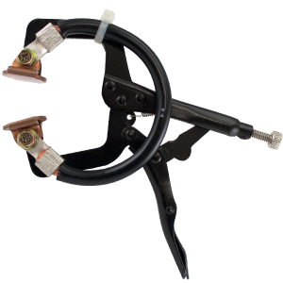
Shunt Pliers from Dentfix

Slide 3
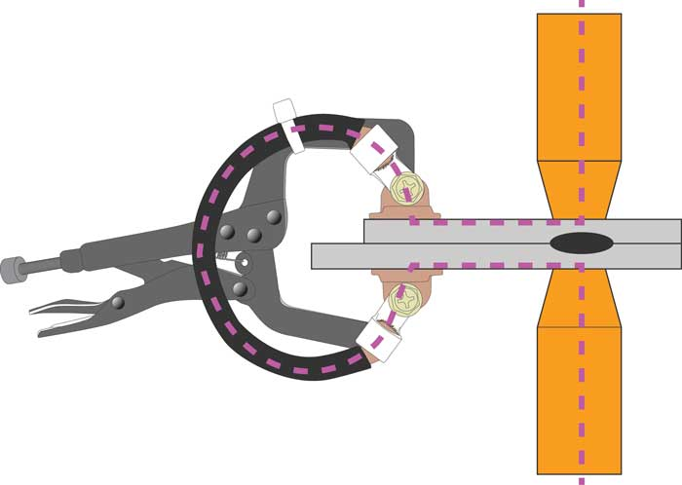
Shunt Pliersfrom Dentfix

Slide 4
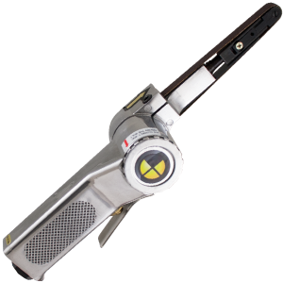
Finger sander from Dentfix

Slide 5
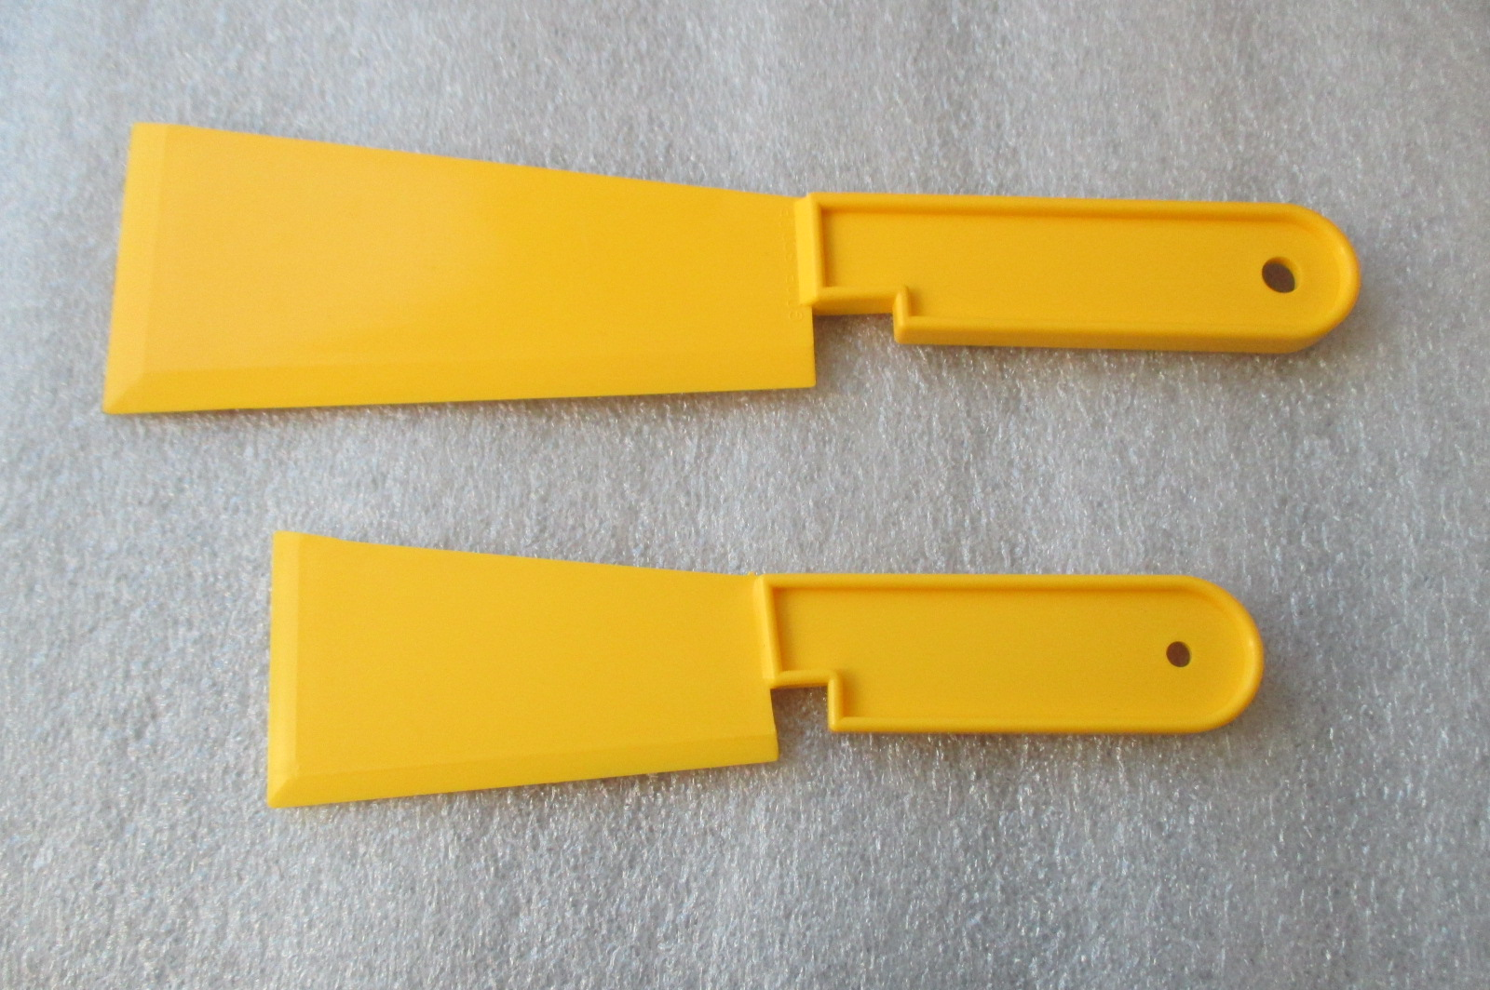
“The Scoop” by GL Enterprise

Slide 6
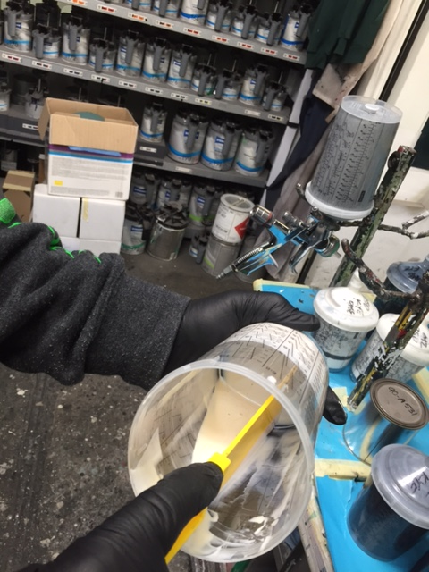
“The Scoop” by GL Enterprise

Slide 7
Shiners from GL Enterprises
Note Clear Plastic Sheet

Slide 8
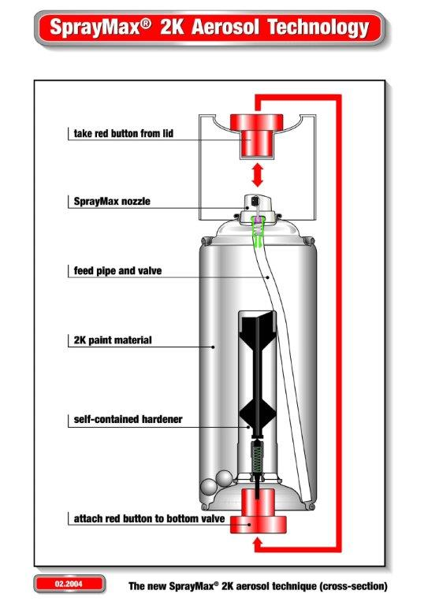
Spray Max Epoxy Primer

Slide 9
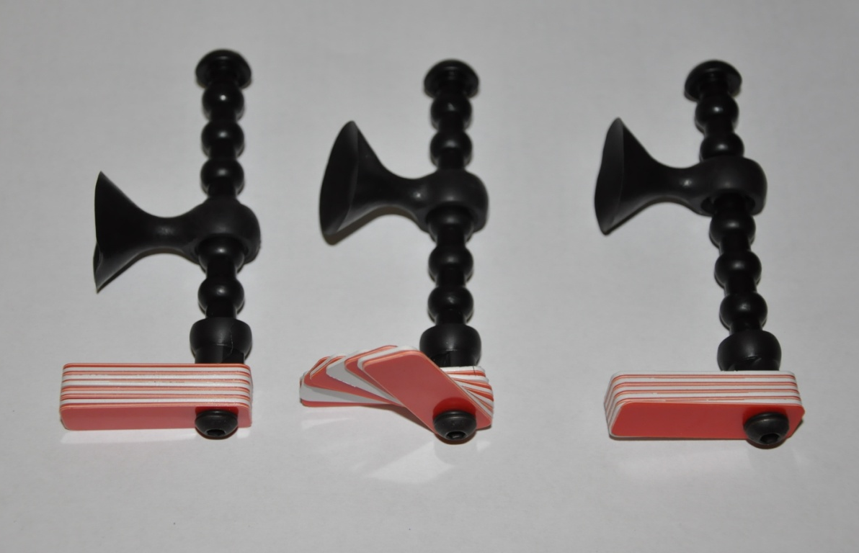
Gap Gauges from Reliable Automotive Equipment

Slide 10
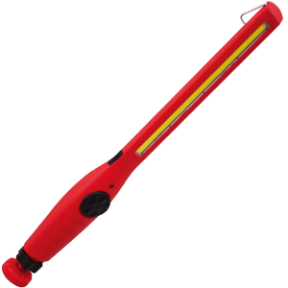
Work Light from Dentfix

Slide 11
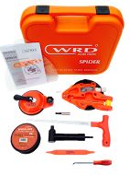
WRD Glass Tools Inc
Our NEW Cutting fiber line removal device.
Safe, efficient, and optimized removal of auto glass panels and bonded elements.
Kit Contents:
1 Spider cup assembly
1 Cutting Fiber Line SF 301
1 Anchor Cup
1 Cutting Line Threader
1 Dash Protector
1 Extended Bit Holder
1 Bit Holder
1 Install Stick
1 Plastic Tool Case
Instruction Manual

Slide 12
WRD Glass Tools Inc

Slide 13
Question—What is matamerism?
Answer--Metamerism is the phenomenom wherein two colored samples will appear to be of the same shade under one light source but will appear to be different shades under a second source

Slide 14
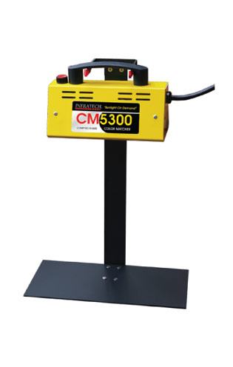
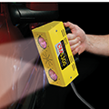
Color corrected lamp from Infratech

Slide 15
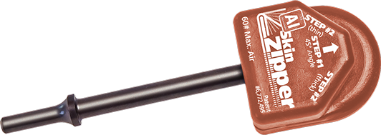
Aluminum Door Skin Hemmer by Steck

Slide 16
Aluminum Door Skin Hemmer by Steck

Slide 17
Slot Cutter from Dentfix
8X20 Slot Hole
8MM Plug Hole

Slide 18
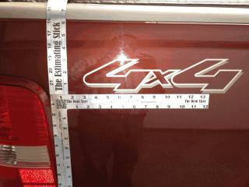
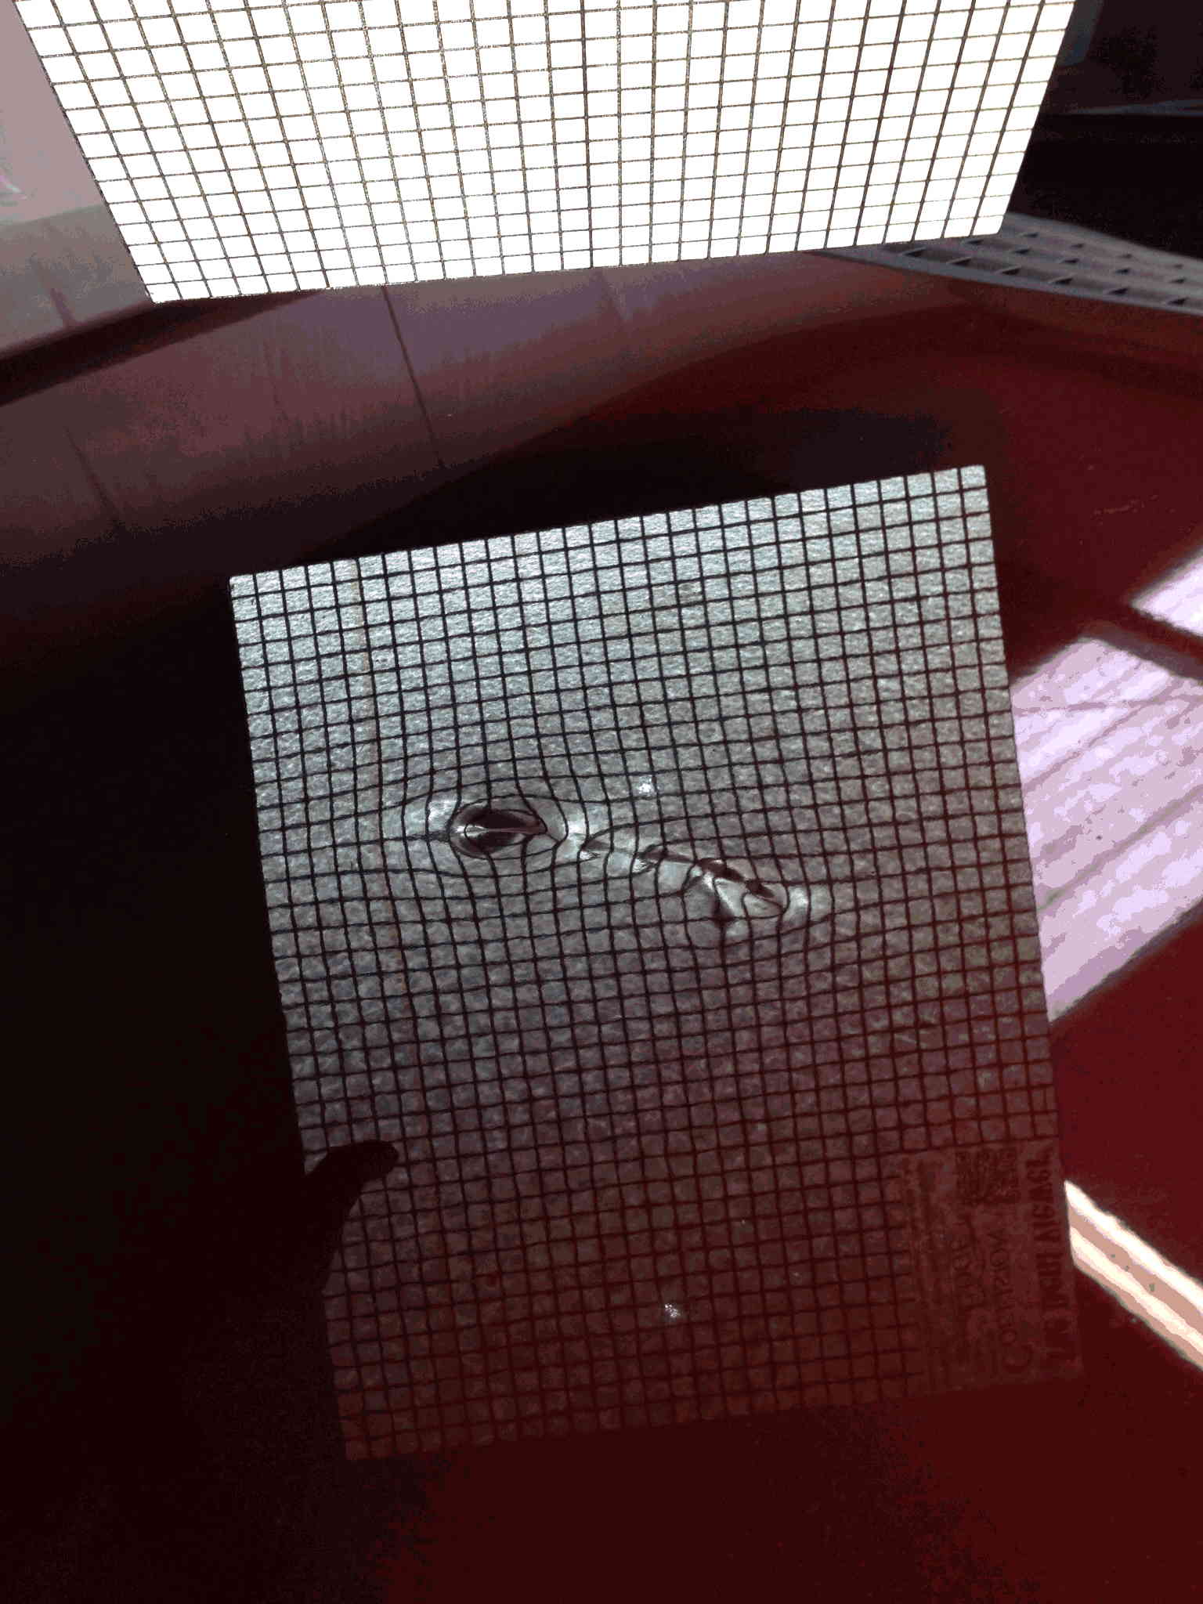
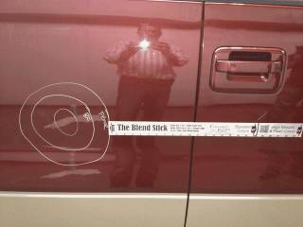
Estimating Tools from the Collision Edge

Slide 19
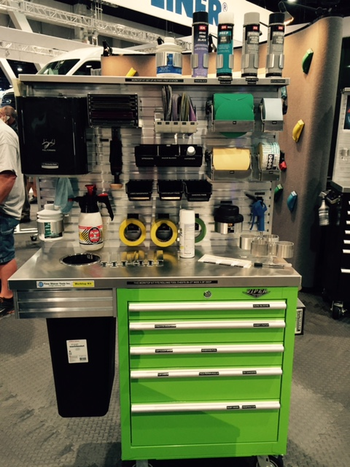
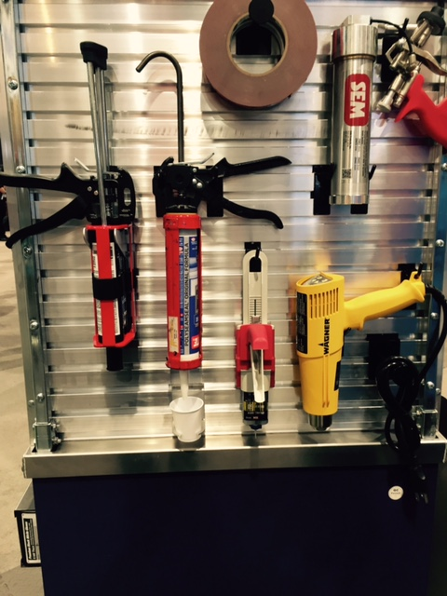
Organization Rack from Time Saver

Slide 20
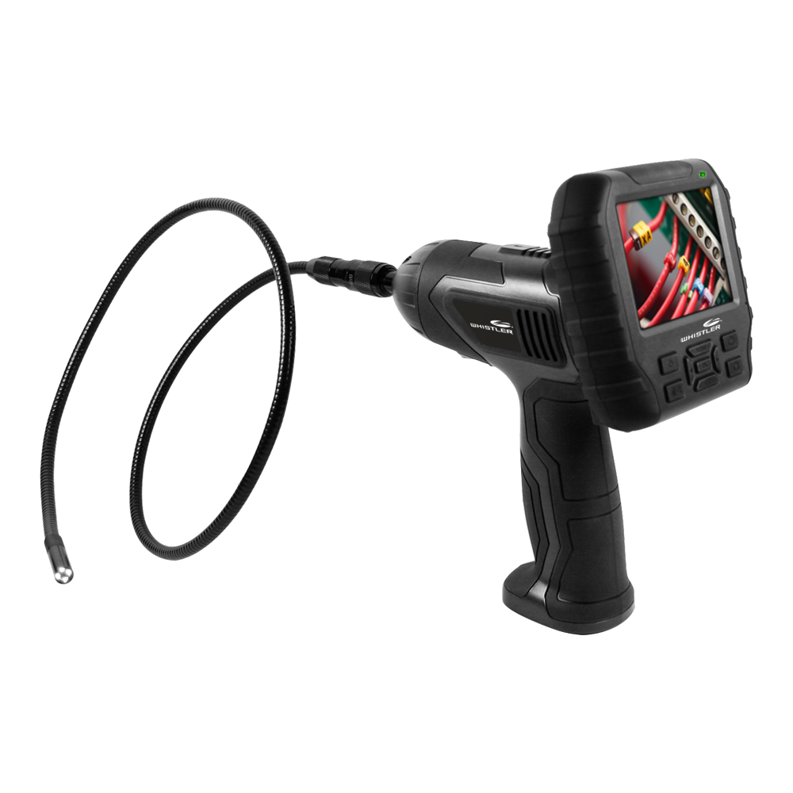
Inspection tool from Whistler

