Slide 1

SCRS’ Education Committee Presents
Kool Tools from SEMA 2016
January, 2017-- Palm Springs, Ca

Slide 2
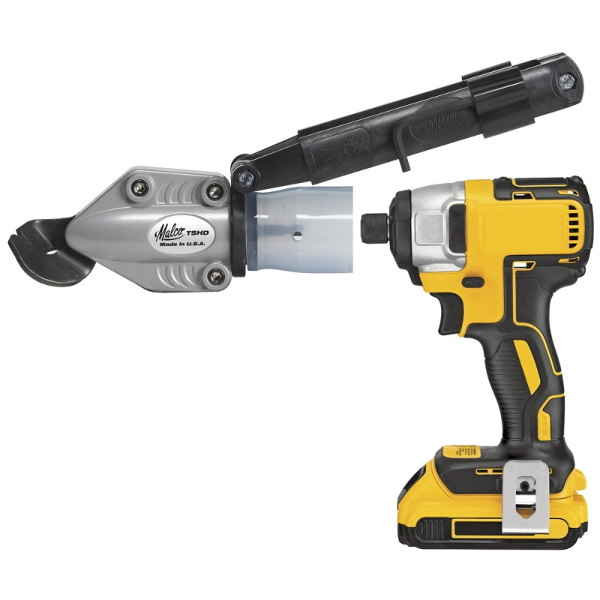
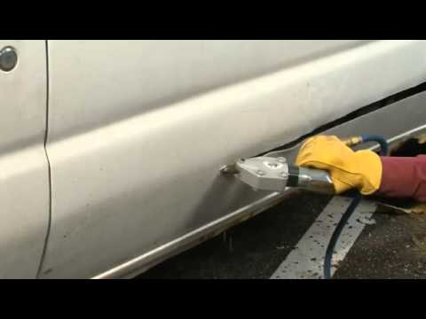
Malco Drill Attachment Turboshears
Available on Amazon.com

Slide 3
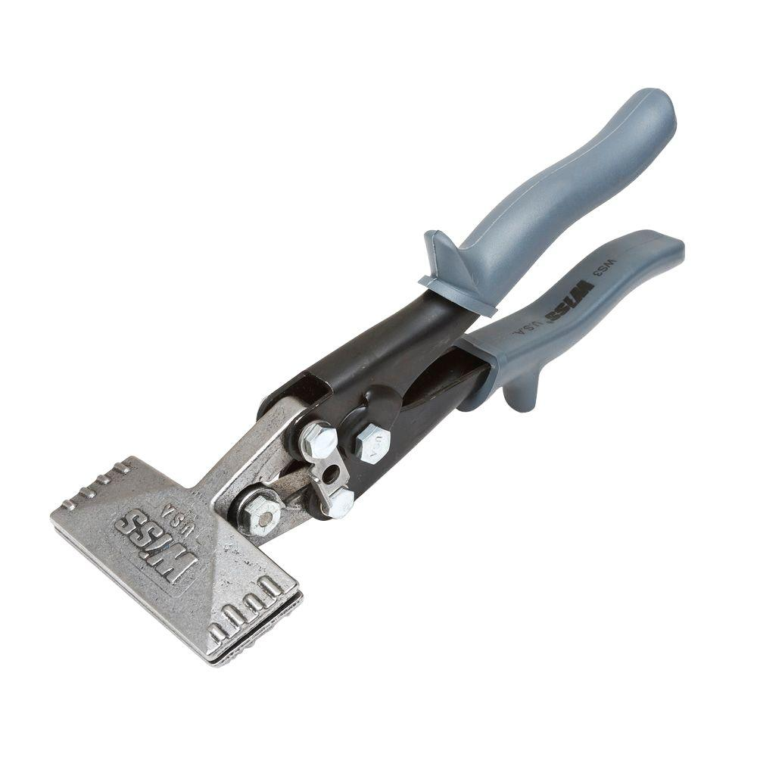
Hand Seamer (for plastic repair)
Available on Amazon.com

Slide 4
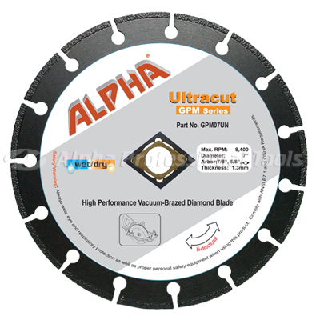
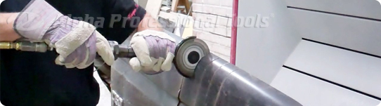
Alpha Professional Tools
800-648-7229
Alpha® Ultracut ABM Series is designed for use on most popular pneumatic cut-off tools which are widely used in automotive body shops and many other industrial manufacturing facilities. Unlike regular abrasive cut-off wheels, the Alpha® Ultracut doesn’t change diameter during the cutting operation. It will maintain maximum cutting depth throughout its life. The Ultracut was made with the highest quality diamond grits allowing you to cut multiple layers of different materials while assuring a fast, clean cutting experience.

Slide 5
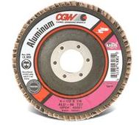
Camel Grinding Flapper Disc for Aluminum
Flap discs and wheels are suitable for:
- Grinding and finishing of welds
- Deburring, rust removal and snagging
- Suitable for most ferrous & non-ferrous materials
- Excellent for surface finishing

Slide 6
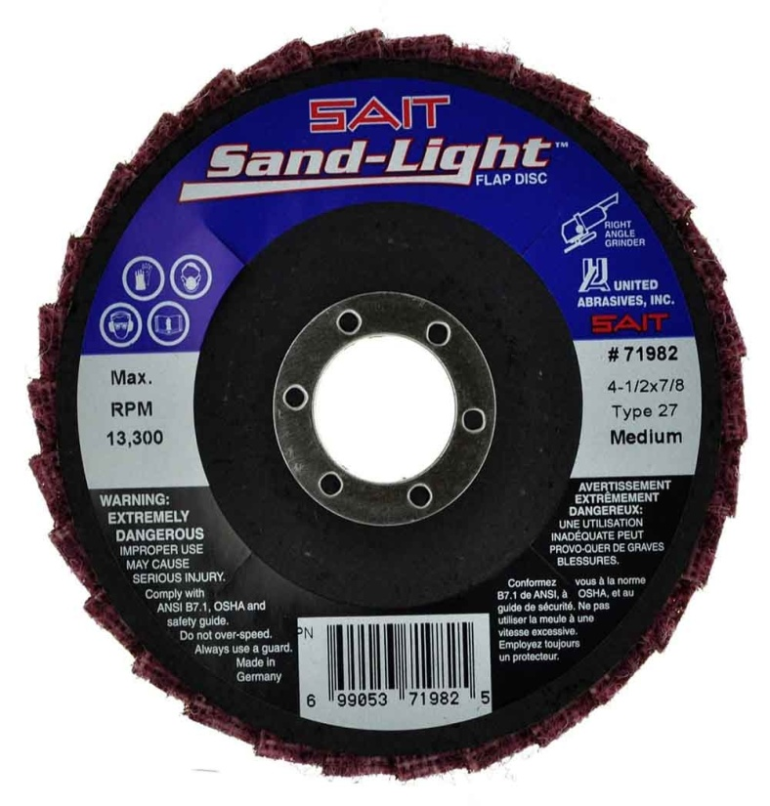
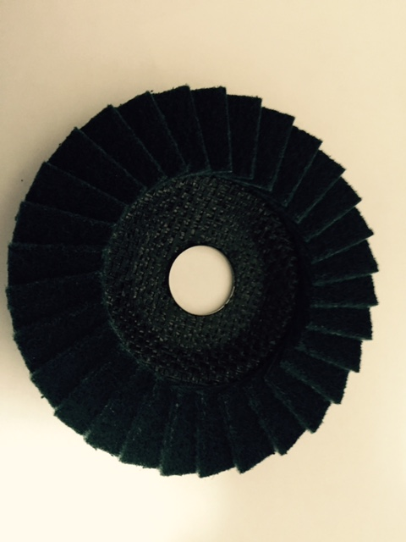
Sait Sand-Light Flap Disc
Medium-Gray-Steel
V Fine-Blue-Aluminum
Features
SAIT Sand-Light Flap Discs, Durable Material, Suitable for Surface Preparation/Cleaning/Finishing applications. Longer Lasting Layered Flaps create a cushioned design which provides a better finish. Use for Ferrous Metals, Stainledd Steel, High tensile steel, Non-Ferrous Metals—Available On-line

Slide 7
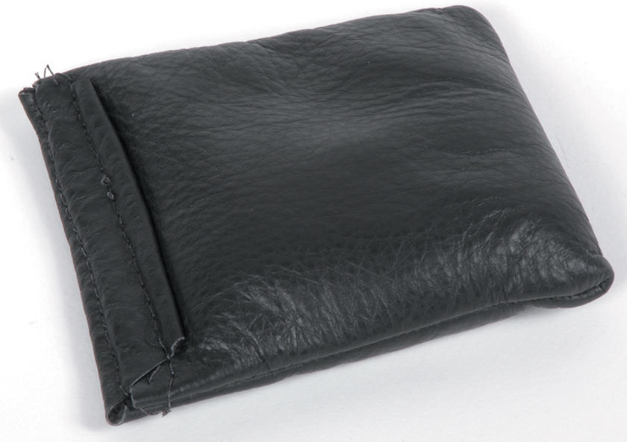
S&H Industries-Lead Shot Dolly
CALL (800) 253-9726

Slide 8
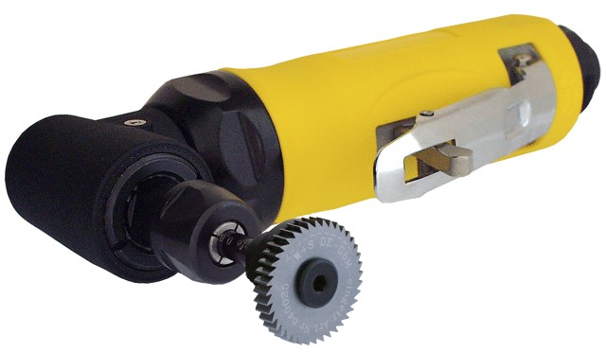
Laser Cutter from Reliable Automotive Equipment
This unique tool has been specifically designed to deal with laser welding, the latest technique in vehicle assembly. The LC 04 allows quick and easy removal of laser welds.
800-328-7855

Slide 9
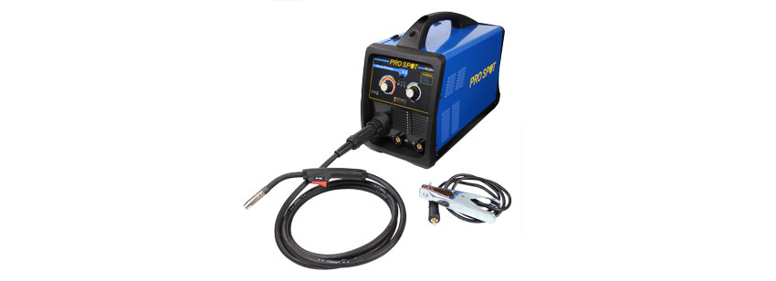
PR-205 MV Synergic MIG Welder from ProSpot International
Pro Spot's new PR-205 Synergic MIG Welder provides a compact, easy-to-use solution for MIG/MAG welding processes as well as MMA/Stick. In Synergic Mode, simply choose your base metal thickness, pull the trigger, and the machine will set the appropriate wire speed automatically. The best feature is that it will work on 110 volts or 220 volts.
800-PRO-SPOT

Slide 10
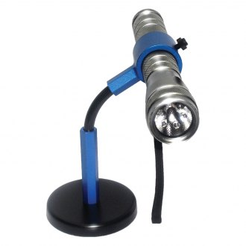
Magnetic Light Holder from Killer Tools
800-369-4262

Slide 11
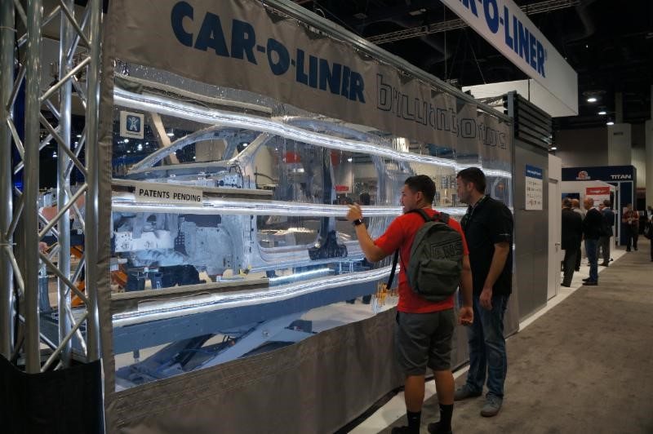
Brilliant Solutions Work Bay LED Curtains by Car-O-Liner
Car-O-Liner is developing a new aluminum work bay curtain, Brilliant Solutions* (as seen at SEMA). These curtains feature 4 LED horizontally mounted light ropes and a welding view panel. Protect your repair and get extra working light

Slide 12
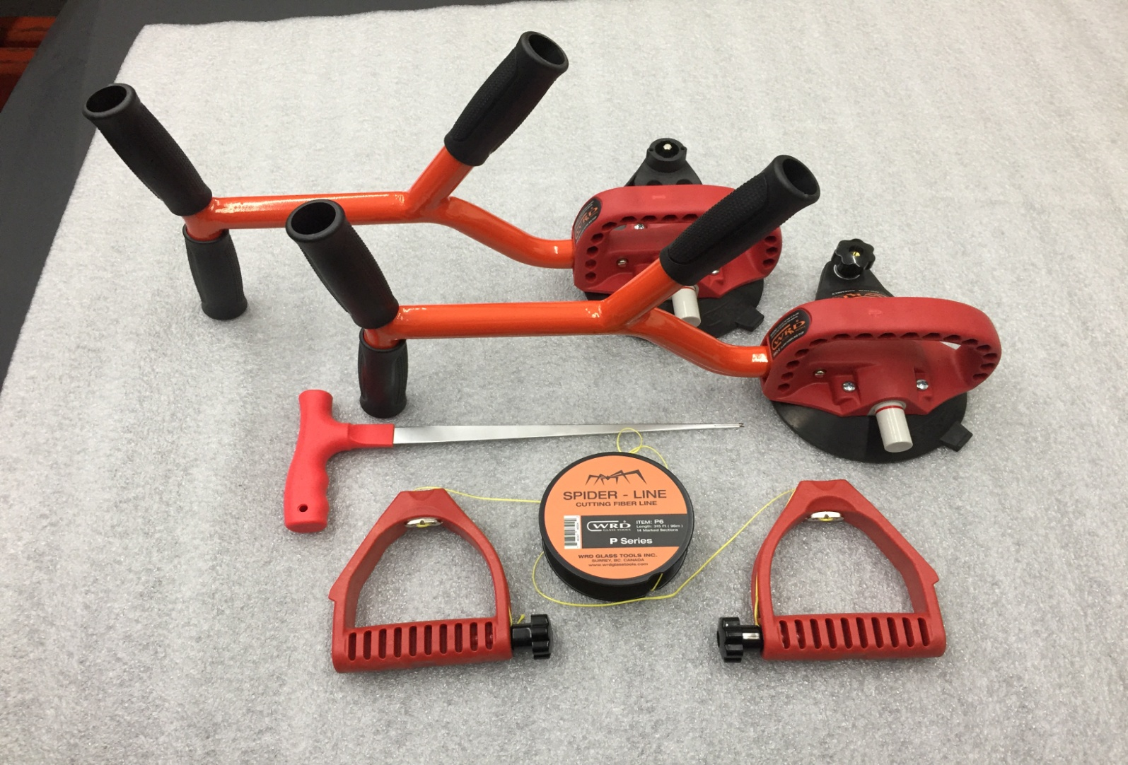
WRD Glass Tool Enhancement
778-688-4697

Slide 13
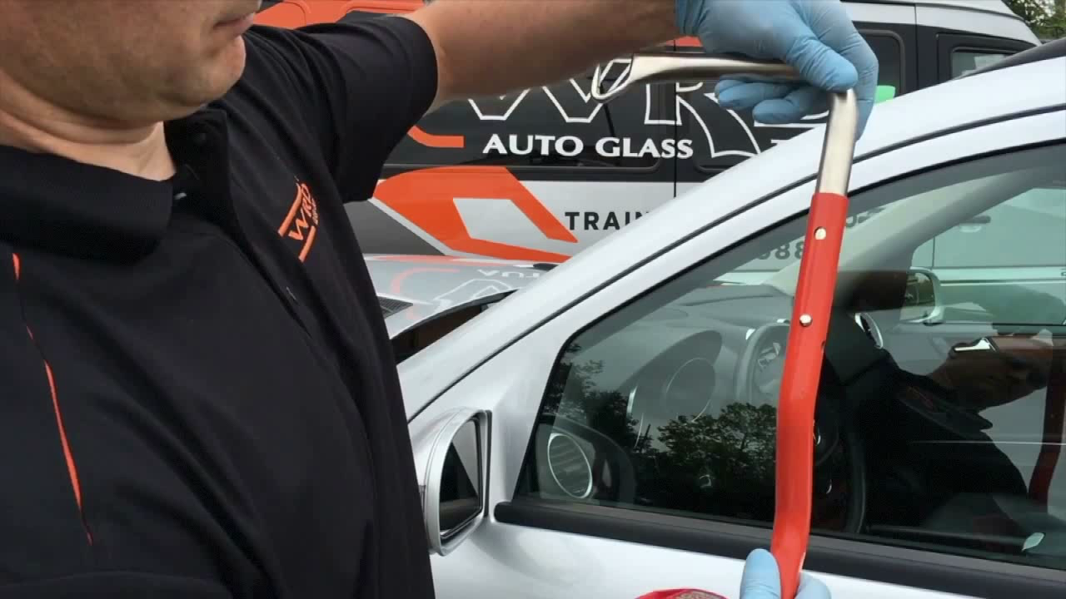
WRD Glass Tool

Slide 14
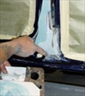
Facts about “Bondo” Dust
Applying Body Filler / Bondo
The application of filler material can expose you to some hazardous materials if you do not take appropriate precautions. Most body fillers contain a solvent called styrene. As the filler dries, styrene is released to the air and you can breathe it. It has a characteristic sweet smell at low concentrations and a sharp disagreeable odor at high concentrations.
Exposure to styrene can cause respiratory irritation. It may also damage your liver and possibly cause cancer at very high levels of exposures - not usually found in autobody shops. Styrene can also be absorbed directly through the skin if you come in direct contact with the uncured filler. In some people, direct contact with the filler may cause skin rashes and repeated exposure may increase your sensitivity.
PPE and controls
When mixing and applying filler material, you should:
wear gloves that are resistant to styrene (such as PVA or polyethylene) and eye protection
mix and apply filler where there is adequate general ventilation arranged to draw the styrene vapors away from you and others working in the area, such as in a prep station
wear a respirator fitted with organic vapor cartridges if you are sensitive to the odors - change the cartridges regularly and as soon as you can smell the styrene while wearing the respirator
wash your hands and exposed skin surfaces thoroughly after applying the filler

Slide 15
Facts About “Bondo” Dust
Sanding
Sanding paint and filler material creates a lot of fine dust that is easily inhaled and can irritate your breathing tubes and eyes. The dust may contain hazardous substances as well, such as lead, chromium, and the abrasives from sanding disks. This dust can be harmful if inhaled or ingested. We are not suggesting that anyone eats the dust on purpose, but it can easily stick to your hands and face, and if not thoroughly washed off, will contaminate your food, drinks and cigarettes. At even very low levels of exposure, the toxic metals in this dust can cause serious health affects and body workers performing these tasks without precautions have exceeded the exposure limits for these hazardous materials

Slide 16
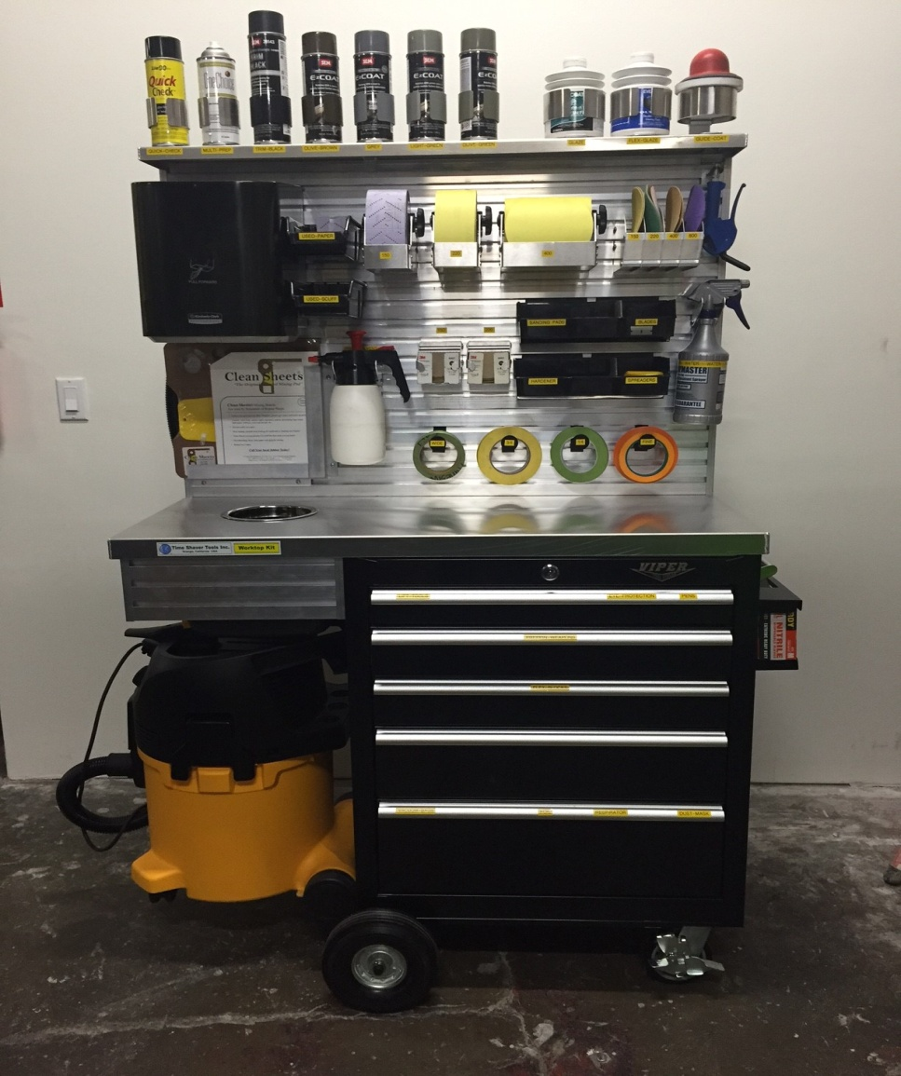
Sanding Station from Time Shaver
714-974-2531

Slide 17
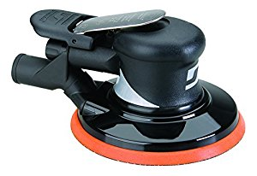
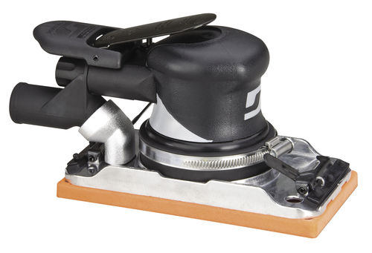
Dynabrade 6” DA Sander and File Sander with Vacuum Attachment
800-828-7333

Slide 18
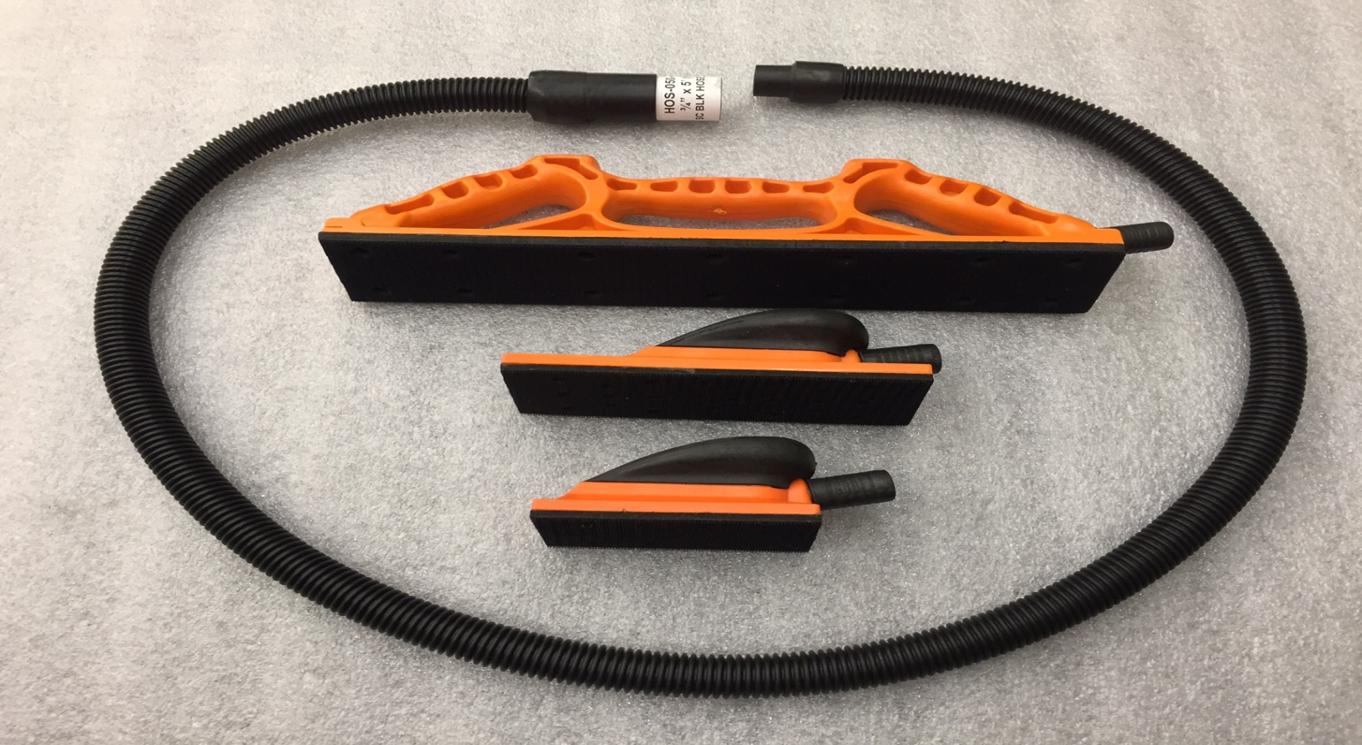
Vacuum Sanding Solutions from Eurovac
800-265-3878

Slide 19
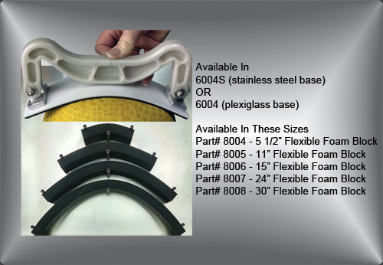
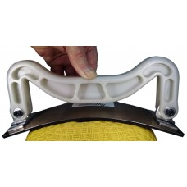
R&H Products
2 Sided Sanding Blocks
Flexible Sander
6004 Series True Flex Sanders: Automatically conforms to curves. Easy 1 handed operation Designed for exceptional final finishv on body filler & primers Available with Plexiglass base or MORE durable Spring Stainless Steel Part# 6004 Plexiglass base Part# 6004S Spring Stainless base True Flex Foam Blocks: Rugged dense foam sanding block with “Tough” Dual texture surface for easy removal of sandpaper & added durability. Easily flexes to follow even the most demanding curves. Flexes for concave & convex curves. Different textures on each side for fast & finish sanding
360-687-9784

Slide 20
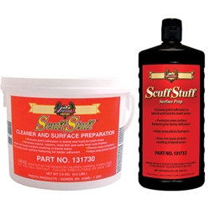
Plastic Prep from Presta Products
Scuff Stuff® is a high-performance scuffing agent that enhances paint adhesion by ensuring cleanliness and consistent surface profiling.
As an industry trusted product for cleaning and abrading plastic bumpers as well as preparing blend and hard-to-reach areas, Scuff Stuff offers superior workability and rinses off easily and cleanly with water.
Kent-Automoitve.com

Slide 21
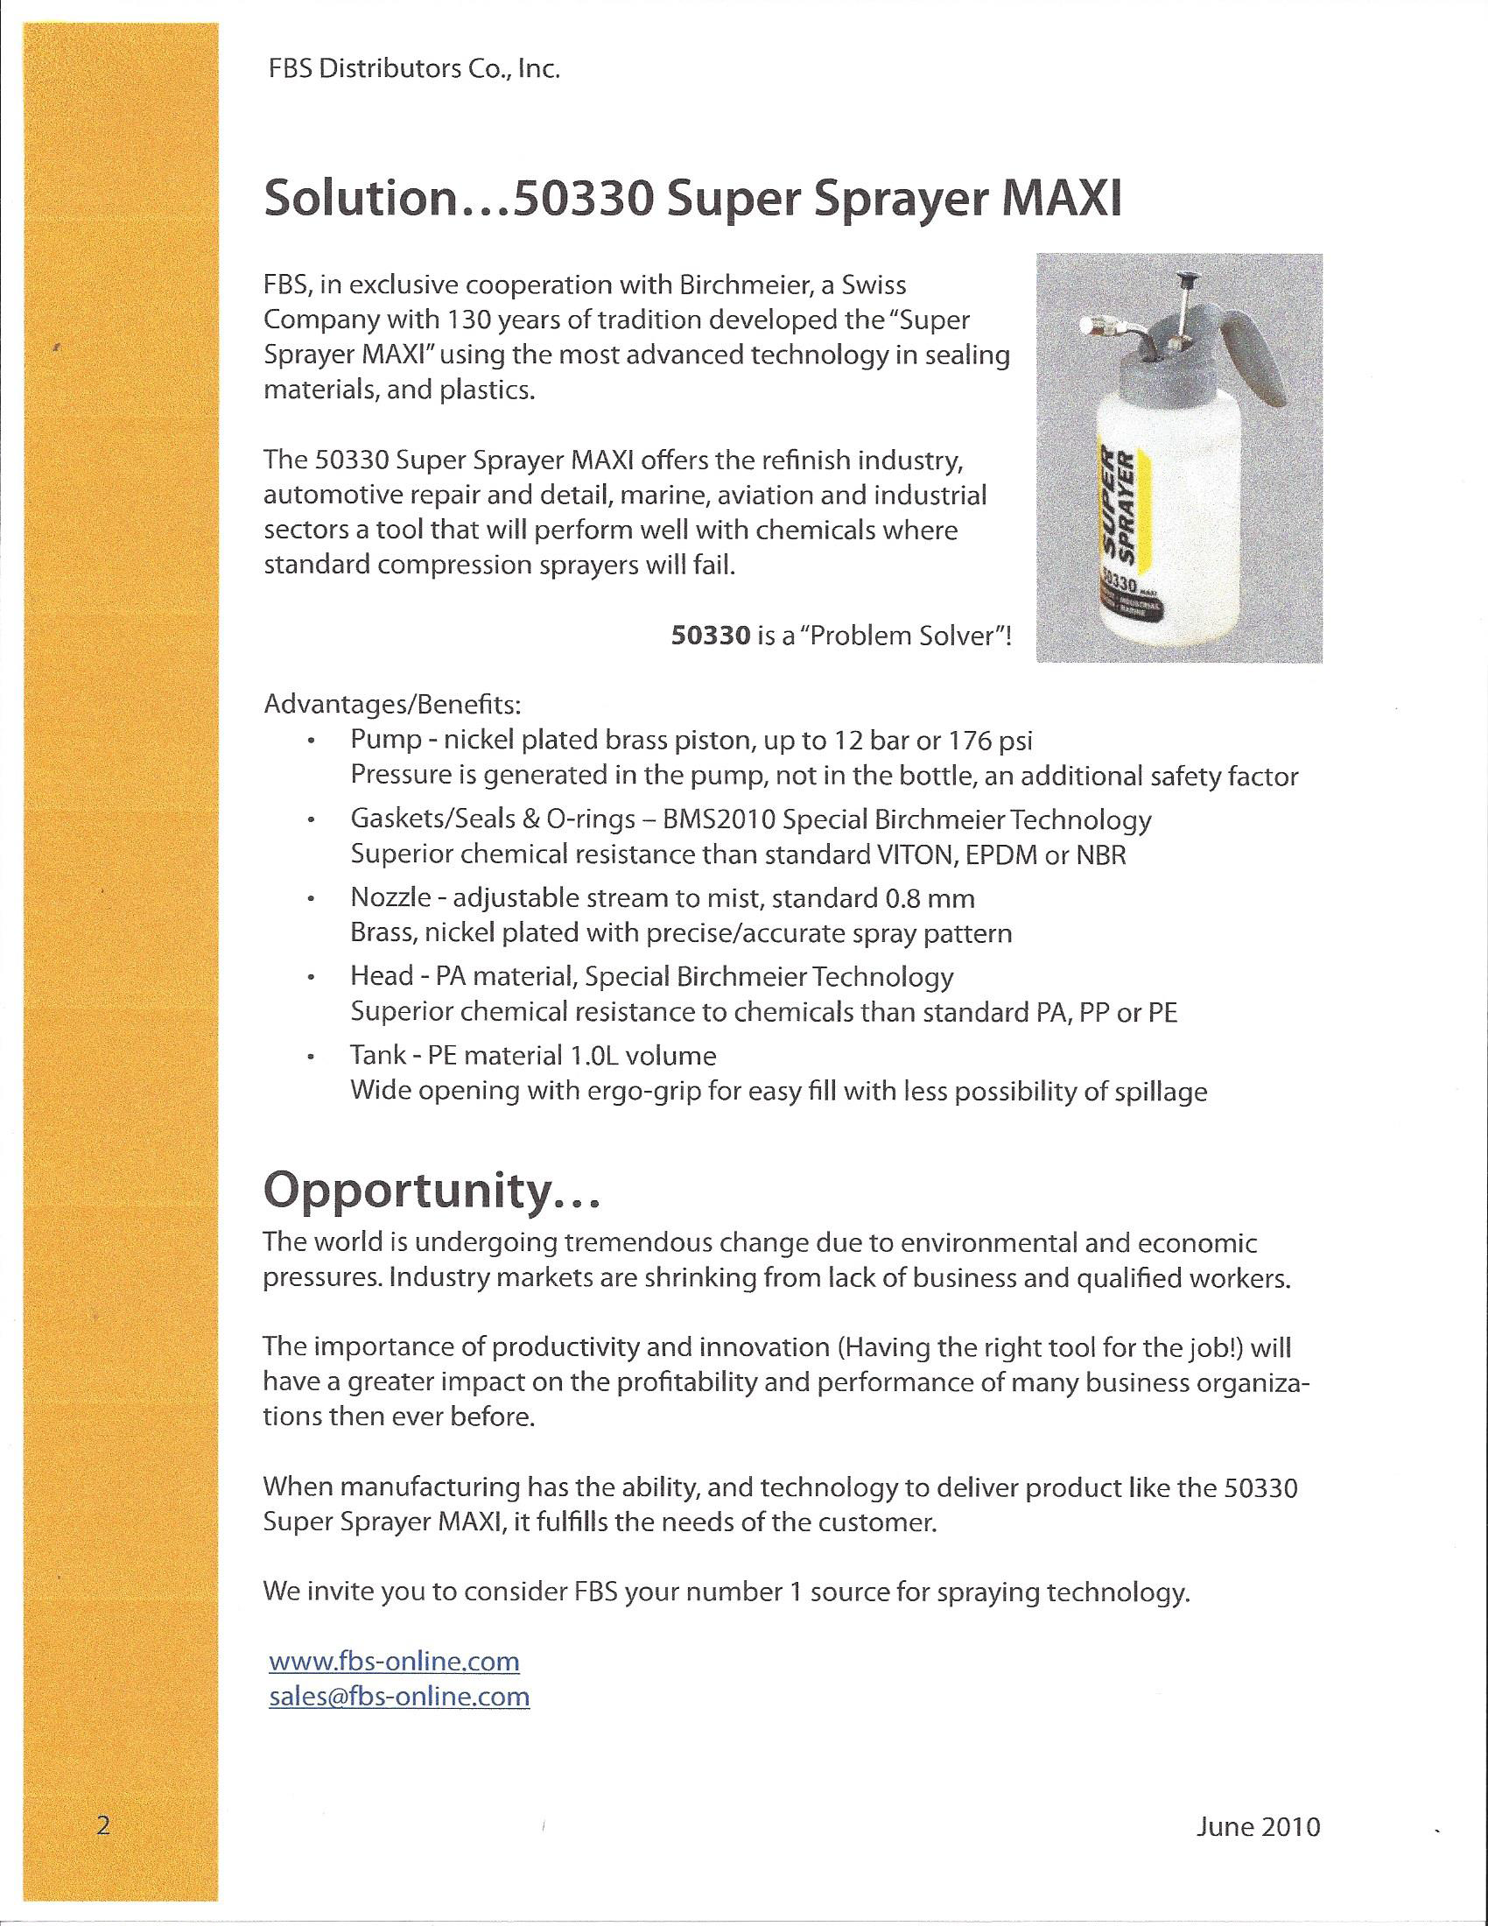
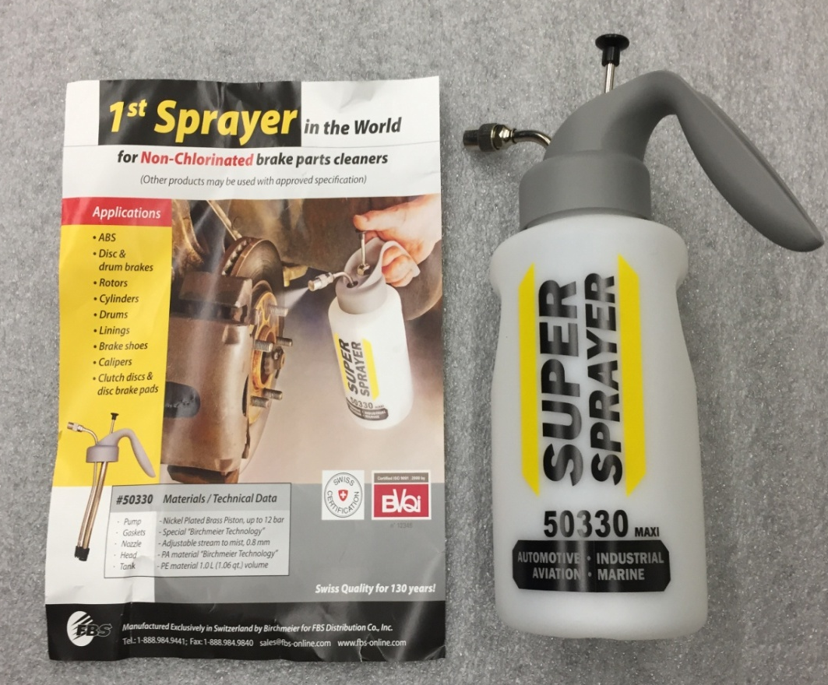
Unique Sprayer from FBS Distributors
613-224-0685

Slide 22
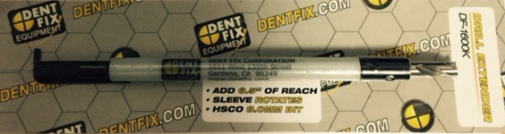
8MM Drill Extension from Dent Fix
When access is limited or obstructed either by a structural member or other component, we have a solution. DF-1600K The Extender is a spot weld drill bit extension that adds 6_ inches of length, letting you get to those deep and hard to reach spot welds. The plastic sleeve protects any nearby structures from damage & cables from getting tangled. You can stabilize the drill point by holding here.
800-523-1751

