Slide 1
SCRS’ Education Committee Presents
Respirators
April 2018 Denver Colorado

Slide 2
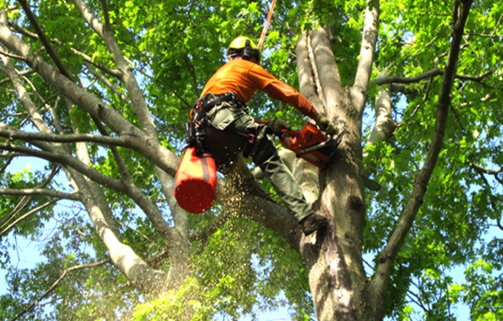
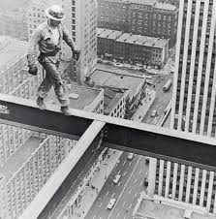
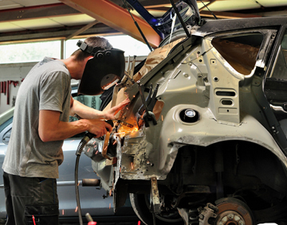
Some of the most dangerous places to work.

Slide 3
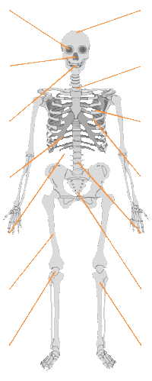
Brain:
Acute poisoning, brain numbing: brain decay
Health Risks in a Body Shop
Eyes:
Damage to mucous membranes, cornea cauterization, cataract
Nose:
Dry mucous membranes
Skin: Eczemas
Mouth:
Dry mucous membranes, tongue coating, taste irritations, bad breath
Respirator System:
Cough, Bronchitis, Lung emphysema
Liver:
Jaundice, acute liver failure
Heart:
Irregular heartbeat
Kidneys:
Kidney inflammation, kidney failure
Stomach:
Nausea, loss of appetite, Vomiting
Reproduction system:
Miscarriage, Deformations, Sterility
Muscles:
Muscle weakening
Bone Marrow:
Leukemia

Slide 4
How Harmful Substances Are Transported Into The Body
Particles (overspray, sanding dust)
The graph below shows the structure of the human lung and the particle size of some well-known substances.
Windpipe 10 micron
Bronchi 10 - 5 micron
Bronchioles 5 - 1 micron
Alveoles 1 - 0,01 micron

Slide 5
Isocyanates in the bodyshop
Starting in June of 2013, OSHA was given a mandate to determine isocyanate protection in the collision industry and part of the mandate, an OSHA inspection could inspect for isocyanate protection without a complaint. They could also inspect to see that any lifts/hoists in a body shop have been inspected. Again inspection without a complaint. So what are isocyanates, where are they found in the body shop and what PPE is necessary for isocyanate protection.

Slide 6
Isocyanates in the bodyshop
Isocyanates are powerful irritants to the mucous membranes of the eyes and gastrointestinal and respiratory tracts. Direct skin contact can also cause marked inflammation. Isocyanates can also sensitize workers, making them subject to severe asthma attacks if they are exposed again. There is evidence that both respiratory and dermal exposures can lead to sensitization. Death from severe asthma in some sensitized subjects has been reported. Workers potentially exposed to isocyanates that experience persistent or recurring eye irritation, nasal congestion, dry or sore throat, cold-like symptoms, cough, shortness of breath, wheezing, or chest tightness should see a physician knowledgeable in work-related health problems.

Slide 7
Isocyanates in the bodyshop
Isocyanate exposure generally occurs through inhalation and/or dermal routes. Depending on the isocyanate type and the application method, there may be significant exposure potential from either, or both, of these routes and this should be considered in the risk management approach.
Inhalation exposure can occur when isocyanates are present in the workplace air, either as a vapor or an aerosol. In some instances, airborne isocyanates can be present in both of these forms simultaneously.

Slide 8
Isocyanates in the bodyshop
Aerosols can be generated by deliberate means, such as spraying, or inadvertently when isocyanates are mechanically agitated or vigorously disturbed. For example, fine aerosol particles will be generated when liquids are brush applied or poured from one vessel to another. However, the amount of aerosol generated in this way will usually be much lower than from spraying processes. Where solid isocyanates are handled, there is potential for airborne dust to be generated.
Dermal (skin) exposure can occur wherever there is potential for workers’ skin to come into contact with isocyanates. The main mechanisms by which dermal exposure to isocyanates occur are:

Slide 9
Isocyanates in the bodyshop
Direct contact with workers’ skin
Deposition of aerosol from the air onto workers’ skin
Splashing, during pouring or mixing activities for example.
Handling contaminated items such as tools or used personal protective equipment (PPE)
Contact with contaminated surfaces, such as control panels or process plant, during maintenance for

Slide 10
Isocyanates in the bodyshop
Isocyanates are found in virtually any two part products, such as bondo, seam sealers, plastic two repair and primers and clear coats. What are the necessary Personal Protection Equipment items for iscyanate protection? Gloves, Goggles, paint suits and respirators. Let’s look at respirators.
There are two types: particulate and vapor. Particulate cartridge have fine mesh screens that trap various size particles that pass thru the microscopic holes. Some examples of particulates would be weld thru primer, aerosols products, and welding fumes to name a few. These filters are pink in color. Vapor Cartridge have charcoal embedded in the filter and the trap vapor fumes. They have a black band around them. Both types of filters become saturated and must by changed on a regular basis.

Slide 11
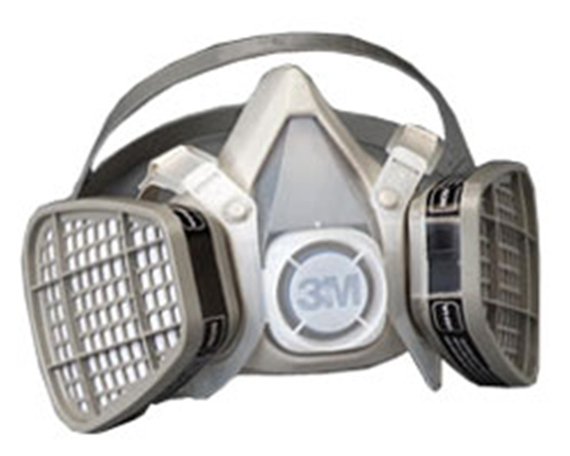
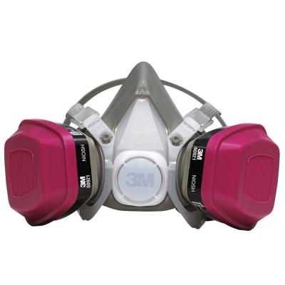
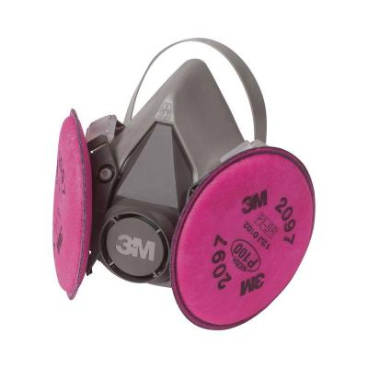
Respirator with various types of filters.
Organic Vapor Respirator
Particulate Respirator
Particulate & Vapor Respirator

Slide 12
OSHA Regulations on Respirators
Employers must provide a medical evaluation to determine employees’ ability to use a respirator before fit testing and use. The employer must use a physician or other licensed health care professional (LHCP) to perform medical evaluations using a medical questionnaire or by c.onducting a medical examination.
Failure to conduct fit testing prior to respirator use, and at least annually, was the fourth most-cited respiratory protection violation (failing to provide information to voluntary users was number three), according to the BLS study. All employees using a negative or positive-pressure tight-fitting facepiece respirator must pass an appropriate qualitative fit test or quantitative fit test. Fit testing is required prior to initial use, whenever a different respirator facepiece is used, and at least annually thereafter. Proper respirator size is determined through a fit test

Slide 13
OSHA Regulations on Respirators
Common Compliance Issues with Respirator Protection
OSHA’s respiratory protection standard, 29 CFR 1910.134, was the fourth most frequently violated agency standard in fiscal year 2014 (October 1, 2013 to Sept 30, 2014). OSHA penalized industries $2.2 million for 3,682 violation citations. The most frequently cited industries for violations of the respiratory protection (RP) standard were automotive repair and maintenance; building finishing contractors; architectural and structural metals manufacturing; foundation, structure, and building exterior contractors; and coating, engraving, heat treating, and allied activities.

Slide 14
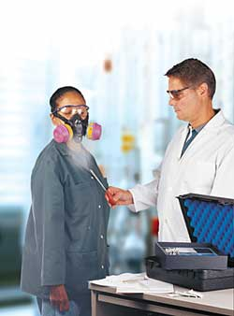
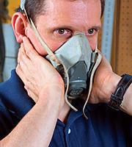
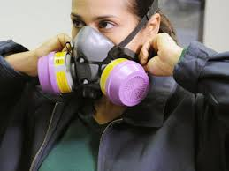
A respirator fit test is now required for the person who polishes a vehicle with rubbing compound. Now Body Technicians & their helpers, Paint Technicians and & their helpers and Polishers will need a yearly fit test. Kent Automotive can conduct the test and no charge.

Slide 15
OSHA Qualitative Fit Testing
Qualitative fit testing is a pass/fail test method that uses your sense of taste or smell, or your reaction to an irritant in order to detect leakage into the respirator facepiece. Qualitative fit testing does not measure the actual amount of leakage. Whether the respirator passes or fails the test is based simply on you detecting leakage of the test substance into your facepiece. There are four qualitative fit test methods accepted by OSHA:
Isoamyl acetate, which smells like bananas;
Saccharin, which leaves a sweet taste in your mouth;
Bitrex, which leaves a bitter taste in your mouth; and
Irritant smoke, which can cause coughing

Slide 16
OSHA Mandatory Fit test Requirements
The individual who uses a tight-fitting respirator is to perform a user seal check to ensure that an adequate seal is achieved each time the respirator is put on. Either the positive and negative pressure checks listed in this appendix, or the respirator manufacturer's recommended user seal check method shall be used. User seal checks are not substitutes for qualitative or quantitative fit tests.
I. Facepiece Positive and/or Negative Pressure Checks
A. Positive pressure check. Close off the exhalation valve and exhale gently into the facepiece. The face fit is considered satisfactory if a slight positive pressure can be built up inside the facepiece without any evidence of outward leakage of air at the seal. For most respirators this method of leak testing requires the wearer to first remove the exhalation valve cover before closing off the exhalation valve and then carefully replacing it after the test.
B. Negative pressure check. Close off the inlet opening of the canister or cartridge(s) by covering with the palm of the hand(s) or by replacing the filter seal(s), inhale gently so that the facepiece collapses slightly, and hold the breath for ten seconds. The design of the inlet opening of some cartridges cannot be effectively covered with the palm of the hand. The test can be performed by covering the inlet opening of the cartridge with a thin latex or nitrile glove. If the facepiece remains in its slightly collapsed condition and no inward leakage of air is detected, the tightness of the respirator is considered satisfactory

Slide 17
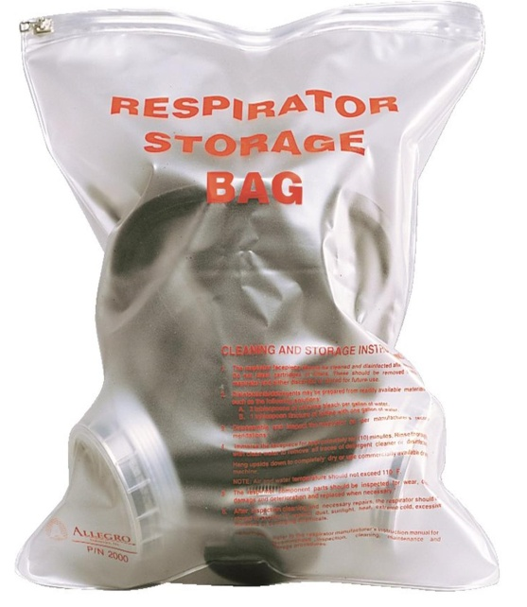
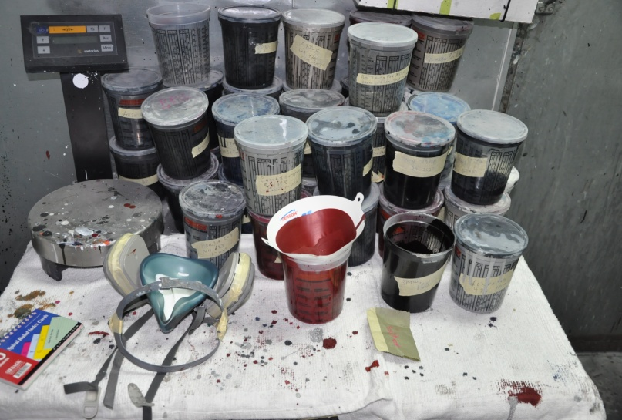
Did you know that it is an OSHA violation if the respirator is not stored in an enclosed container when not in use?

Slide 18
June 1, 2016: All employers that use, handle, or store hazardous chemicals must update alternative workplace labeling and hazard communication programs, as necessary, and provide additional employee training for newly identified physical or health hazards.
OSHA allows that a shop can store the new SDS forms on their computer not accessed by the internet or printed forms stored in a binder at the body shop. Check with local authorities to see if the new SDS can be stored on a computer or a hard copy is required.

Slide 19
The Occupational Safety and Health Administration (OSHA) has issued a final rule to curb lung cancer, silicosis, chronic obstructive pulmonary disease and kidney disease in America's workers by limiting their exposure to respirable crystalline silica. The rule is comprised of two standards, one for Construction and one for General Industry and Maritime.

Slide 20
Both standards contained in the final rule take effect on June 23, 2016., after which industries have one to five years to comply with most requirements, based on the following schedule:General Industry and Maritime - June 23, 2018, two years after the effective date.

Slide 21
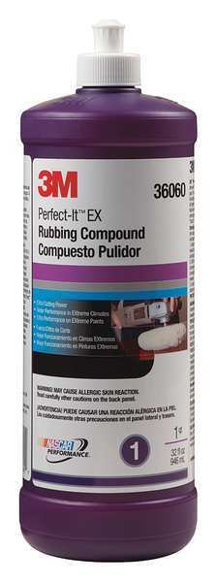
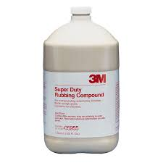
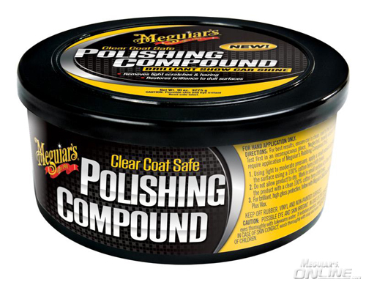
Where in the body shop do you find Crystalline Silica?
In Rubbing/Polishing Compounds

Slide 22
What Personal Protection Equipment is necessary for Crystalline Silica?
The necessary items for PPE are as follows: A partiuclate/vapor respirator, Goggles, and gloves.

Slide 23
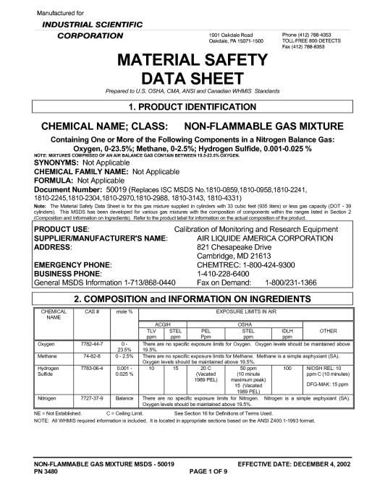
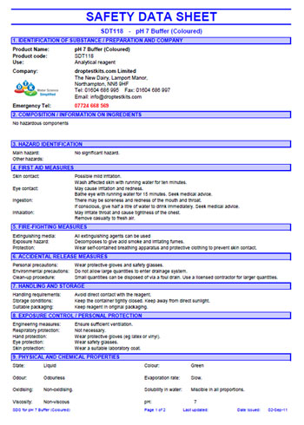
The Hazard Communication Standard (HCS) requires chemical manufacturers, distributors, or importers to provide Safety Data Sheets (SDSs) (formerly known as Material Safety Data Sheets or MSDSs) to communicate the hazards of hazardous chemical products. As of June 1, 2015, the HCS will require new SDSs to be in a uniform format, and include the section numbers, the headings, and associated information.
Body Shops
Have to change
To SDS sheets
By 6/1/2016

Slide 24
Possible Damage During Paint Spraying
1.) Particle charge:
Particles penetrating the lung settle incurably and hinder the blood oxygen exchange
➔ Deterioration of lung capacity = Gasping for air
2.) Isocyanates:
• Dry throat • Pressure on the chest • Headache • Breathing problems
3.) Solvents: Damage to the entire organism, especially:
• Liver • Brain • Nervous system ➔ strong deterioration of personal performance capacity and personality

Slide 25
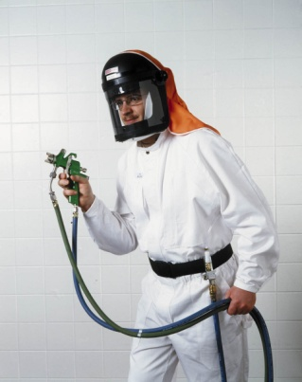
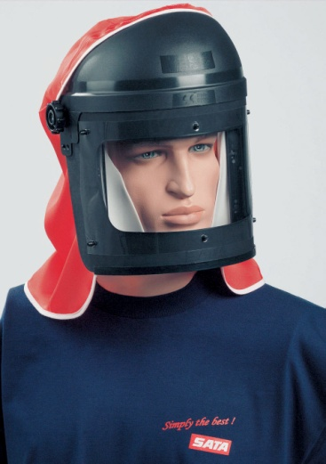
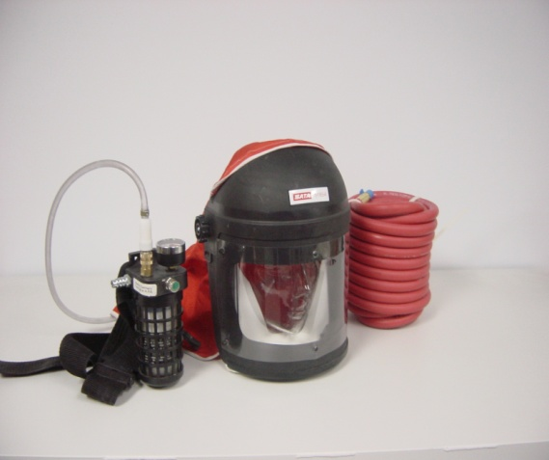
SATA Vision 2000 Full Mask with or without Charcoal Filter Unit
SATA Breathing System
NIOSH Approved
Non-Gassing Air Hose
To be used with Grade D Air
Loose fit positive air respirator
Charcoal Belt Unit with Gauge
Light weight
Complete protection for entire head including eyes, face, and hair

Slide 26
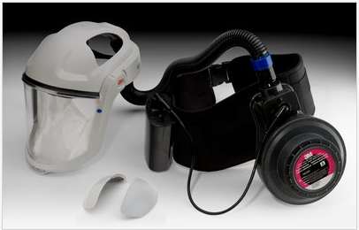
Battery Powered Fresh Air System from 3M

Slide 27
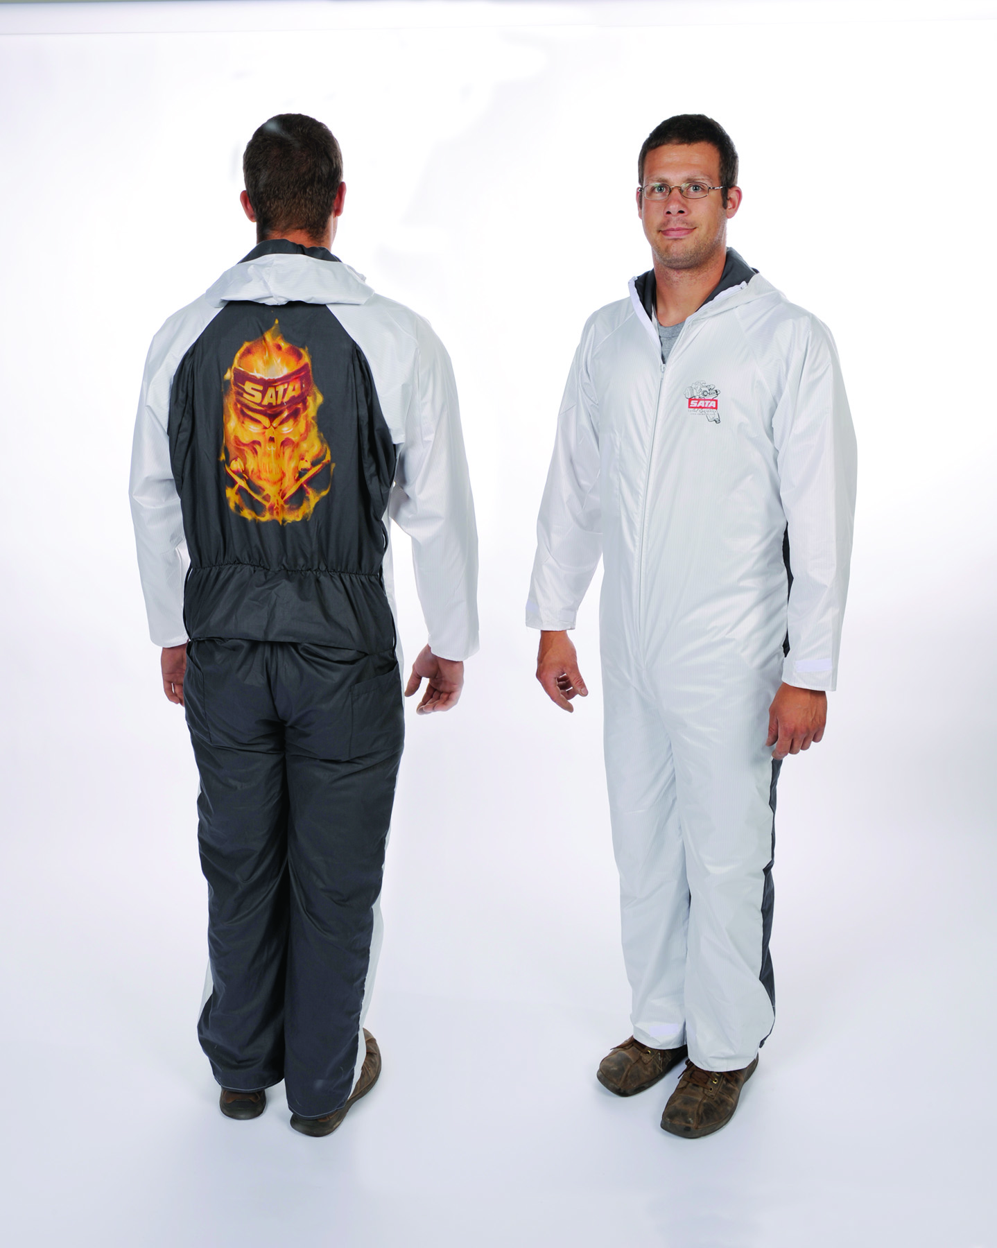
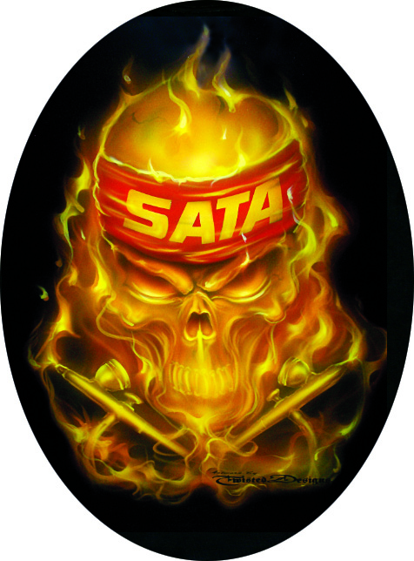
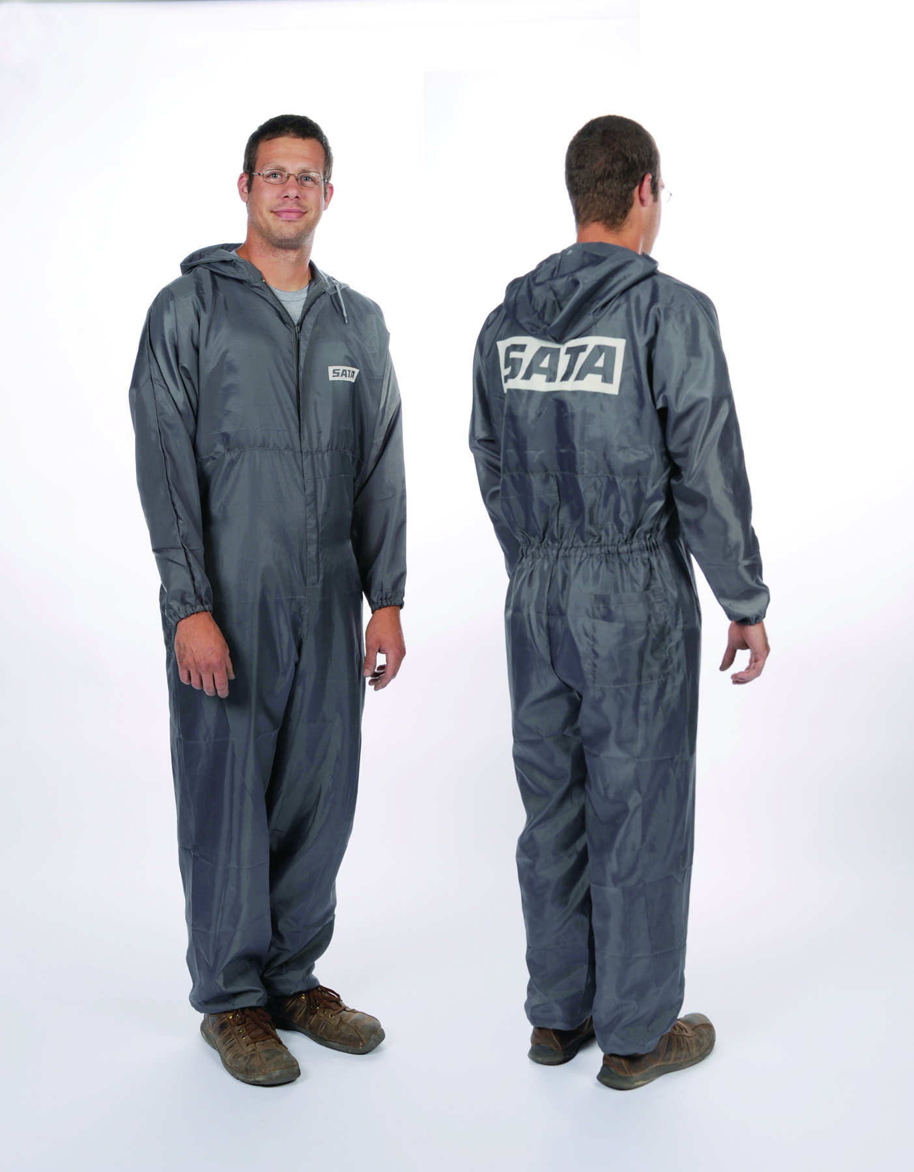
SATA Paint Suits By Dan-Am
Breathable
Comfortable
Elastic waist, arm, and leg bands
Protects from harmful over spray of solvents, resins, and pigments
Pro Series has sewn in Carbon Fiber thread to dissipate electro-static charges

Slide 28
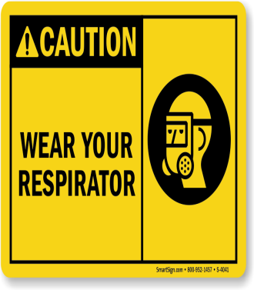
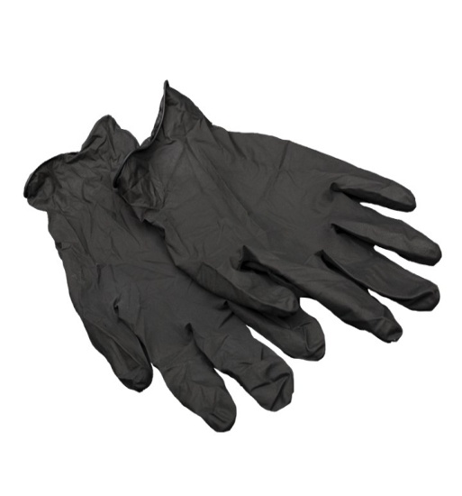
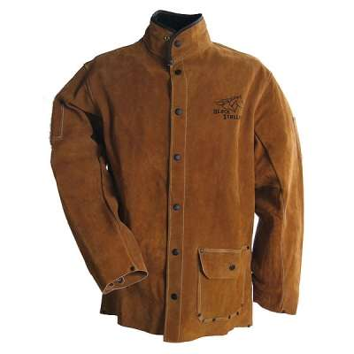
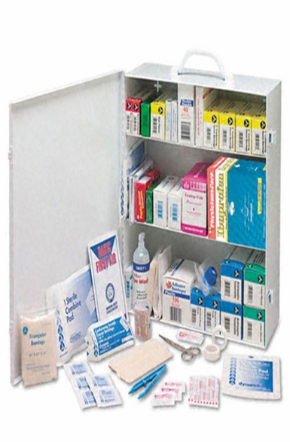
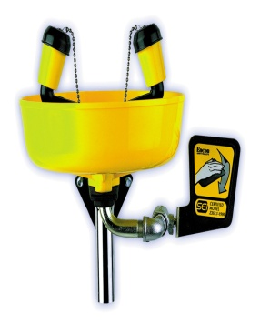
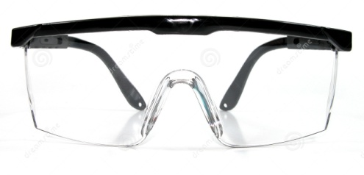
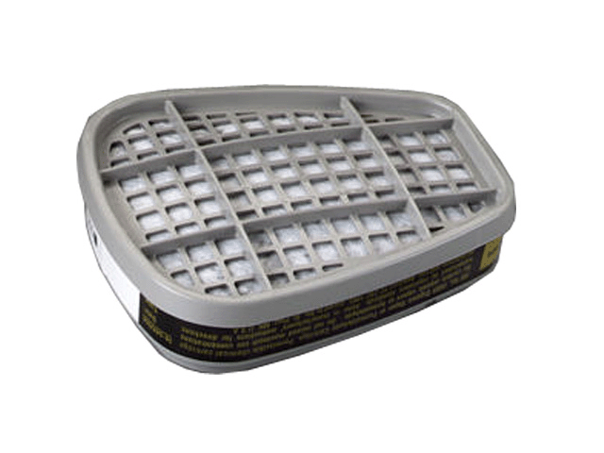
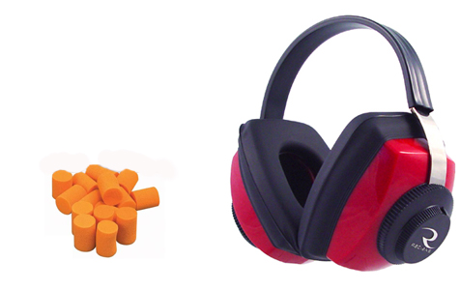
Let Kent Automotive be your Safety supplier.
Welding PPE
Hand Protection
OSHA Signage
First Aid Kits
Eye Wash Station
Eye Protection
Hearing Protection
Respiratory Protection
And Much, Much, More

