Slide 1
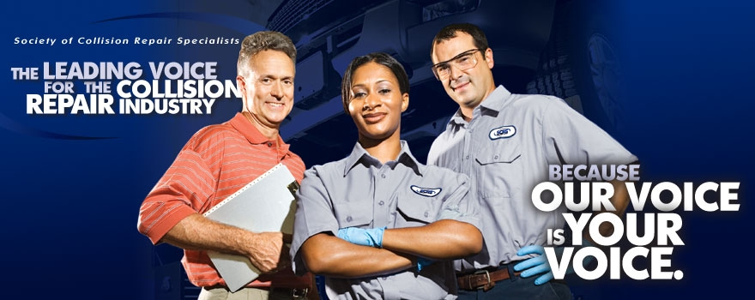
SCRS’ Education Committee Presents
The Importance of Understanding How Energy Moves in a Vehicle that is Involved in an Accident.
April, 2016– Seattle, WA

Slide 2
Understand how energy flows through a vehicle when it is involved in an accident

Slide 3
One of the first barrier crash test recorded

Slide 4
2001 Ford F150 Front Barrier Crash Test

Slide 5
2011 Ford F150 Front Barrier Crash Test

Slide 7
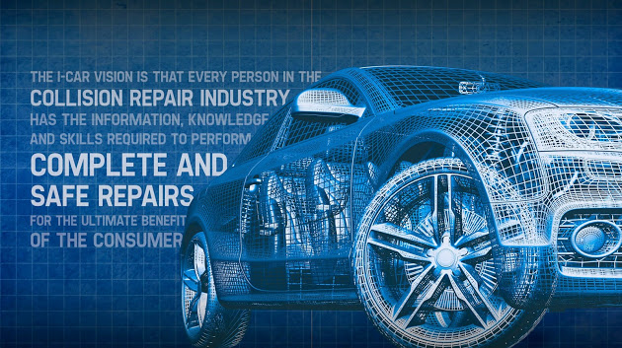
I-CAR’s NEW 16 Class

Slide 8
Page taken from I-CAR’s NEW 16 Class Presentation

Slide 9
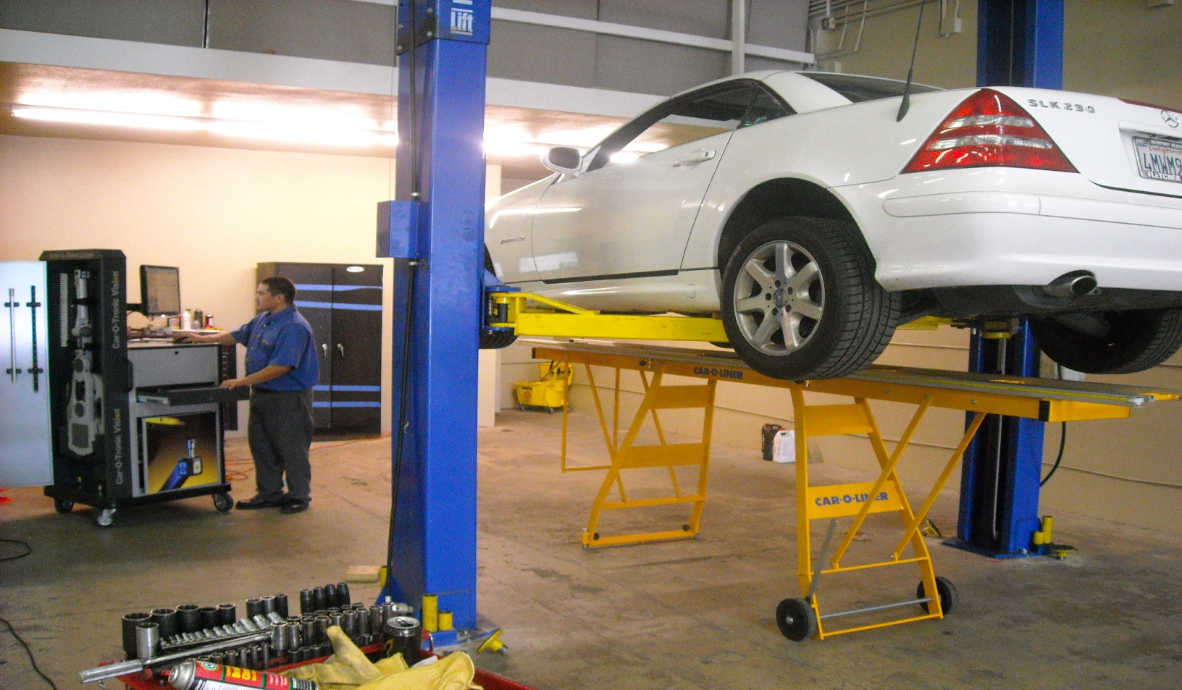
Pre-measure

Slide 10
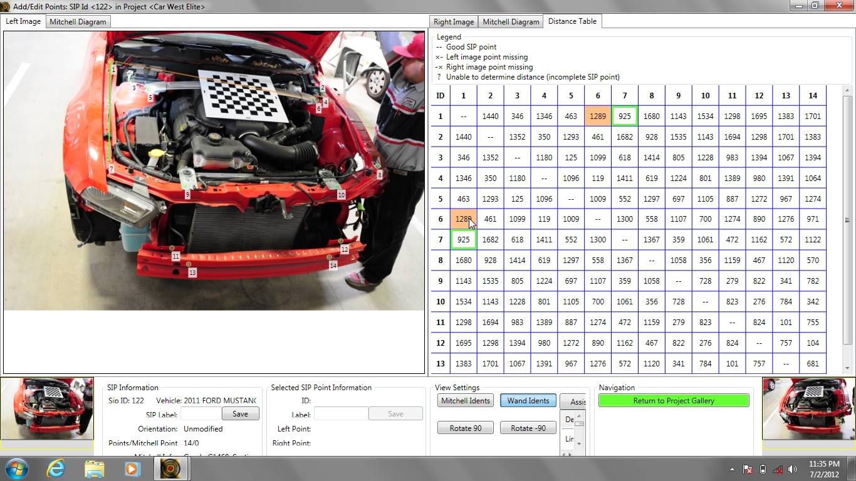
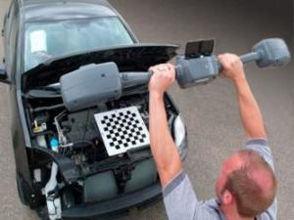
Pre-measure

Slide 11
Courtesy of Chief Automotive

Slide 12
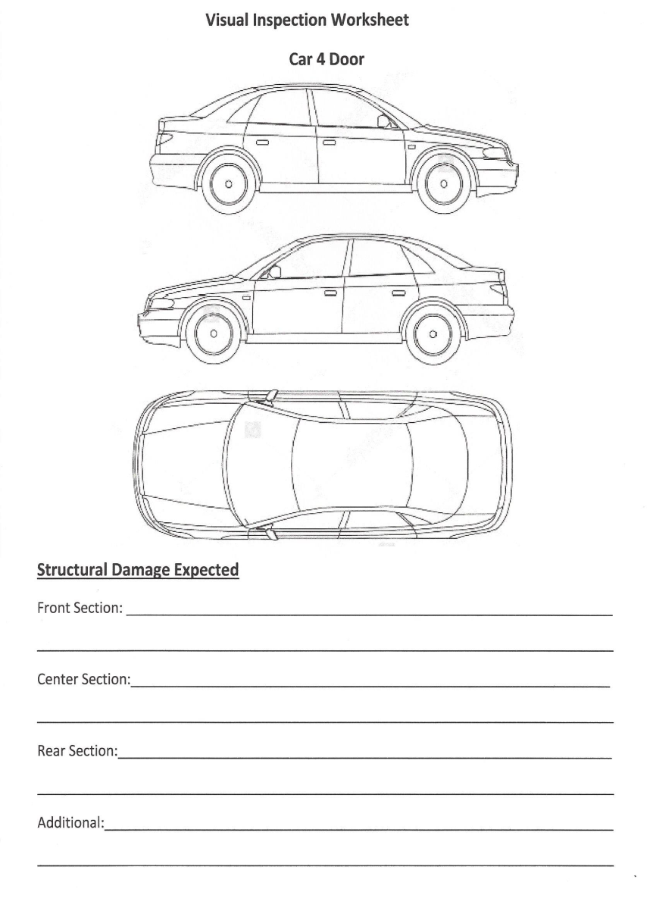
Courtesy of Chief Automotive

Slide 13
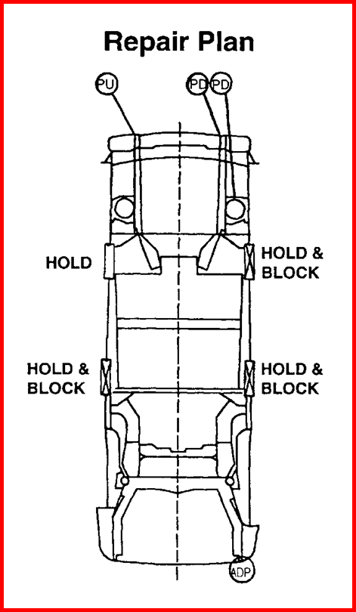
Courtesy of Chief Automotive

Slide 14
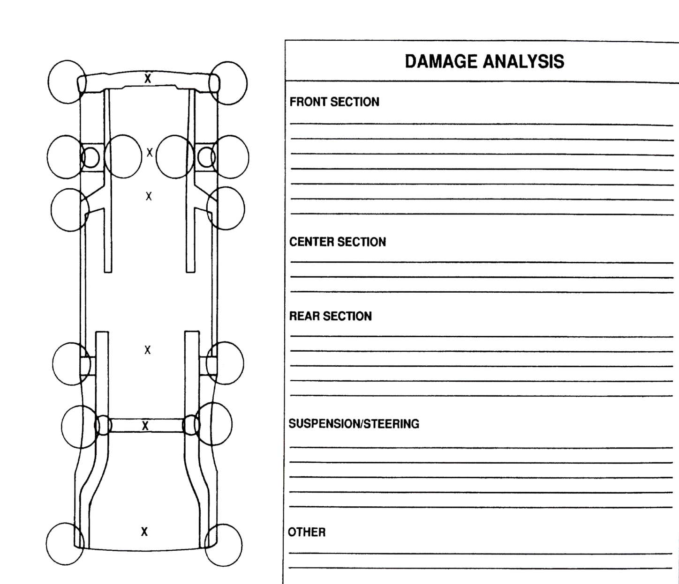
Courtesy of Chief Automotive

Slide 15
SOPs for Frame/Benching a Vehicle
Obtain the estimate for the vehicle being repaired
Obtain the OEM data for the specific vehicle
Gather all necessary tools needed for the repair
Make sure all weld on parts are correct and available
Pull up data on repaired vehicle from Equipment Mfg.
Remove any parts for access to pinch welds or other
methods of attachments
Place vehicle on frame machine or bench
Attach vehicle on pinch weld clamps or other recommend clamping systems
Remove tires and wheels
Disconnect the Battery if necessary
Remove additional parts for access if necessary
Set up measuring system or jigs
Pull to correct Mash, Sway, Sag and/or Diamond
Remove and install all parts as specified in the estimate
Re-measure vehicle
Install tires and wheels
Replace any corrosion protection items necessary at this junction of the repair.
Remove vehicle from the frame machine or bench
Repair pinch welds if necessary
Replace equipment to proper storage areas.

Slide 16
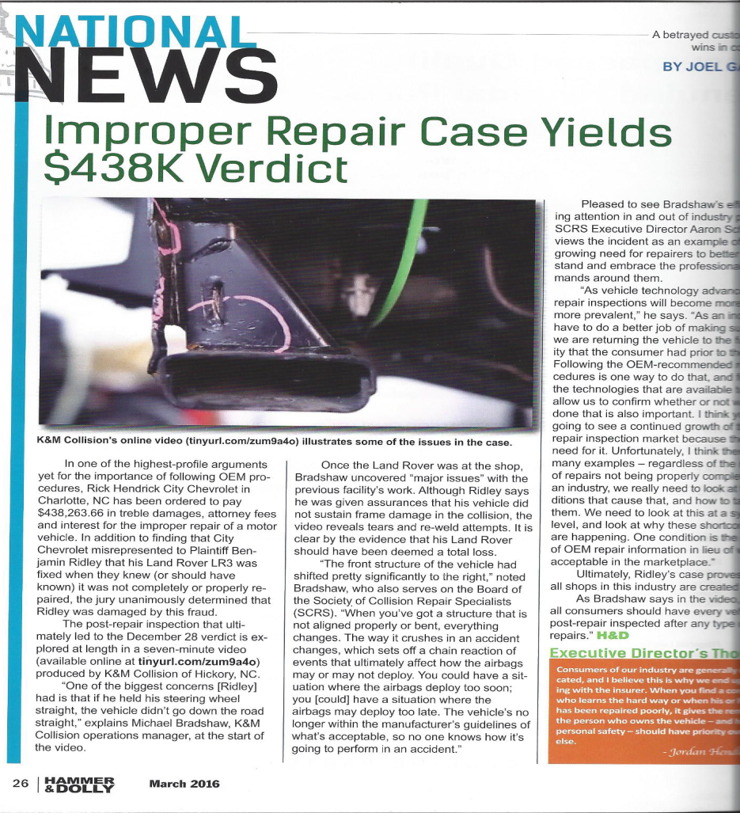
March 2016 Issue of Hammer & Dolly Magazine

Slide 17
A body shop repaired a Range Rover and the vehicle was re-inspected by another repair facility. It was determined that the original repairs did not follow OEM printed procedures and there was still additional frame damage that was missed on the estimate and by the repair tech. A case of fraud was brought against the original body shop and a judgment of nearly a half a million dollars was awarded to the plaintiff.

Slide 18
Ladies and Gentlemen It is time that repairers stop repairing cars to satisfy insurance KPI’s and start to repair vehicles to insure the safety of the driver and the passengers. It is nearly impossible to have a car towed into a shop and complete tear down including pre measuring done in 24 hours. We need to stop fooling ourselves. Today's vehicles need to be thoroughly inspected and all structural damage measured and identified. OEM procedures need to be adhered to and not what an insurance adjusted wants in order to make numbers. This law suit should be an eye opener to all repairers. If you think this is a one time event, you are kidding yourself. Toby Chess

