Slide 1


Slide 2

EDUCATION COMMITTEE PRESENTATION

Slide 3

Kool Tools of 2018

Slide 4
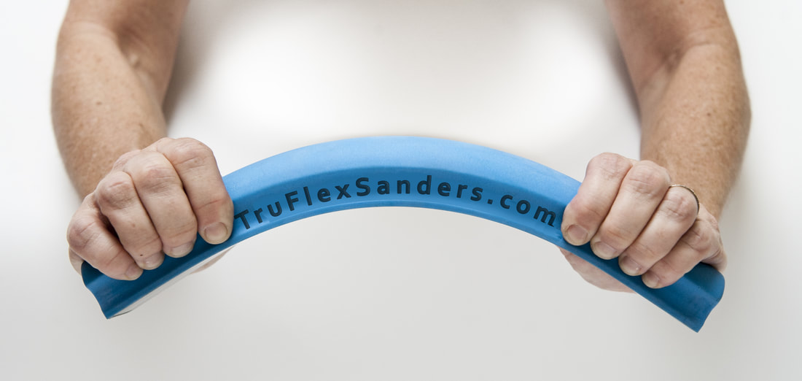
Tru Flex Sanders
With a patented steel core interior, TruFlex Sanders enable painters and auto body workers, who want flawless curved or flat surfaces, the ability to achieve perfection more quickly than ever before.

Slide 5
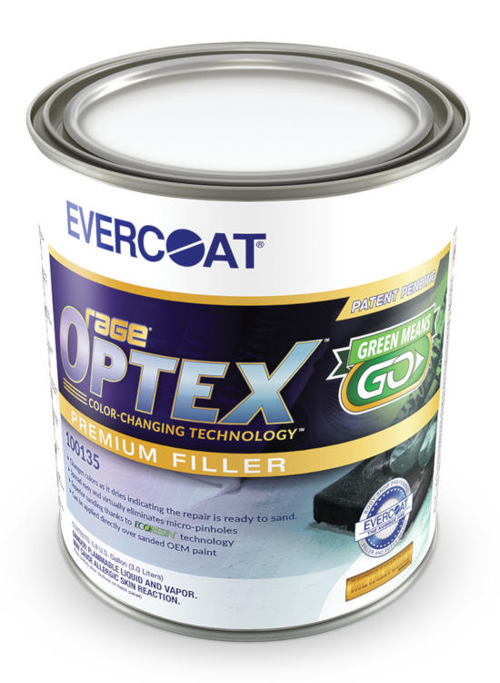

Evercoat Body Filler
Rage® OPTEX™ with color-changing technology is an ultra-premium body filler that helps body shops save time and money on every repair. There’s no second guessing—once mixed with cream hardener, OPTEX changes color to indicate the repair is ready to sand. Formulated with Evercoat’s patented ECORESIN™ technology, OPTEX offers superior adhesion to a broad range of substrates and unparalleled sanding properties. OPTEX is also part of the METALWORKS® System that guarantees the repair to maintain the O.E.M. corrosion warranty on original factory corrosion protected sheet metal and galvanized sheet metal when used in accordance with the application instructions
http://www.evercoat.com

Slide 6
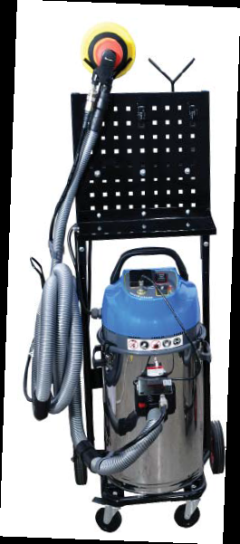
Uni-ram Mobile 300 Vacuum
ON / OFF control at the
sander automatically
turns the powerful
vacuum on and off
for collection of dust
and debris. Sanders
store neatly on the “Y”
posts. Posts can be
placed on the steel peg
board to neatly store
disc sandpaper.
http://www.uniram.com

Slide 7
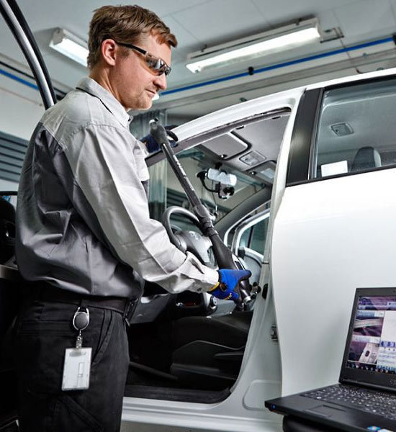
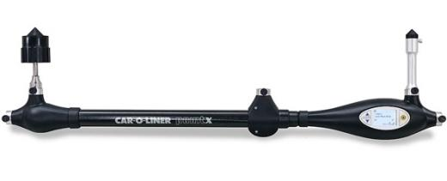
Car-O-Liner Point X Measuring System
https://car-o-liner.com

Slide 8
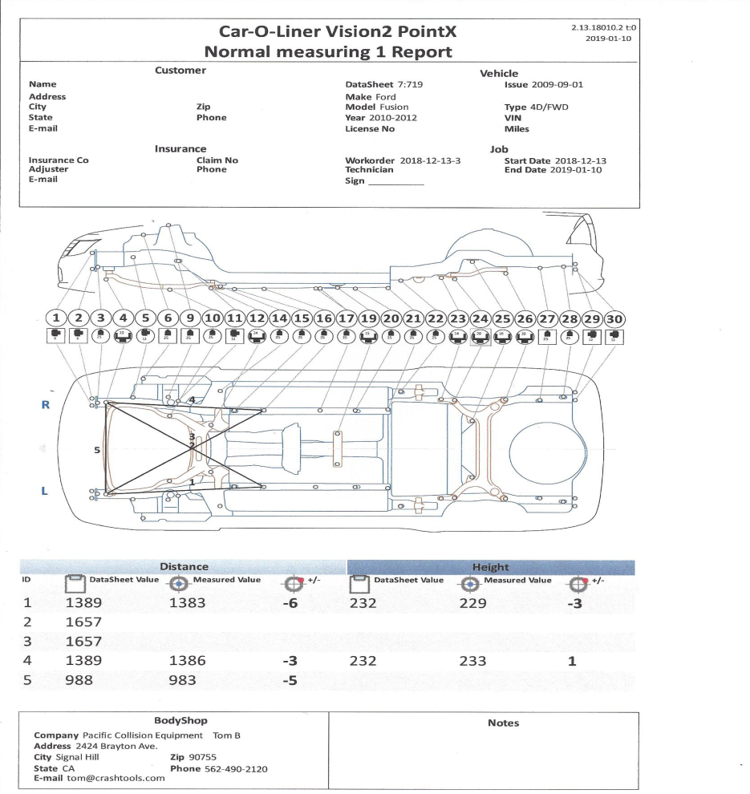
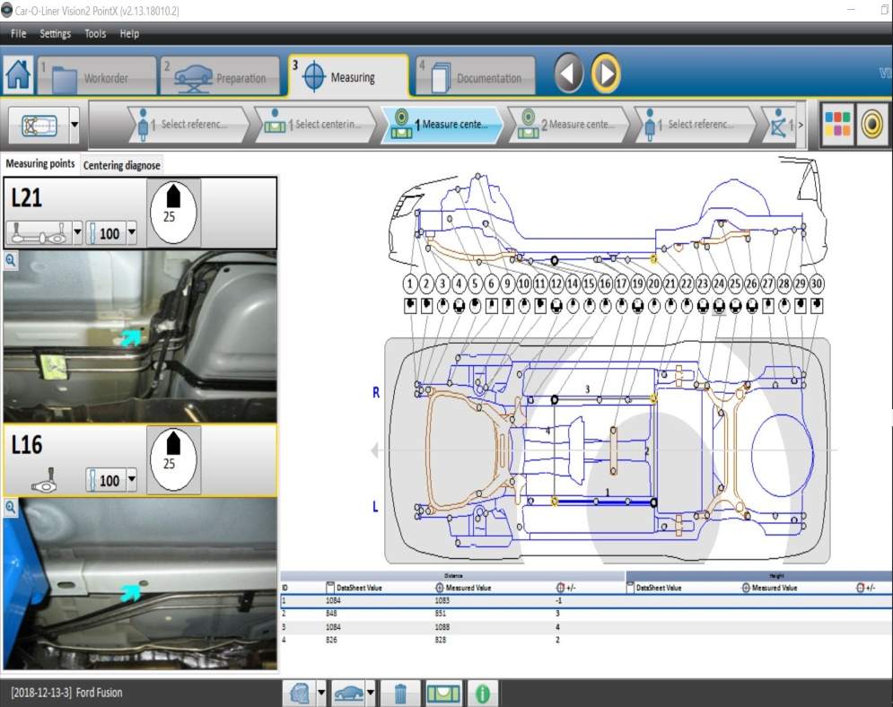
Car-O-Liner Point X Measuring System

Slide 9
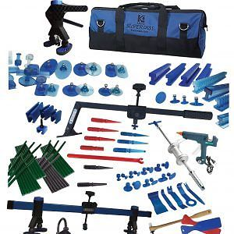
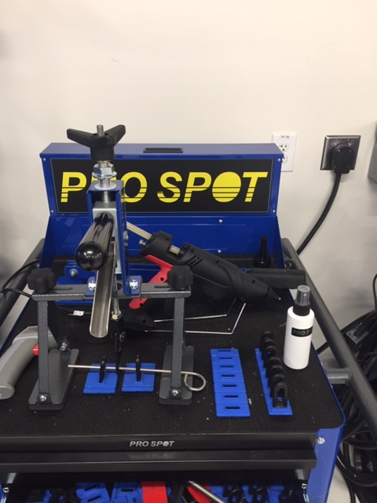
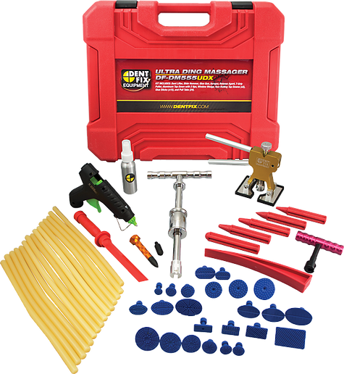
KECO Glue Gun Kits
Glue Gun Kits
Prospot International Glue Gun Kit
Dent Fix Glue Gun Kit

Slide 10
KECO Glue Gun Kits
https://kecotabs.com

Slide 11
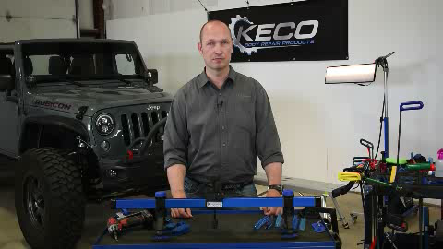
KECO Glue Gun Kits

Slide 12
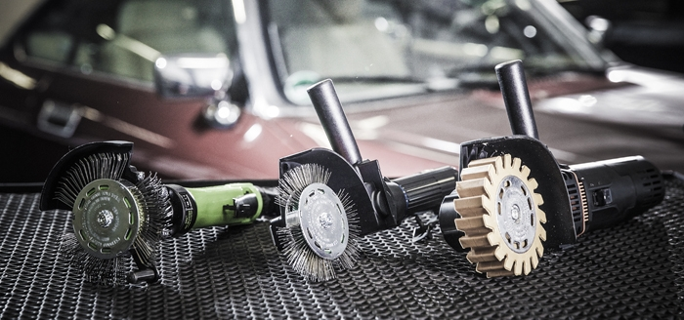
Monti Die Blaster
Bristle Blaster®
Removes corrosion, coatings, scale and adhesive residues
Grit blasting alternative
Surface preparation grade comparable with Sa 2½ up to Sa 3 per ISO 8501-1
Roughness levels up to 120 µm R_{z}
Fast, flexible and cost-effective to use
Ideal for spot repairs, touch-up work and preparing welds
Available from Kent Automotive
866.837.9908

Slide 13

Monti Die Blaster

Slide 14
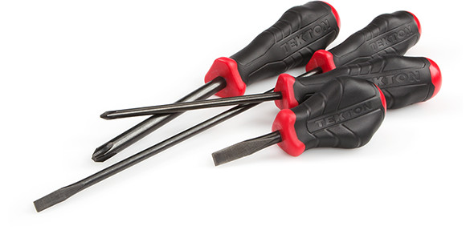
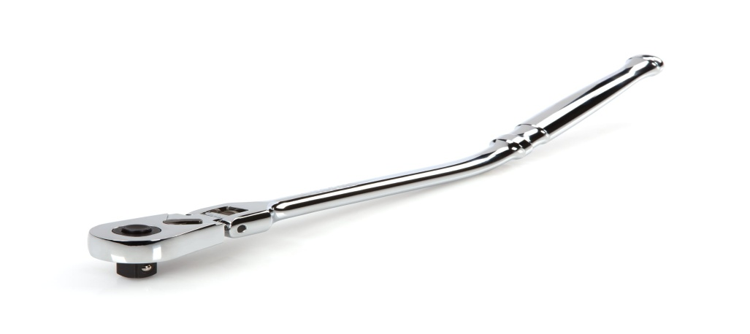
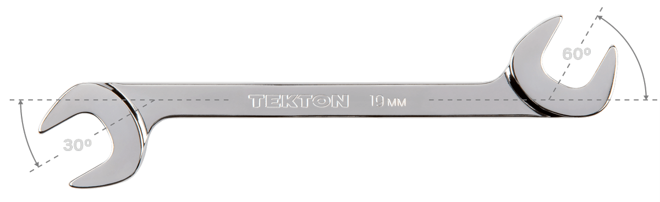
Tekton Tools
https://www.tekton.com/
Receive additional 10% discount-Promo Code SCRS-10

Slide 15


Tekton 30°/60° Wrench
30°/60° Wrench
15°/60° Wrench

Slide 16
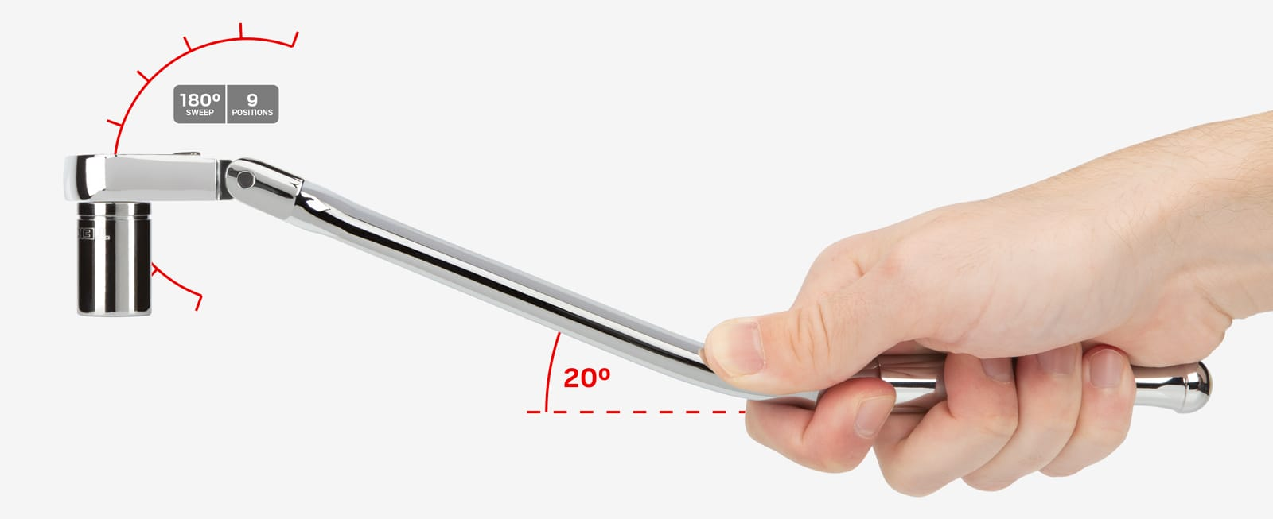
Tekton 3/8 Inch Drive x 12 Inch Flex Head Bent Handle Ratchet
90-Tooth Gear = 4° Swing Arc
Smooth and refined, the 90-tooth ratcheting system offers a concise 4° swing arc that works in the tightest spaces. Depending on the drive size, the single half-moon pawl maintains 6 to 9 teeth (more than most dual pawl designs) in contact with the gear at all times, ensuring it will never slip or skip under stress.
This unique ratchet is made to access especially hard-to-reach fasteners. The agile flex head lets you choose the best angle to avoid obstructions. Bent to 20°, the extra long handle extends your reach into narrow spaces and keeps your hand up and out of the way.

Slide 17
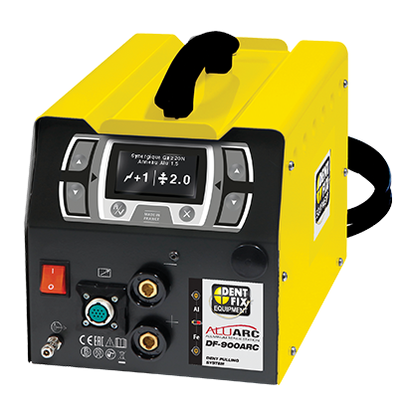
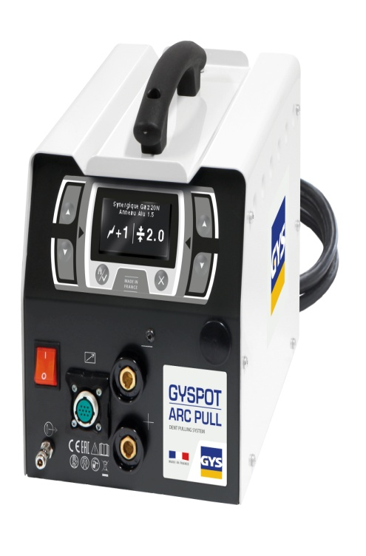
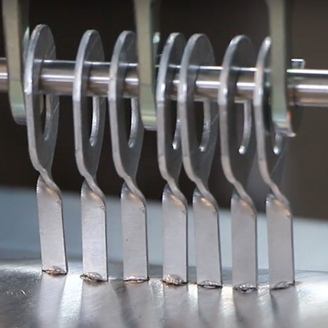
Additional Aluminum Pulling Equipment
http://www.gys-welding.com
https://www.dentfix.com

Slide 18

Battery Powered Drill SPR Rivet Gun
https://www.raeservice.com/

Slide 19
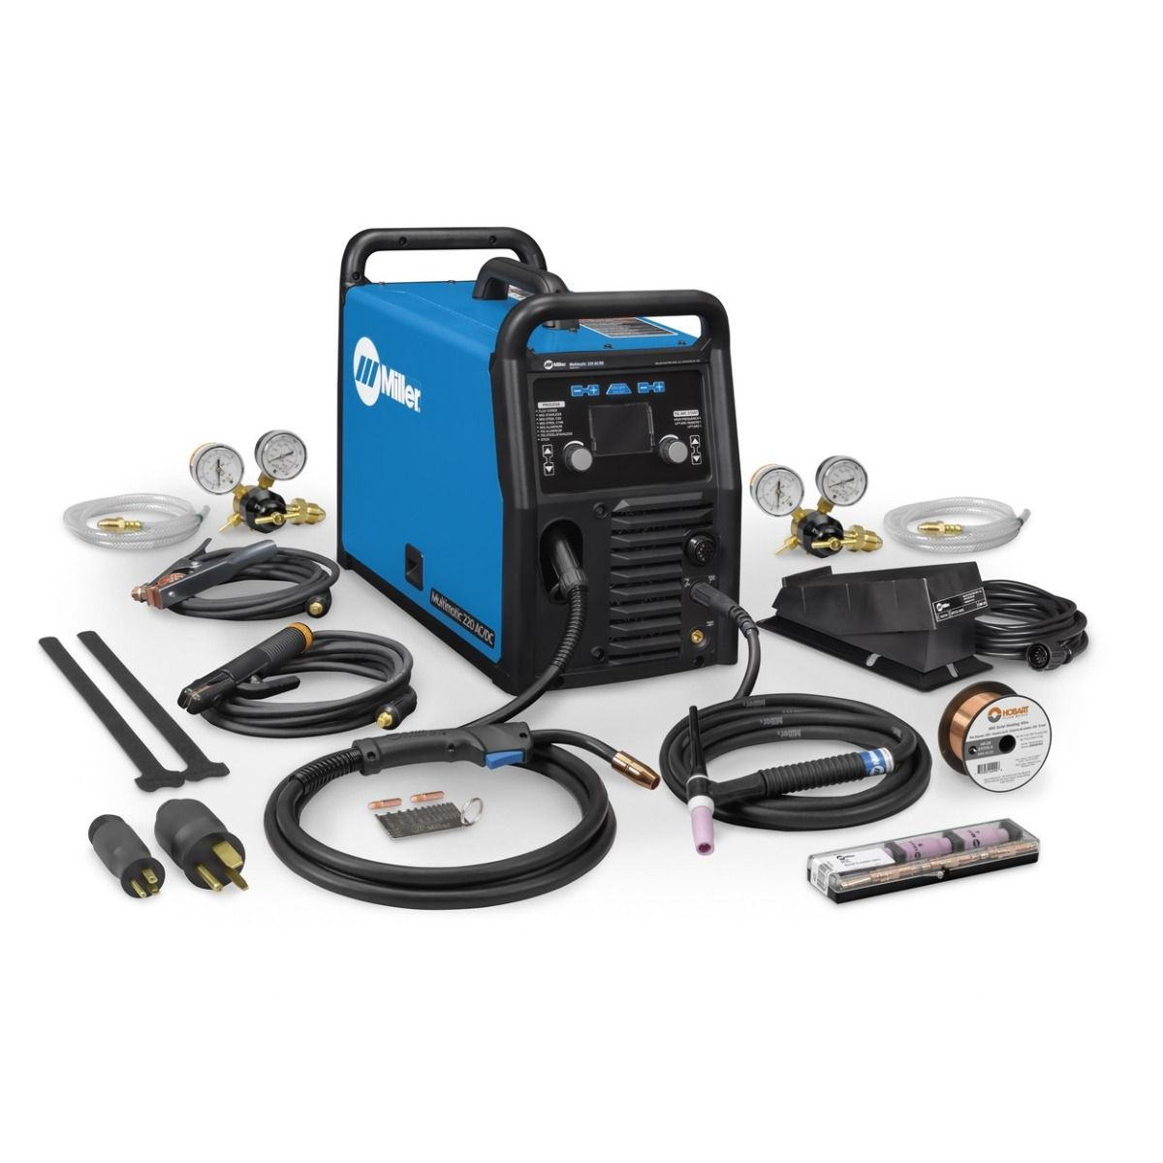
Miller Electric 220 AC/DC
This welder has a wide range of capabilities, welding up to ⅜” steel (24 gauge) and ⅜” aluminum (18 gauge) with your MIG gun. For DC stick welding, the Multimatic 220 can handle 16 gauge ⅜” steel, and the AC/DC TIG option can work with 24 gauge steel or aluminum that are up to ¼” thick.
https://www.millerwelds.com

Slide 20
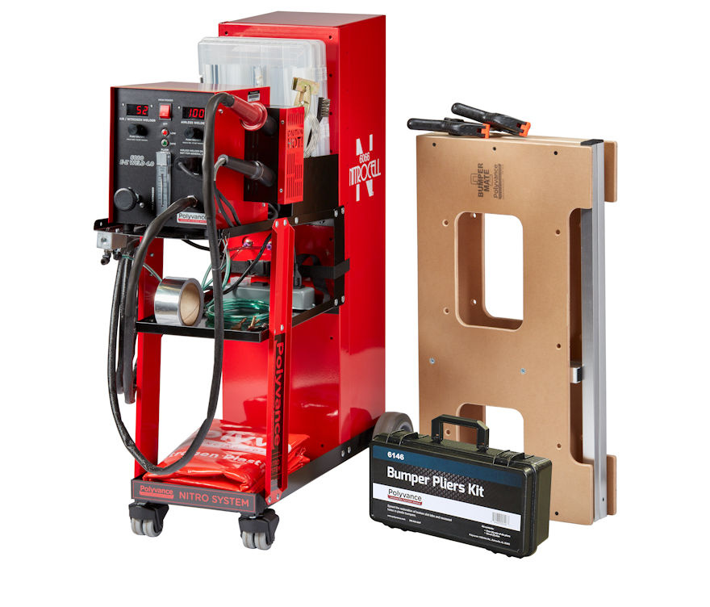
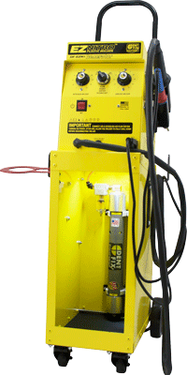
Nitrogen Generator Plastic Welders
A nitrogen hot air welder uses compressed nitrogen gas to eliminate oxygen from the weld area. The nitrogen acts as a shielding gas and allows for a contaminant-free weld with less smoke, which creates a stronger weld.
Polyvance 6080 GC
Dent Fix
DF-EXnig
https://www.polyvance.com
https://www.dentfix.com

Slide 21
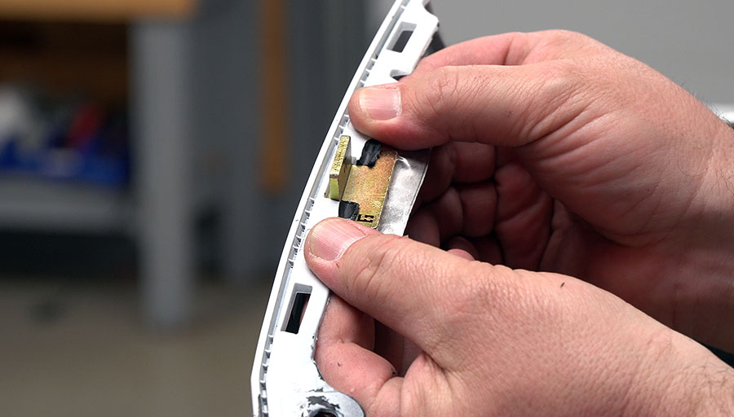
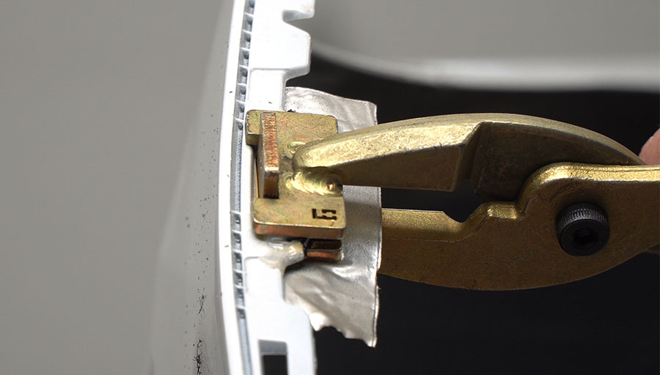
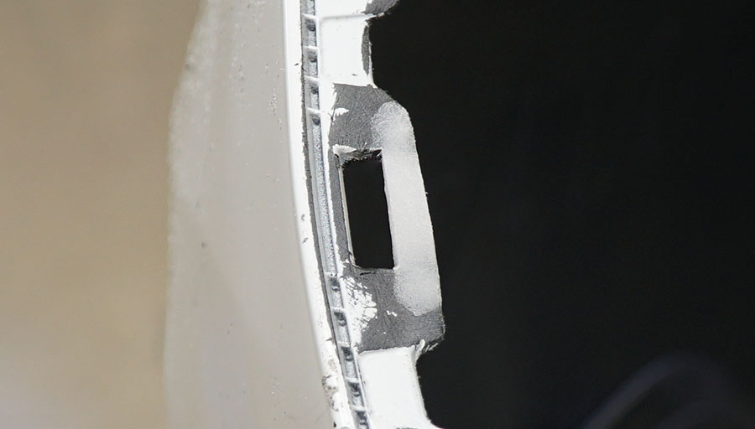
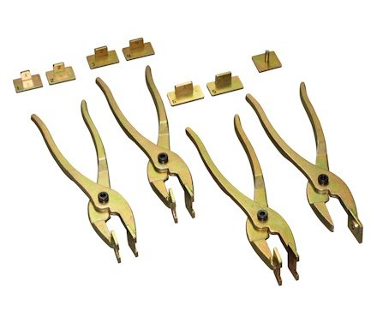
Polyvance Bumper Pliers
https://www.polyvance.com

Slide 22
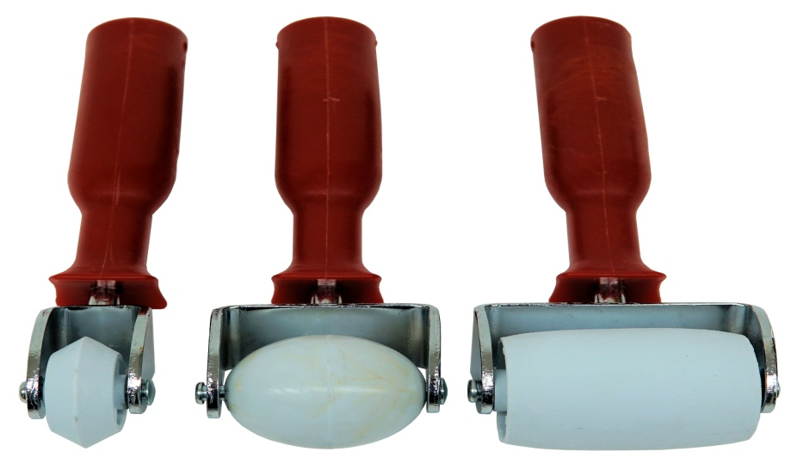
Bumper Rollers by Polyvance
https://www.polyvance.com

Slide 23
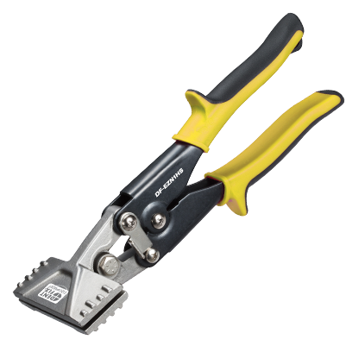
Hand Seamer from DentFix
https://www.dentfix.com/

Slide 24
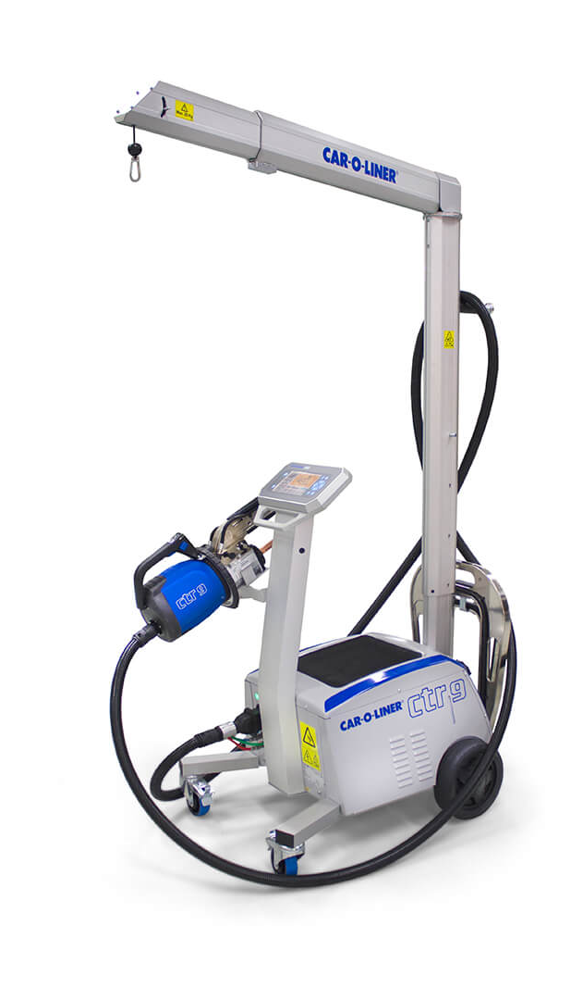
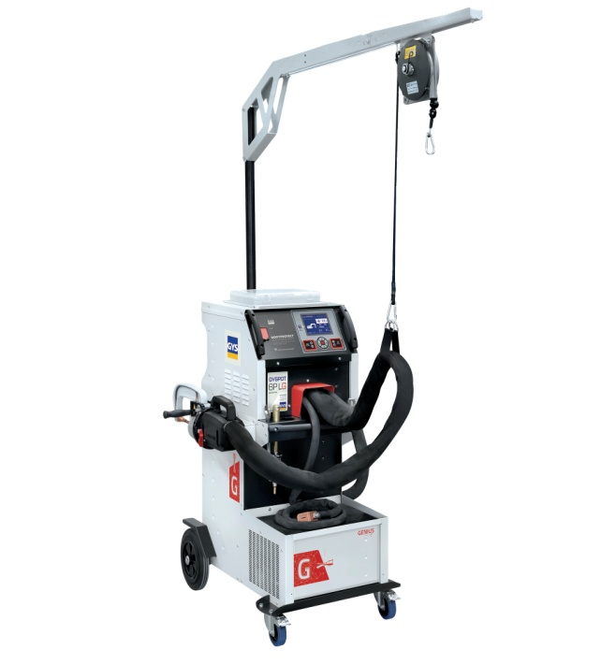
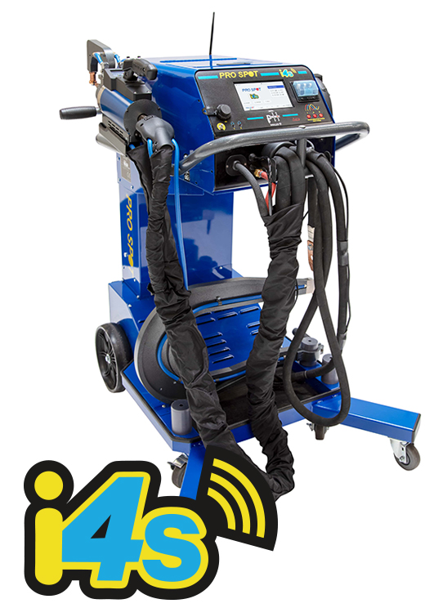
3 upgraded Spotwelders
Prospot International
Car-O-Liner
GYS

Slide 25
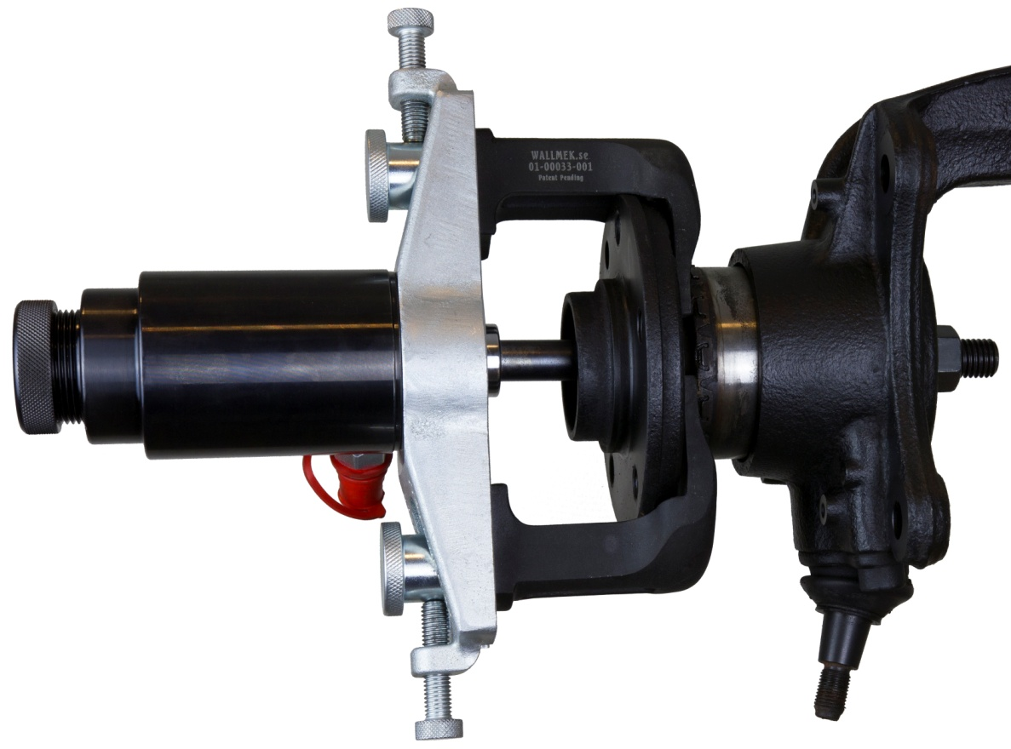
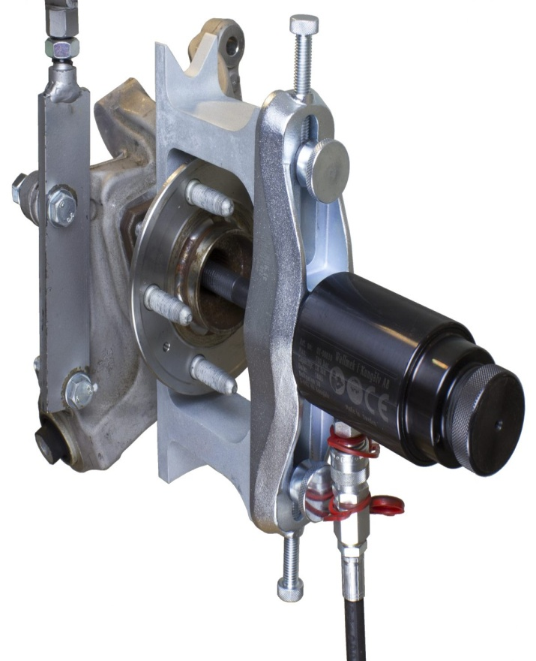
Wallmek Tools
https://www.wallmek.se/en/

Slide 26
Wellmek Tools

Slide 27
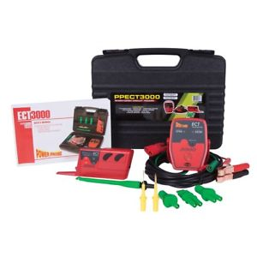
Power Probe Tek ECT3000
The ECT3000 offers a quick solution to your automotive circuit problems. It consists of 2 main components. An Intelligent transmitter and an Intelligent receiver, along with a set of connection adapters.
* Locate short circuits without unnecessarily removing plastic panels, molding, and carpet
* Trace wires to see where they lead
* Find open circuits, switches, or breaks in wires
* Track and locate the cause of a severe battery drain
* Test and find intermittent conditions
* Check continuity with the assistance of the Power Probe III, IV, or Hook.
The Power Probe ECT3000 transmits a signal into an isolated circuit (shorted or open) and traces the direction to the problem. The receiver allows you to see the distance from the wire being traced and the direction to the short. The auto-signal locking feature eases first-time use and eliminates the need to remove interior trims and carpets. The integrated flashlight will illuminate the workspace and the automatic 10-minute shut off helps users save battery life.
https://www.powerprobe.com

Slide 28
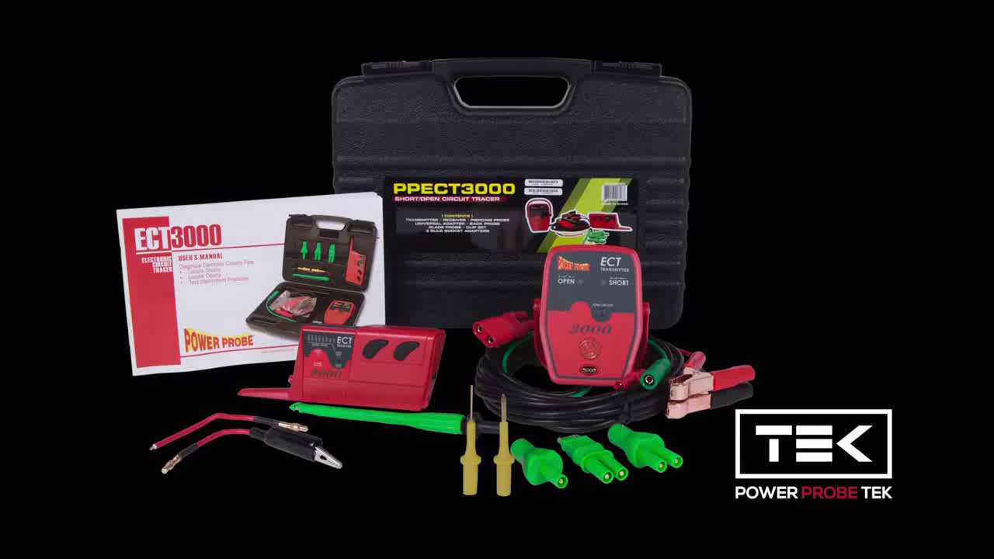
Power Probe Tek ECT3000

Slide 29
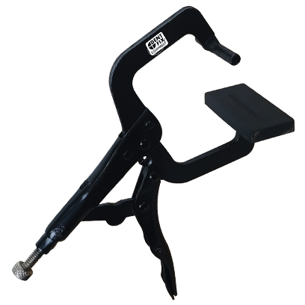
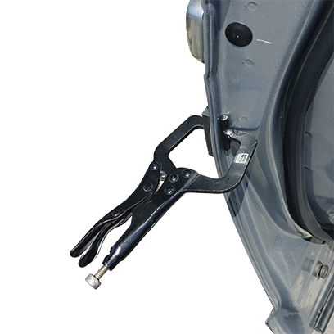
Door Skin Pliers by Dentfix
https://www.dentfix.com/

Slide 30
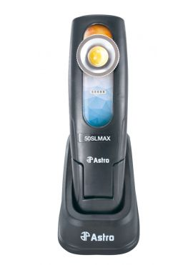
Astro 50SL Max Color Matching Light
Dual color temperatures, quickly switch from warm to cool ultra-high quality color matching light
Warm-white 4500k for lighter color paints, and for darker paint use cool-white 6000K which provides cooler light without being blue
Collapsible 360-degree rotating hook and 180 degree folding magnetic base
96 CRI rated
Easily removable and cleanable lens
Impact resistant and IP65 water and dust proof
http://www.astrotools.com/

Slide 31
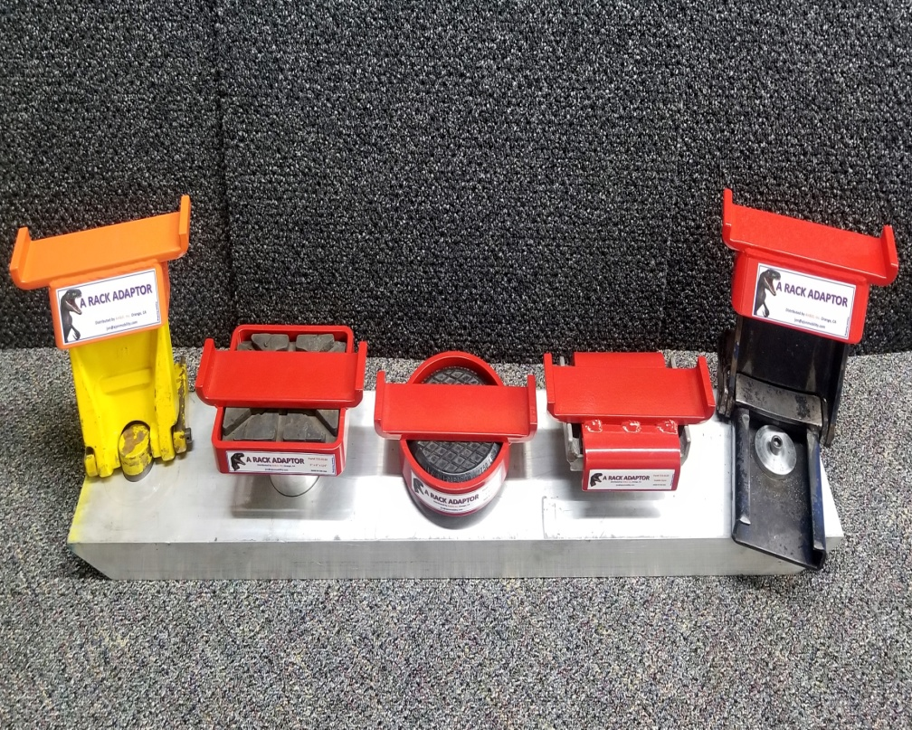
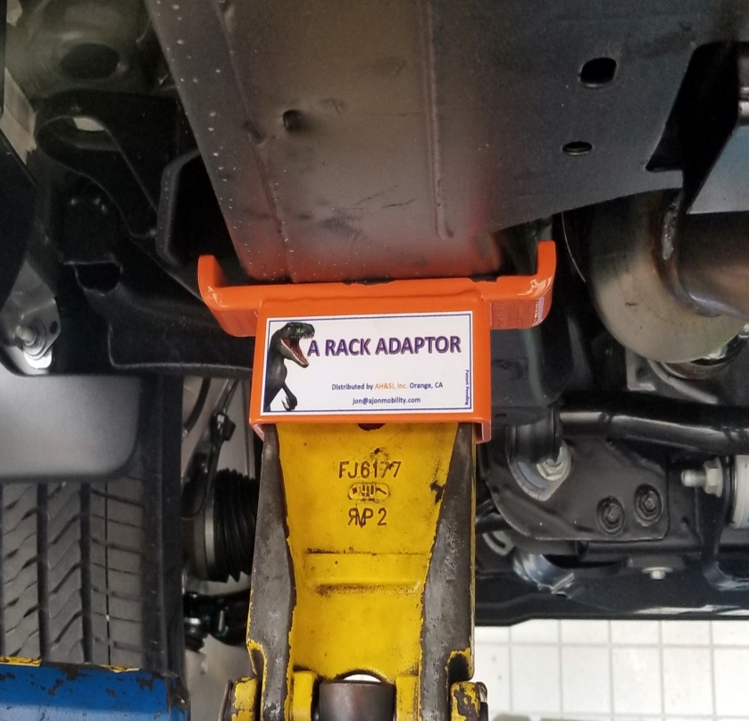
The Rack Adaptor from AH & SI Inc.
844-355-2566

Slide 32
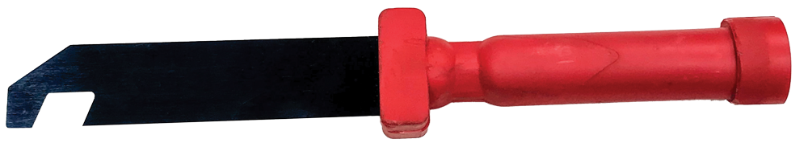
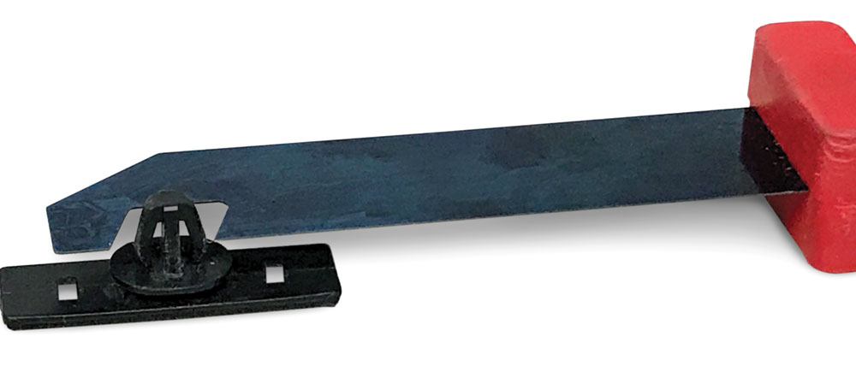
Steck Retainer Clip Release Tool
https://www.steckmfg.com/

Slide 33
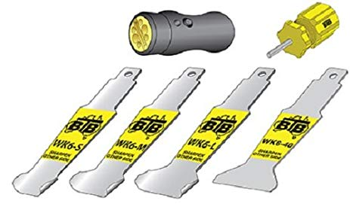
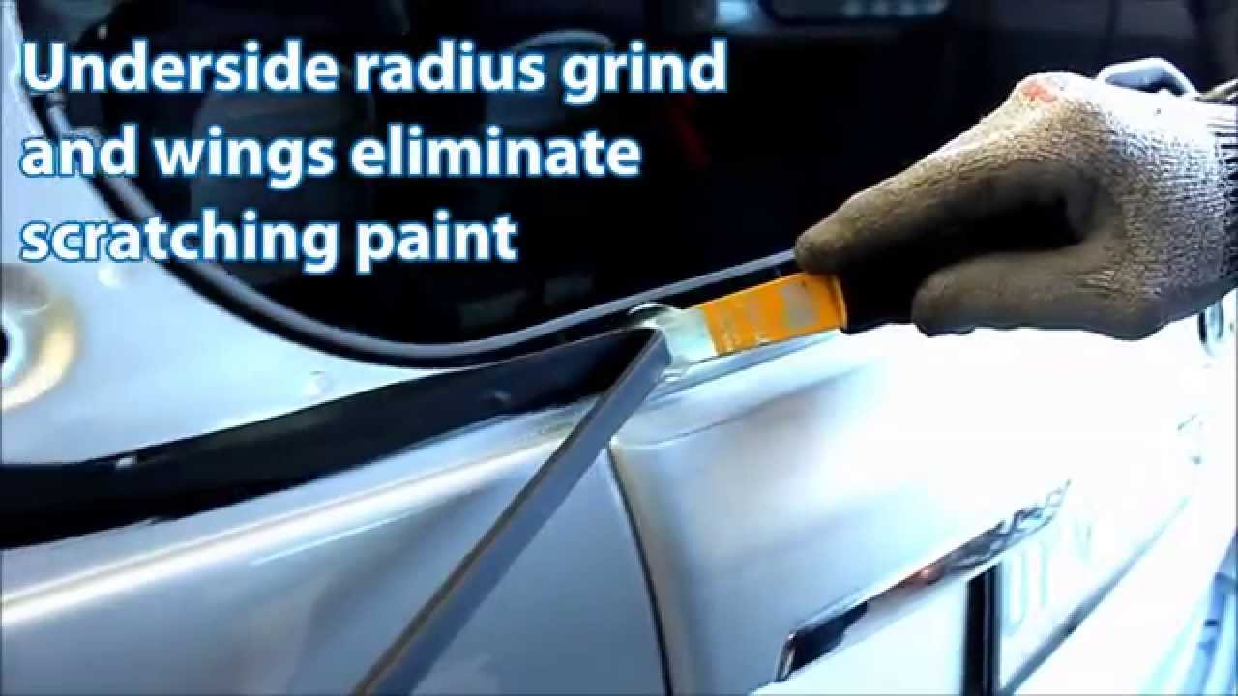
Winged Tool by Equalizer

