Slide 1
Required Manufacturers Safety Inspections
Presented By:
Bruce Halcro & Ronald Reichen

Slide 2
Access & Analyze OE Repair Procedures
May be on a fee basis
Incorrect information conveyed by manufacturers service team
Especially those that do not have certified collision centers
Example: Dealership misunderstanding

Slide 3
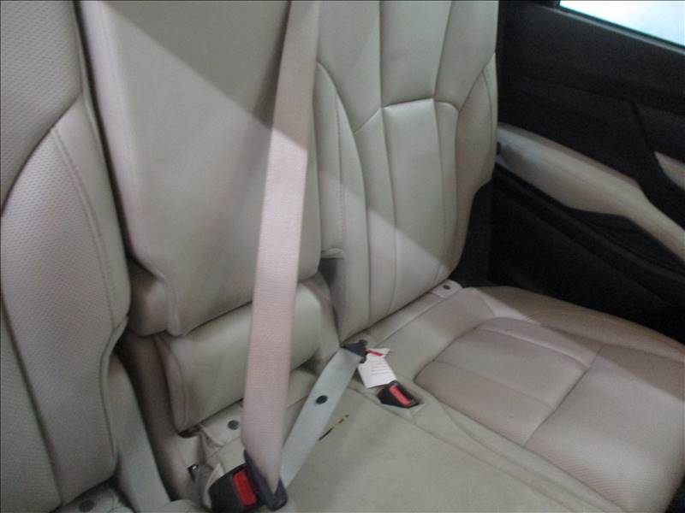
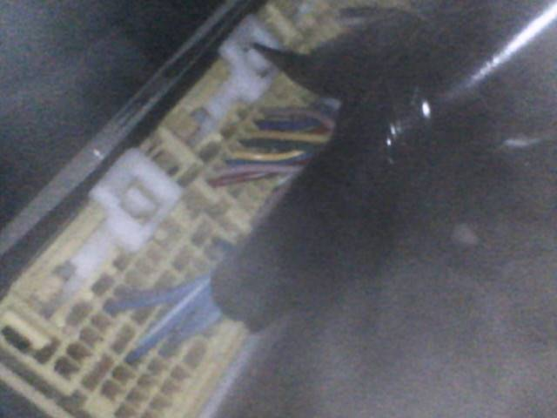
Rear Center Seatbelt
Control Module

Slide 4
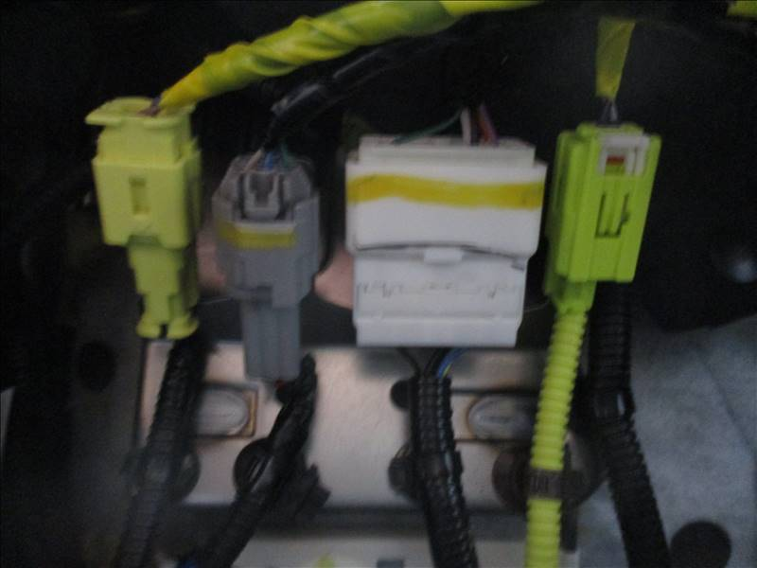
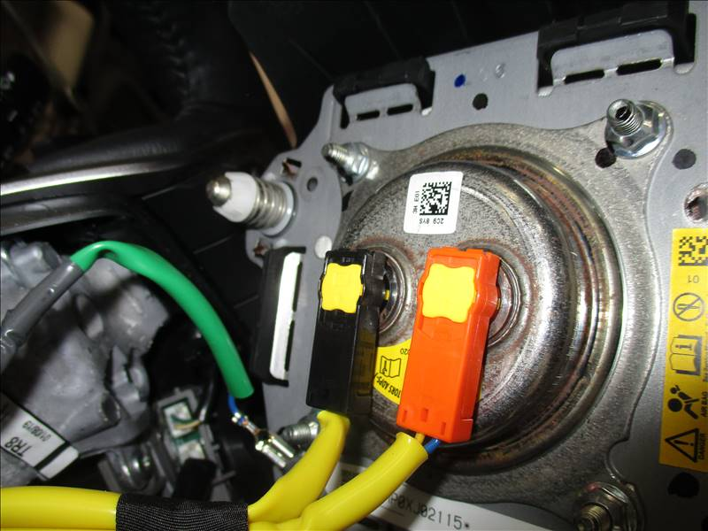
Driver’s Seat Airbag
Driver’s Side Airbag

Slide 5
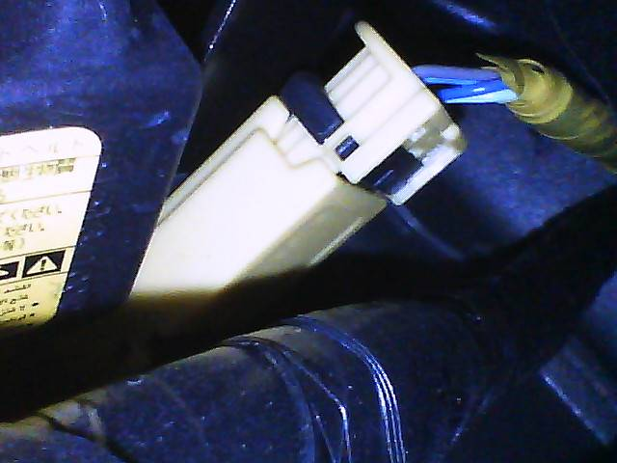
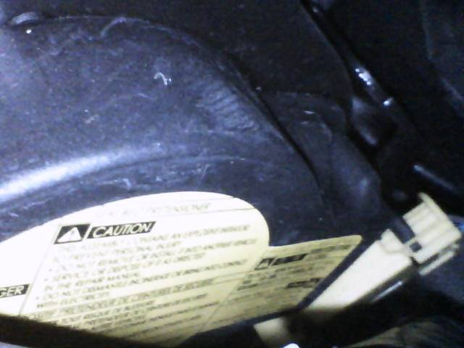
Knee Airbag Connector
Knee Airbag Connector 2

Slide 6
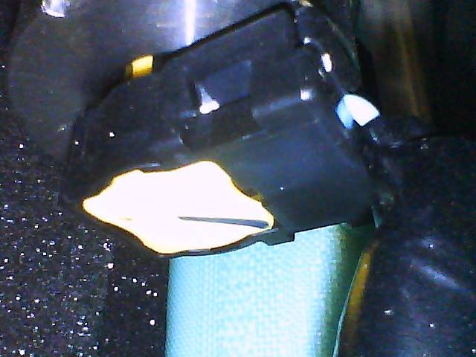
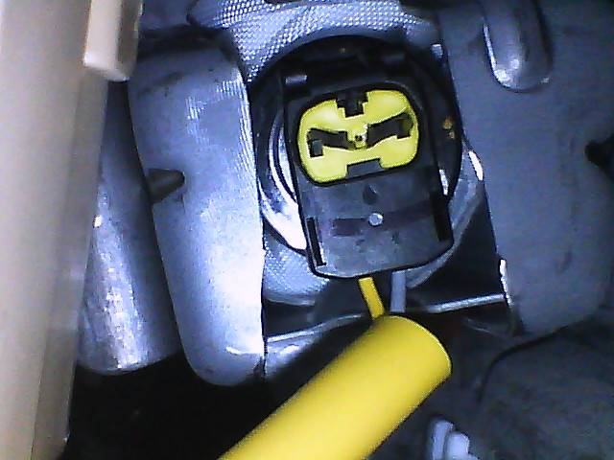
Left Curtain Airbag
Left Curtain Airbag 2

Slide 7
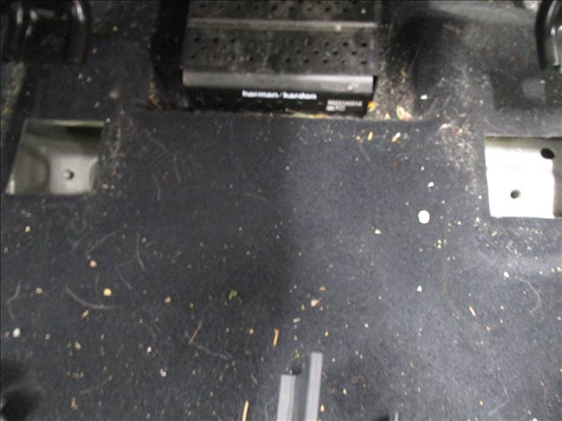
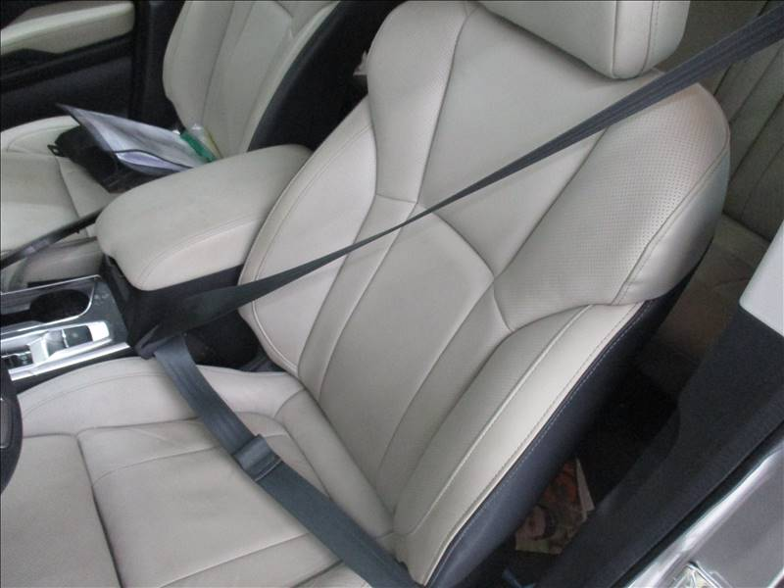
Left Front Seat Mount
Left Front Seatbelt

Slide 8
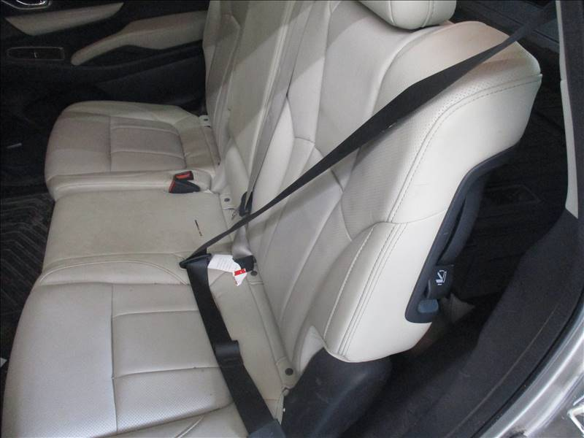
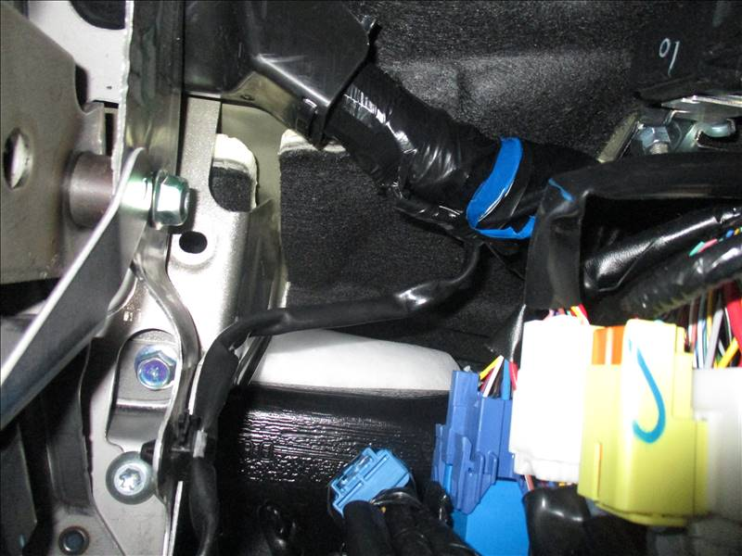
Left Rear Seatbelt
Left Console Harness

Slide 9
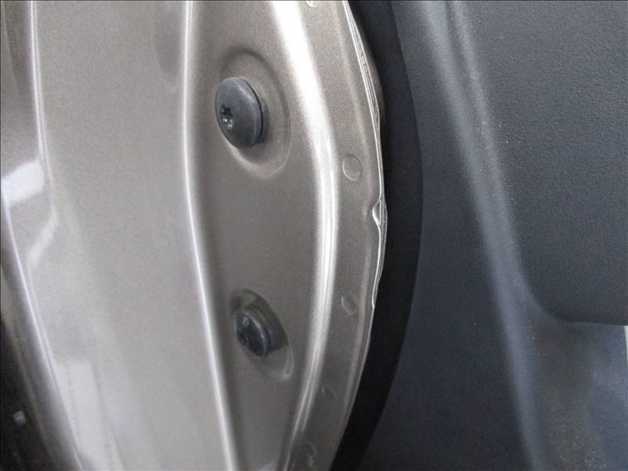
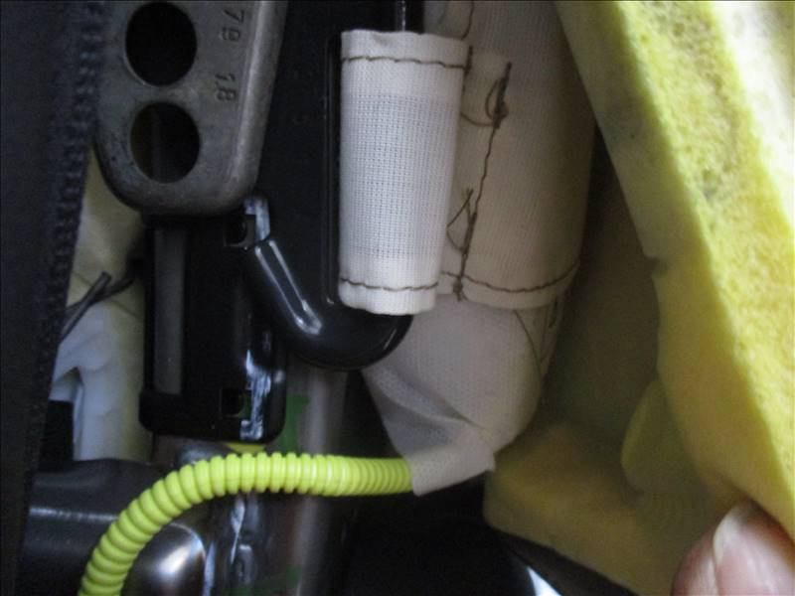
Left Dash Beam Outer Mount
Left Front Seat Airbag

Slide 10
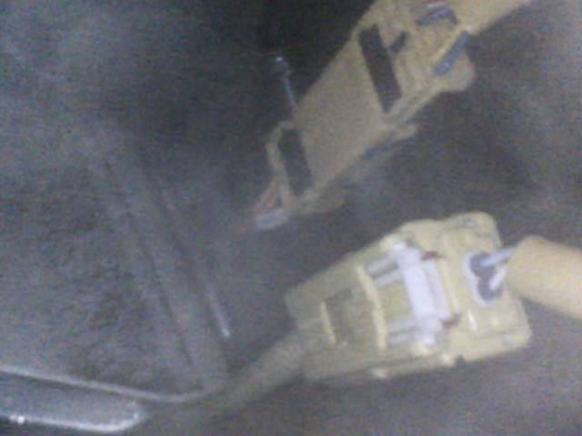
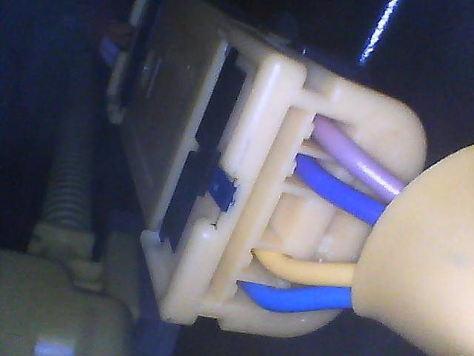
Passenger Airbag Harness
Passenger Airbag

Slide 11
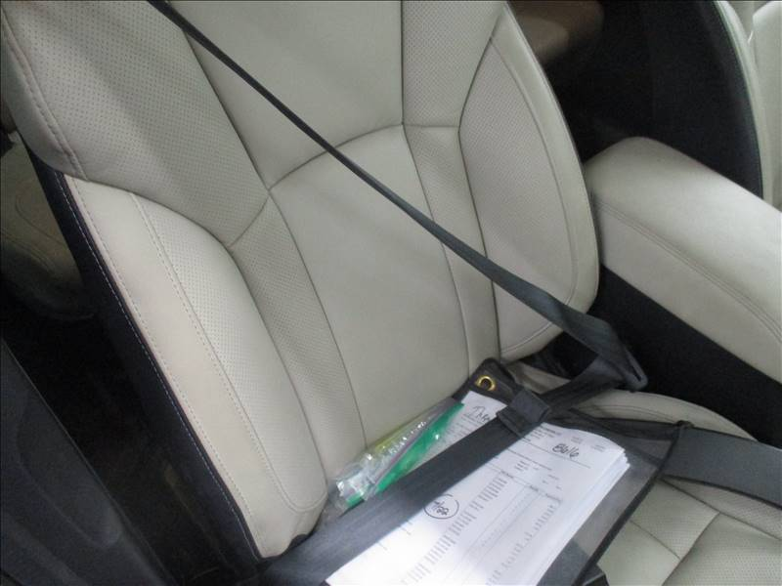
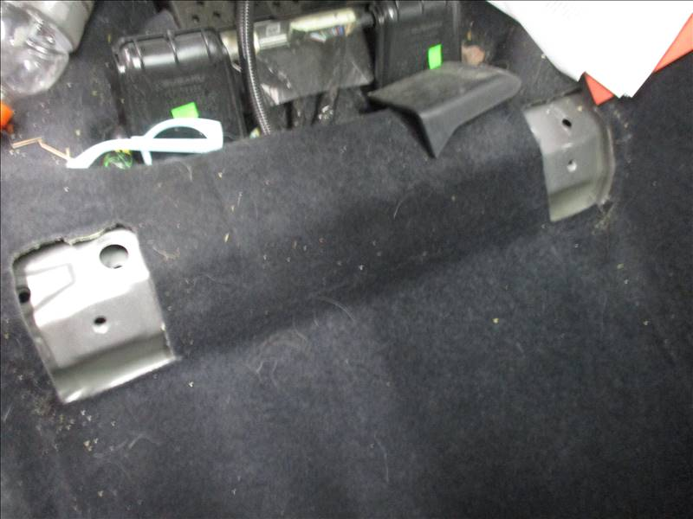
Right Front Seatbelt
Right Front Seat Mount

Slide 12
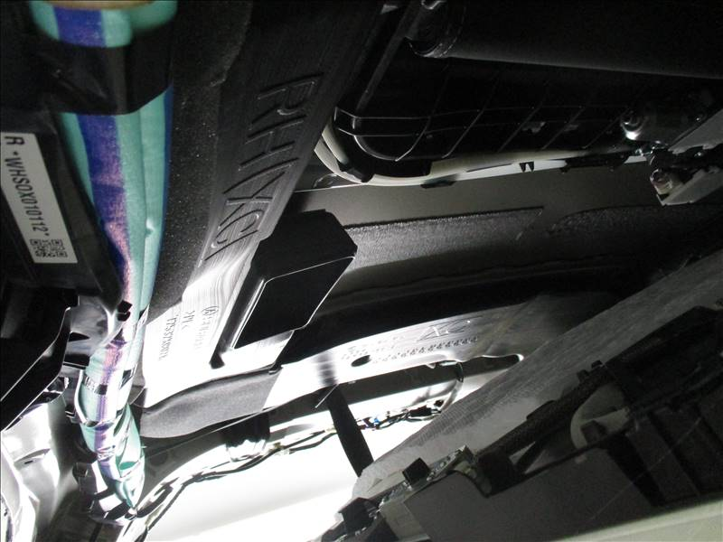
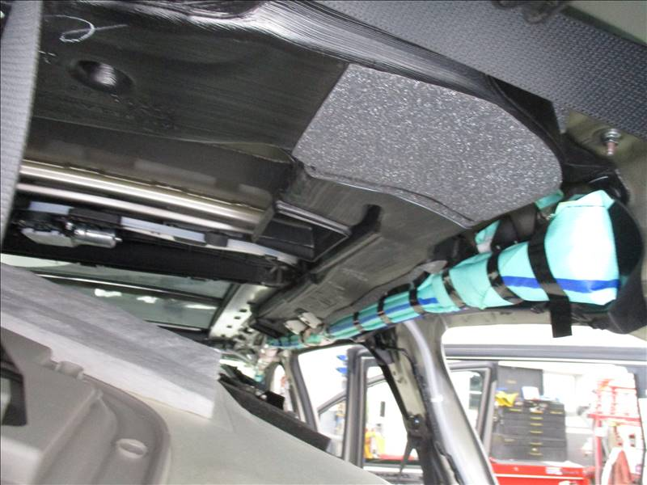
Right Curtain Airbag
Right Curtain Airbag 2

Slide 13
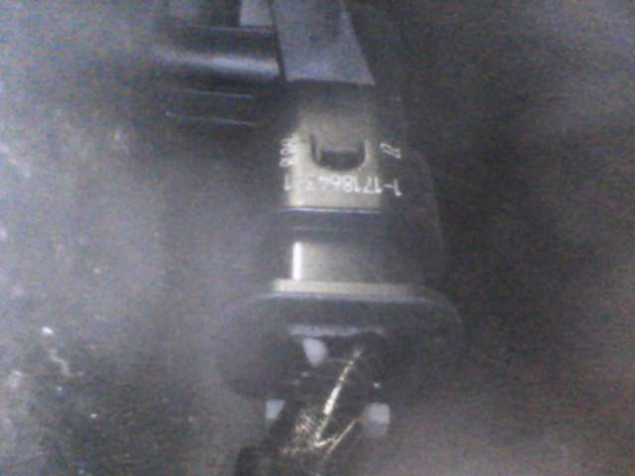
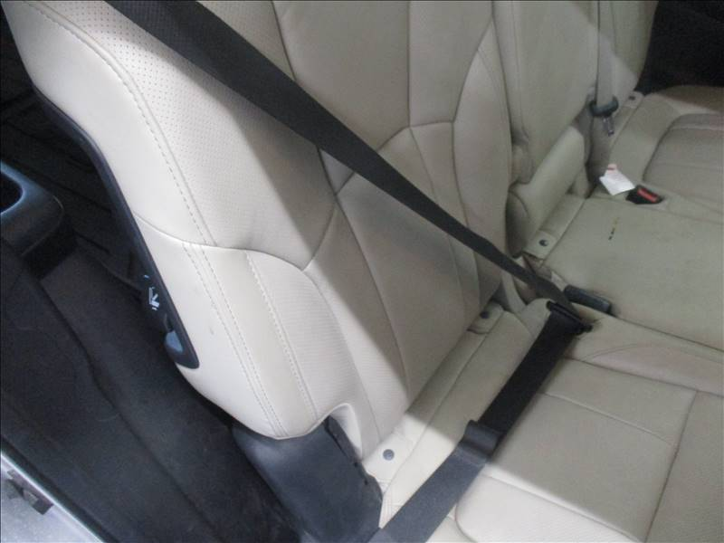
Right Quarter Airbag Sensor
Right Rear Seatbelt

Slide 14
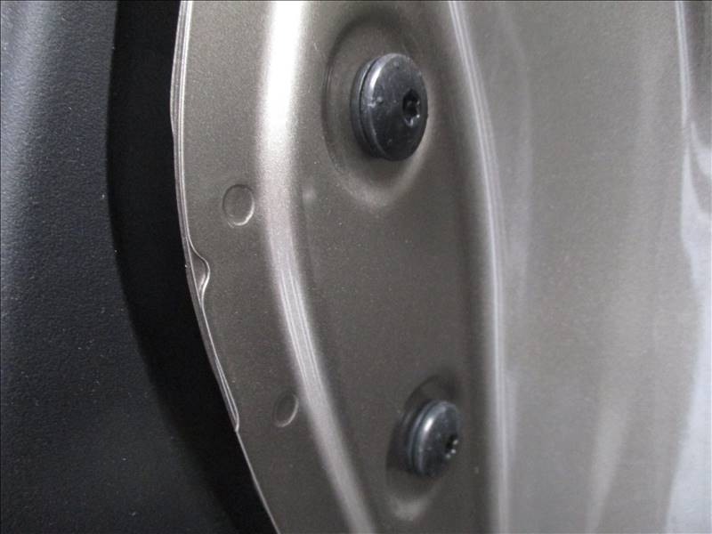
Right Front Seat Mounts
Right Dash Beam Outer
Mount

Slide 15
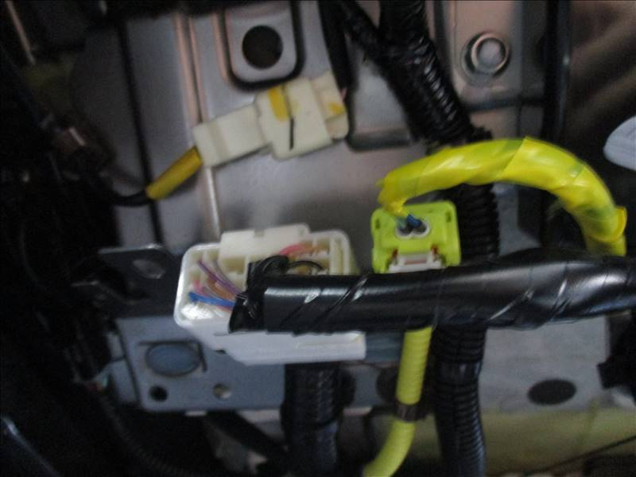
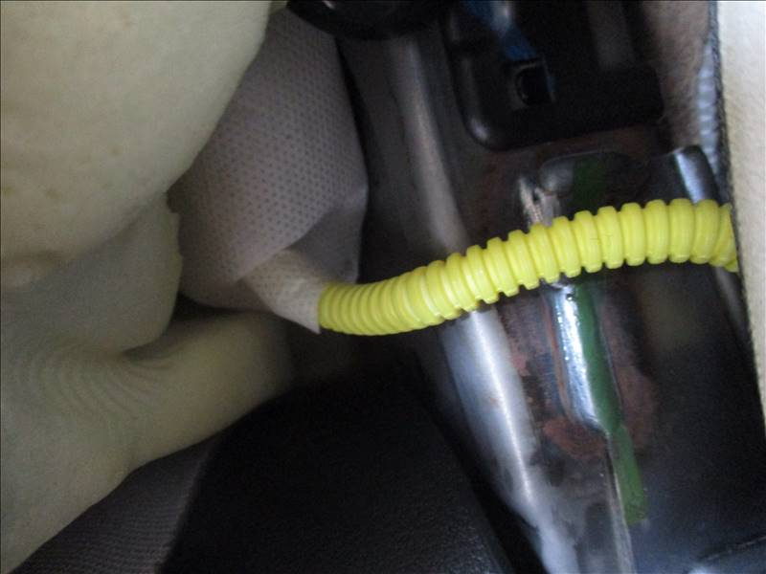
Right Front Seat Airbag
Right Front Seat Airbag

Slide 16
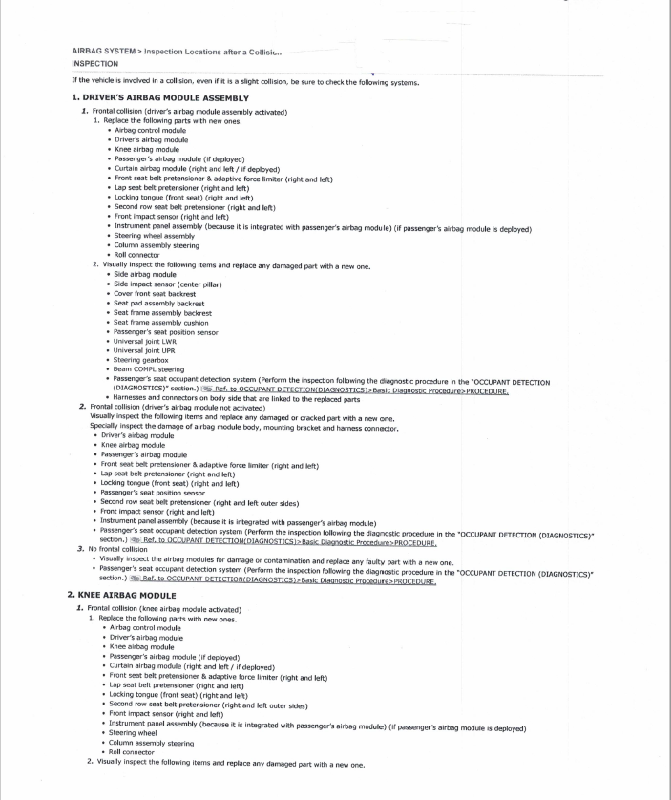
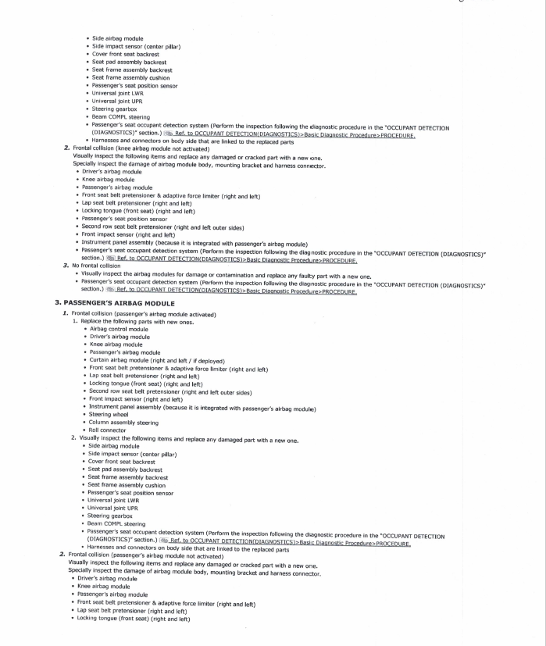
Airbag System Inspection Locations After Collision:

Slide 17
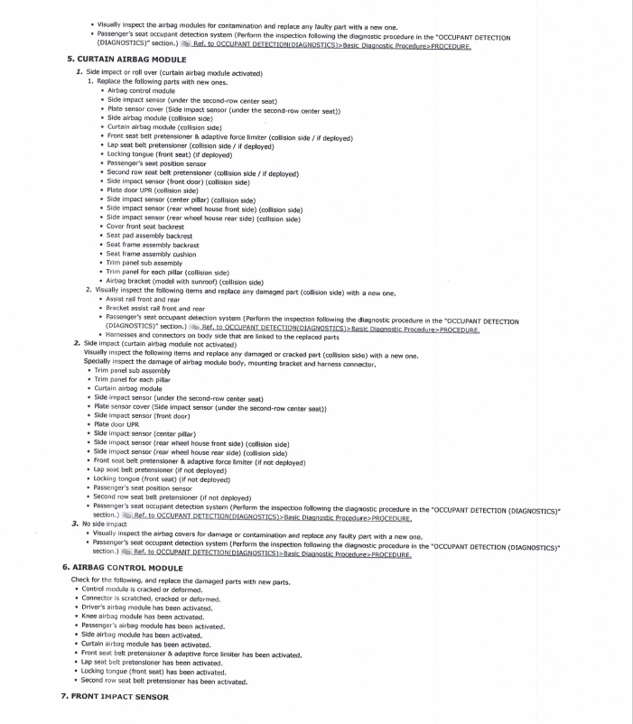
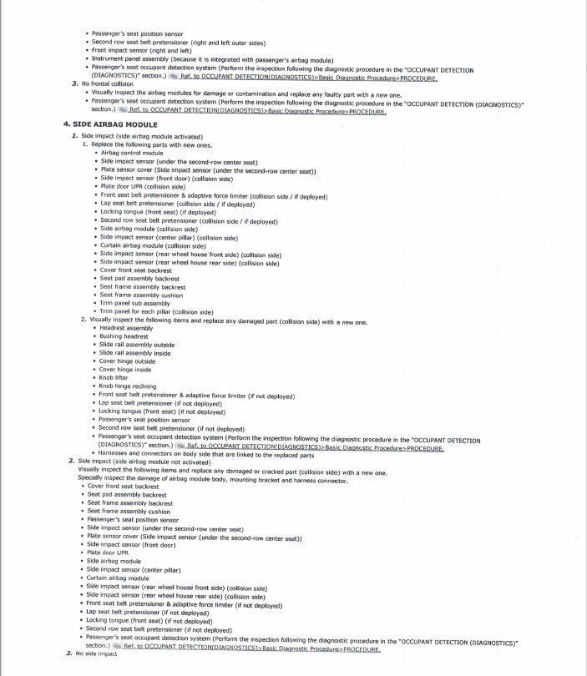
Airbag Inspection Locations Continued

Slide 18
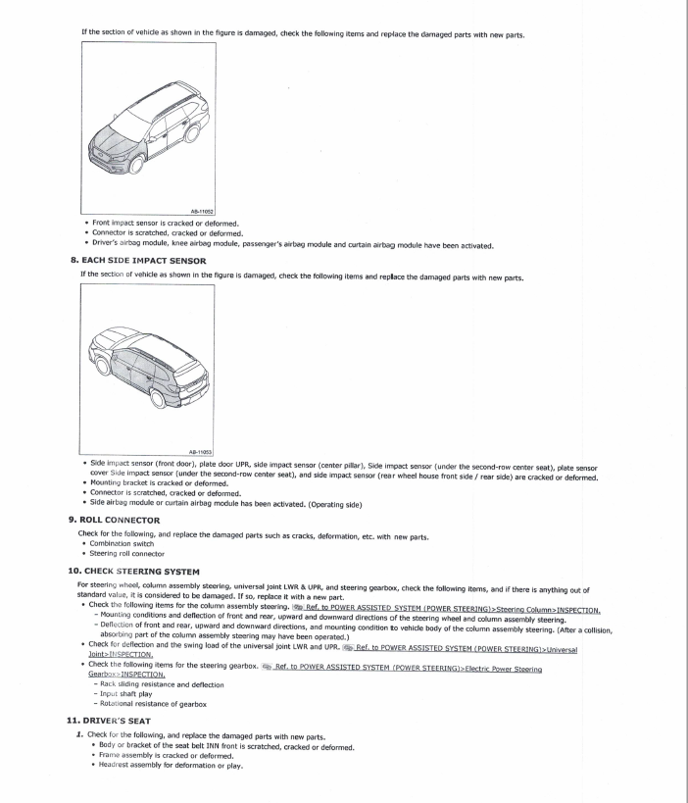
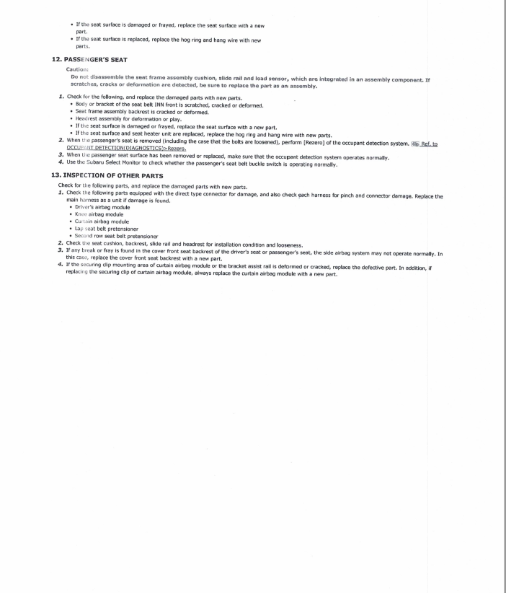
Airbag Inspection Locations Continued

Slide 19

Conclusion
Deviating from OEM procedures in any current repairs could cause further safety issues, cause a secondary accident as well as present liability or legal disputes for the repair facilities.

