Slide 1


Slide 2

EDUCATION COMMITTEE PRESENTATION

Slide 3
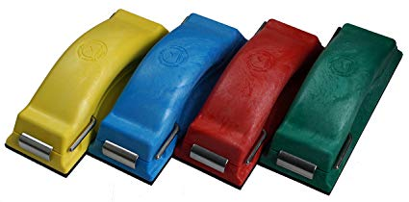
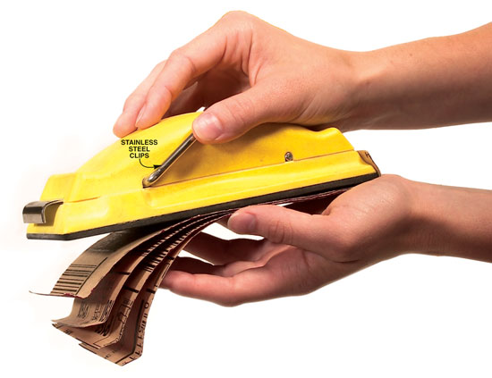
Time Shaver Sanding Blocks
4 sheets of sand paper from 9”x 11”
All metal stainless steel-will not rust
Stack 4 sheets at once
Use 2 ¾’ sand paper
Contoured to fit a hand
4 colors to fit different grit sand paper
Spring lock device cuts end waste by nearly 40%
714-974-2531

Slide 4
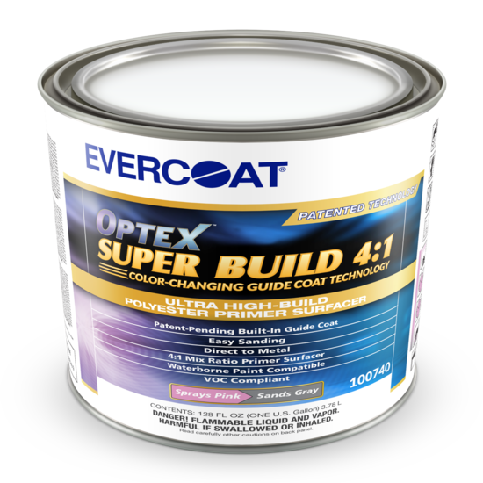
Evercoat Optex with built in guide coat.
Optex Super Build 4:1 Primer highlights dents, low spots, scratches, and other surface imperfections while at the same time eliminating the need for messy carbon black powdered guide coats. This 4:1 primer sprays on pink and turns gray as it is sanded, revealing high spots while low spots and scratches remain pink.
909-203-0458

Slide 5
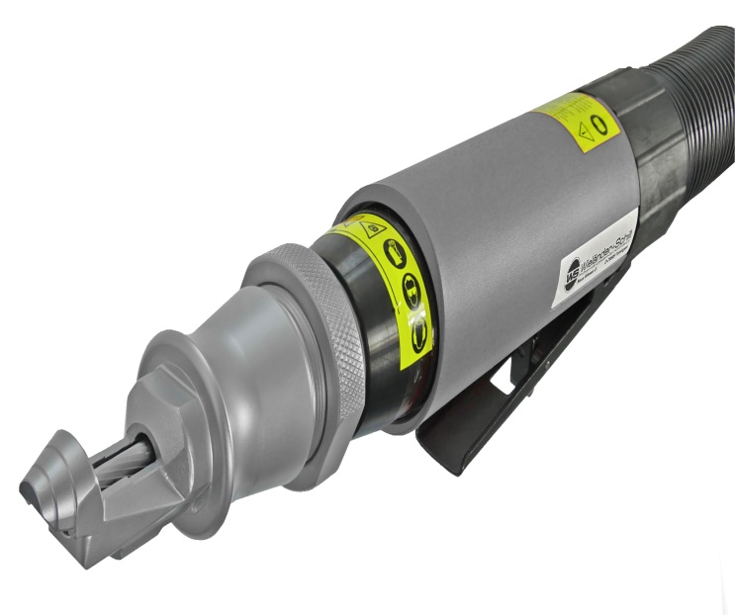
Reliable Automotive Equipment MEC600
Benefits:
• milling depth stepless adjustablel
• variable angel positions enable a generally car type application
• milling depth steplessly adjustable
• innovative tungsten carbide special milling cutter
• high work process-secure
• no flying sparks
The MEC600 pneumatic milling cutter tool has been designed to open welding seams for easy removal of the outer panels. The adjustable guide of the cutter allows the MEC600 to be easily adjusted to different angular positions of the metal sheets and no damages by preventing the cutter from slipping off the edge.
732-495-7900

Slide 6
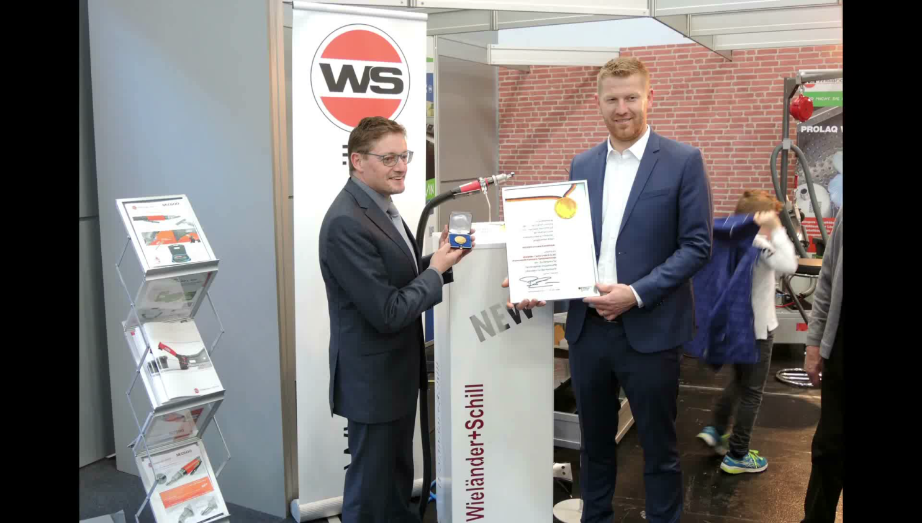

Reliable Automotive Equipment MEC600

Slide 7
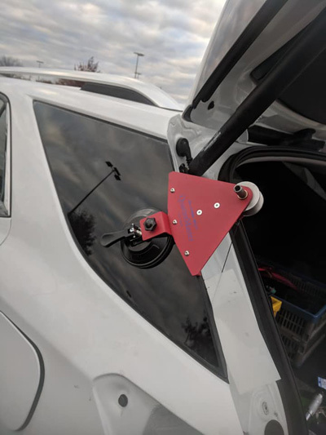
Glassbot Quarter window removal system
Glassbot® QuarterMaster Anchor one end of cutting element to body of QuarterMaster, insert the other end of the cutting element into the through-bore in shaft. Attach Tip Extension to shaft...
530-748-8880

Slide 8
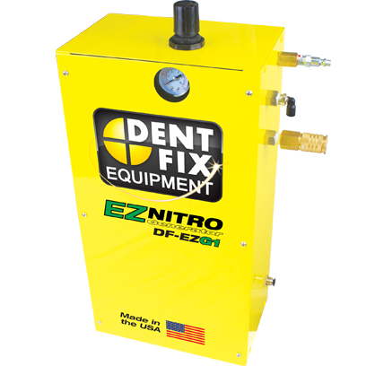
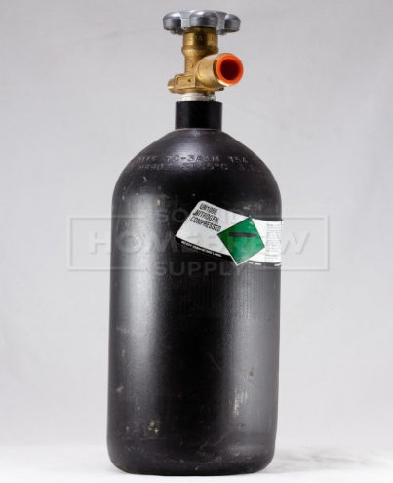
Dent Fix Nitrogen Generator
Upgrade most brands of Plastic Welder with the DF-EZG1 EZ Nitro Generator and “Ditch the Bottle”, Never Run out of Nitrogen AGAIN! Dent Fix's revolutionary Dual Chamber Separating System transforms your compressed shop air into an endless supply of both regulated & high pressure nitrogen. PLUS you can also fill your customer’s tires with beneficial nitrogen and/or safeguard the internals of your pneumatic tools by powering them with nitrogen from the EZ Nitro Generator!
310-349-1940

Slide 9
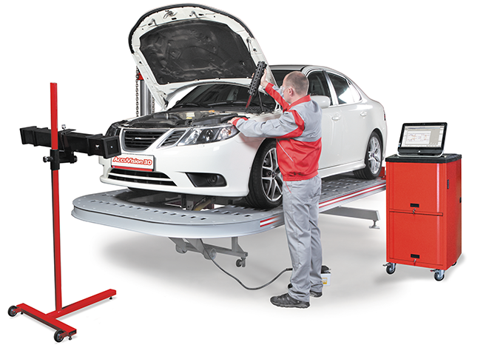
Accuvision 3D measuring
514-694-1113

Slide 10
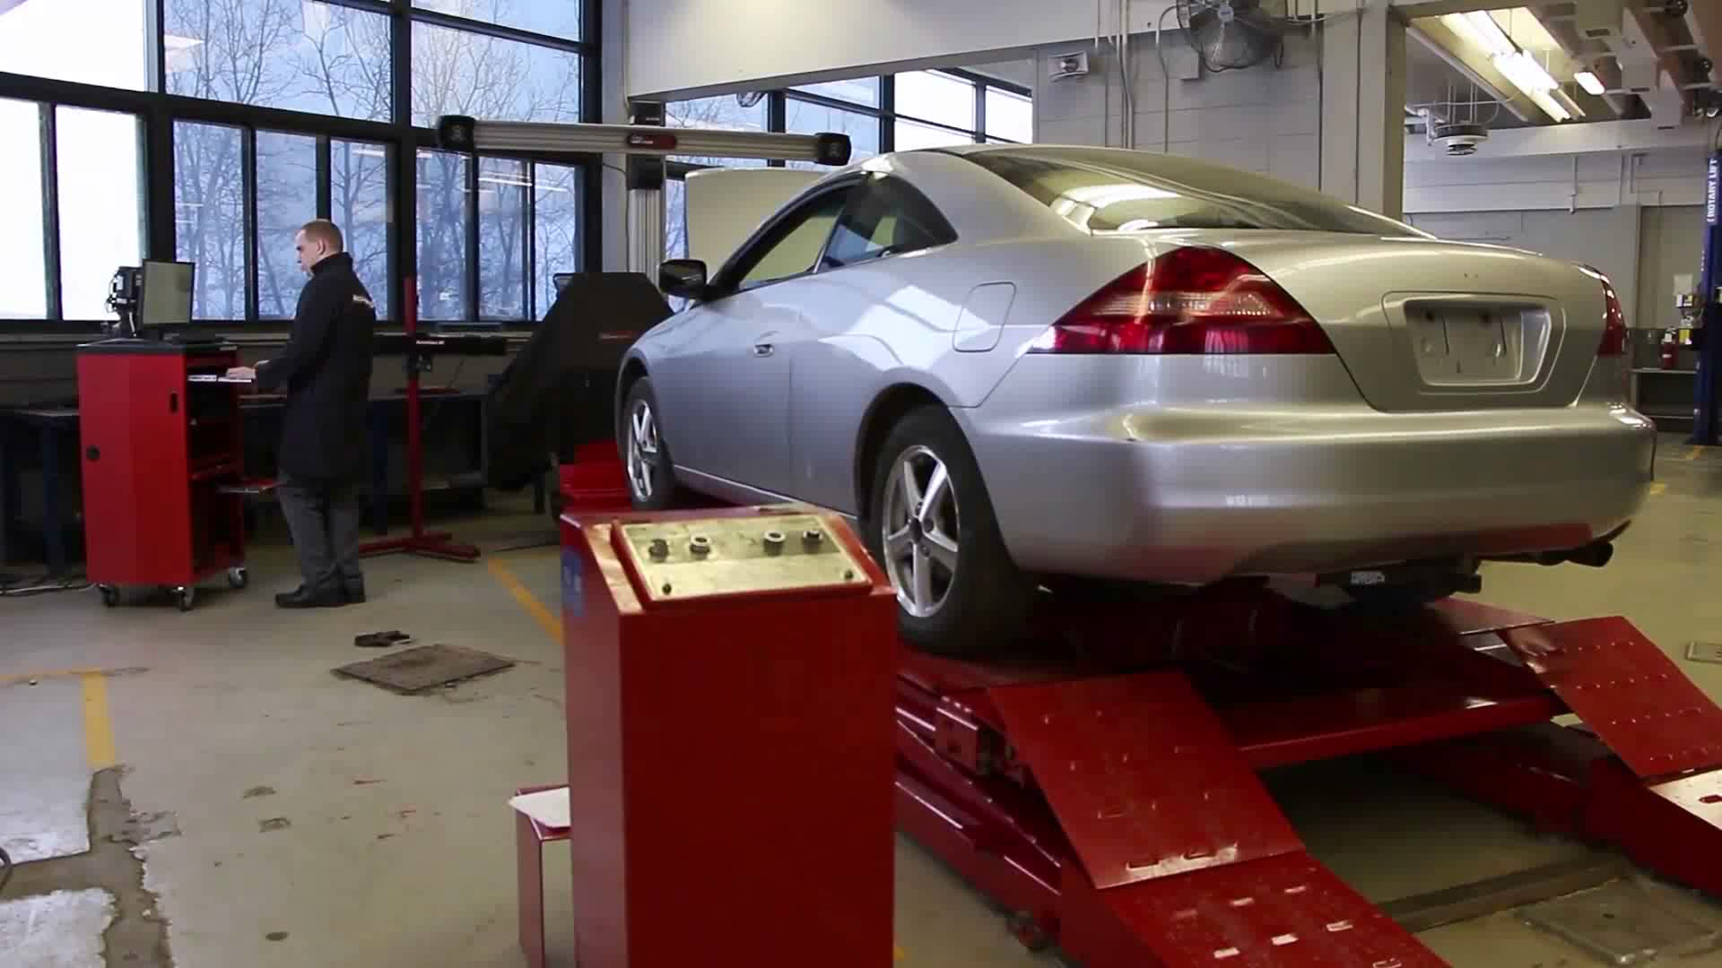
Accuvision 3D measuring

Slide 11
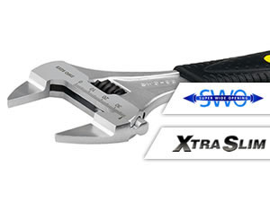
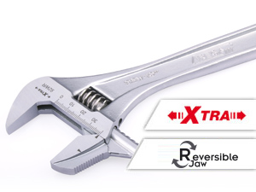

IREGA adjustable reversible wrenchs
856-784-8600 Ext109

Slide 12
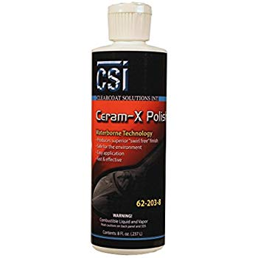
CSI Ceram-X Polish
The first polish formula to make the claim of "One product does it all" or "No More compound" CSI Ceram-X is the fastest way to polish paint. We at CSI have worked hard to make this claim, from mill gauge measuring to digital gloss measurement reading. With CSI Ceram-X there is absolutely no need to ever use compound again. Using a one component system, a saving between 30 and 35 percent cost can be achived.
https://csishine.com/pages/contact-us

Slide 13

CSI Ceram-X

Slide 14
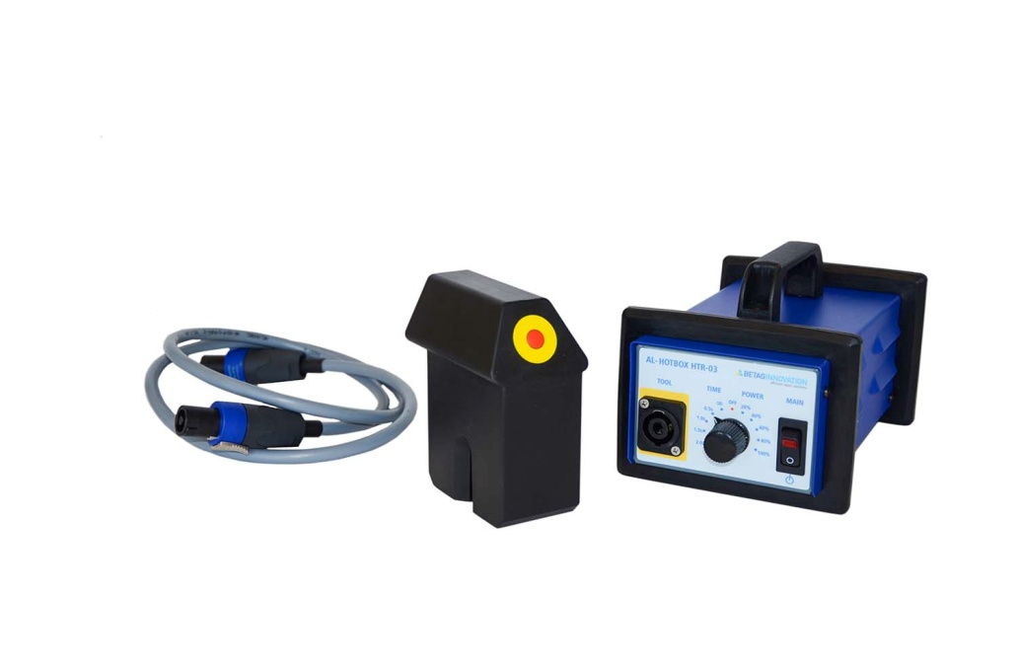
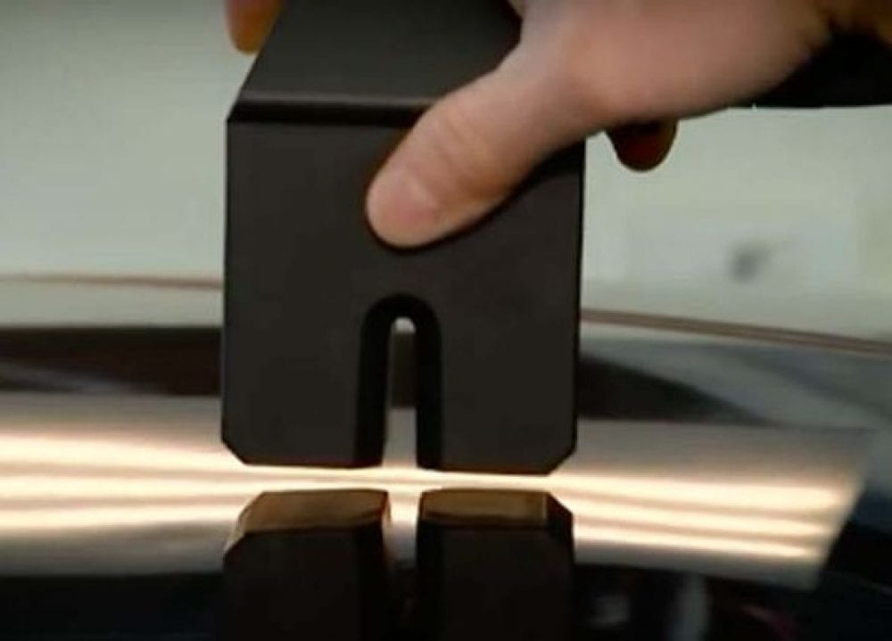
Betec Aluminum Dent Pulling System
224-289-0699

Slide 15
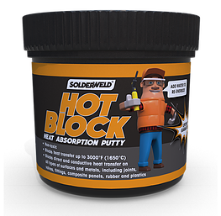
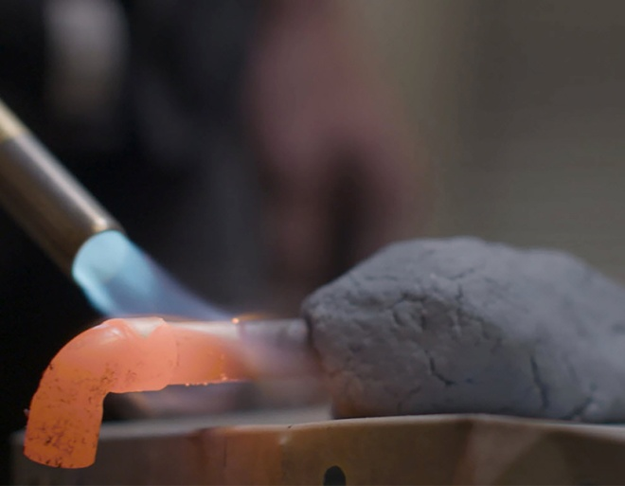
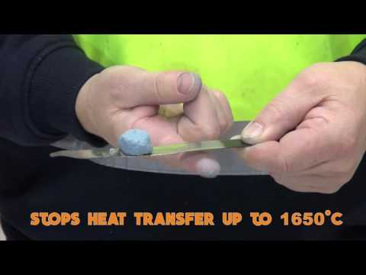
Solderweld Hot Block Heat Absorption Putty

Slide 16
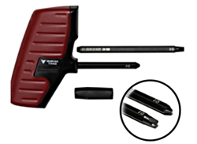
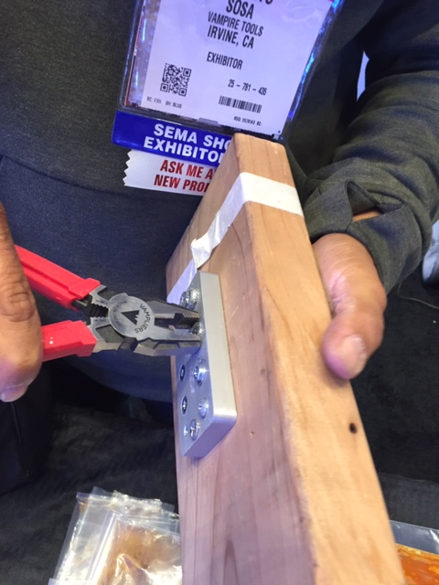
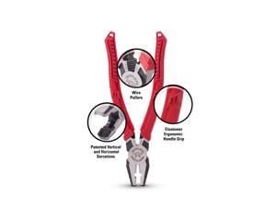
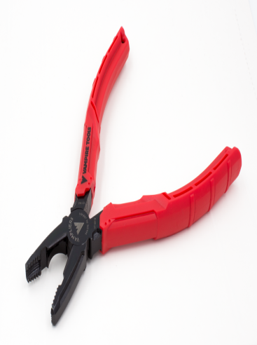
Vampire Tool Phillips Screw Extractor
949-748-0552

Slide 17
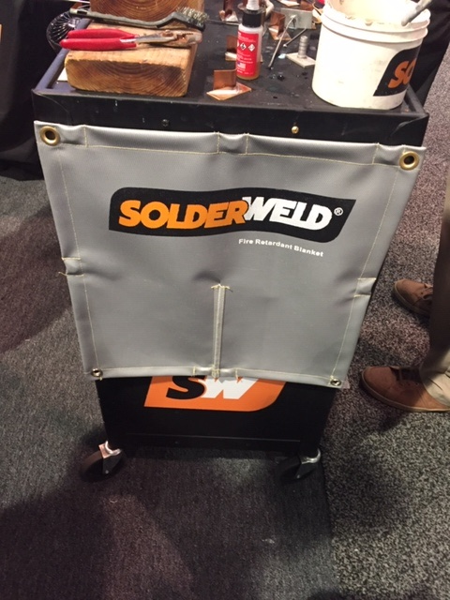
Solder Weld Magnetic welding blanket
With firm grip magnets and opening slit, our flame resistant blanket can be easily snapped into place and removed during your repair

Slide 18
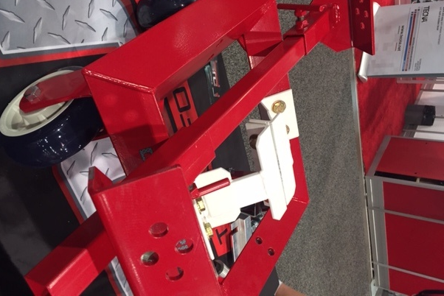
DFS Fabrication Steady Bar
951-698-4510

Slide 19
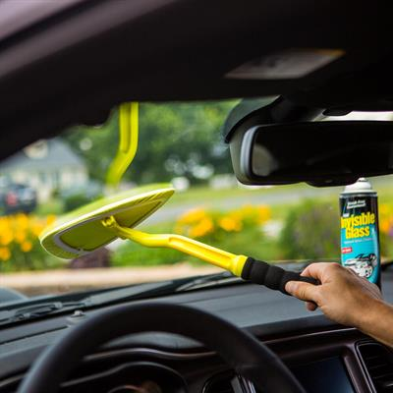
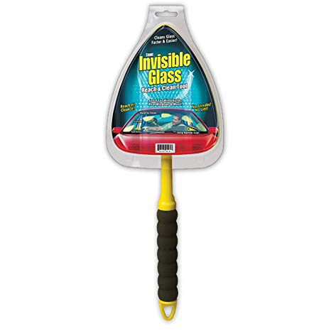
Invisible Glass Reach & Clean Tool
Available on Amazon

Slide 20


SATA Female Paint Suit

Slide 21
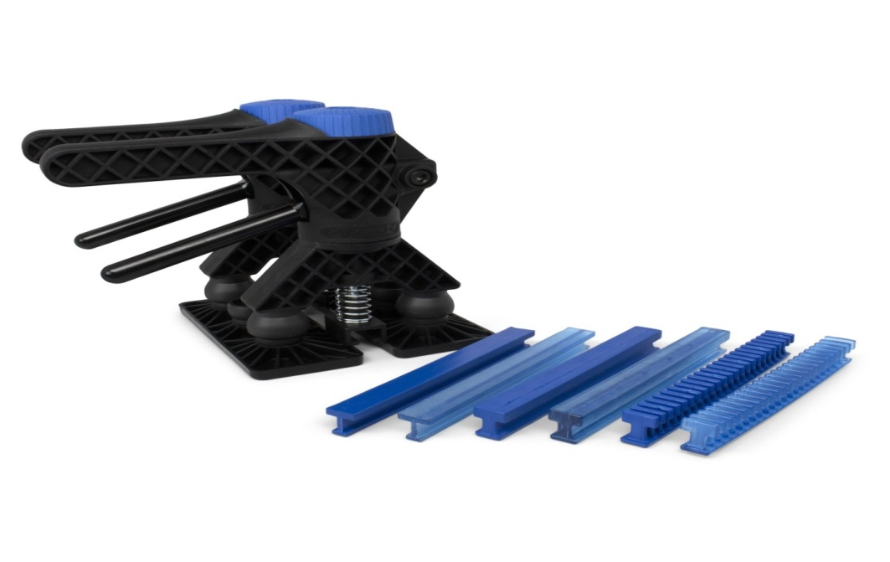
Keco Tabs-Crease Killer
The KECO Crease Killer is the ultimate crease pulling machine. Creases that were previously only fixable with push tools can now quickly be pulled with glue and the power of two Robo lifters, adjustable crease plates, new longer pass-through adapters, and the 7 mm Dead Center Centipede tabs.
Wide Pass-Through Adapters - create twice the lifting power spread evenly across tabs
Adjustable Precision Crease Pull Plates - hold metal down while focusing lifting and reducing time spent on corrective blending and knockdown sessions
Dead Center 7mm Centipede Crease Tabs - targets smaller creases without sticking and over pulling the crown

Slide 22


SCRS Blue Print Optimization Tool
The SCRS Blueprint Optimization Tool:
- Intelligent business analytics that provide only the missing operations for the estimate.
- Will eventually operate with all major estimating systems. Current version developed to interact with CCC estimates.
- Immediately identifies overlooked repair operations and dollar amounts
- Provides an organized way to add overlooked operations and items into the estimate
- Supports Individual and multiple shop profiling with customization for unique business needs
Benefits of the application include the ability to:
- Audit in-house estimates before repairs to minimize supplements
- Audit external insurance estimates to identify overlooked repair procedures
- Establish consistency and uniformity with multiple users as part of the repair planning process
- Promote self-training for new employees to write complete and accurate estimates
This leading-edge technology will help achieve higher levels of user efficiency and accuracy

