Slide 1

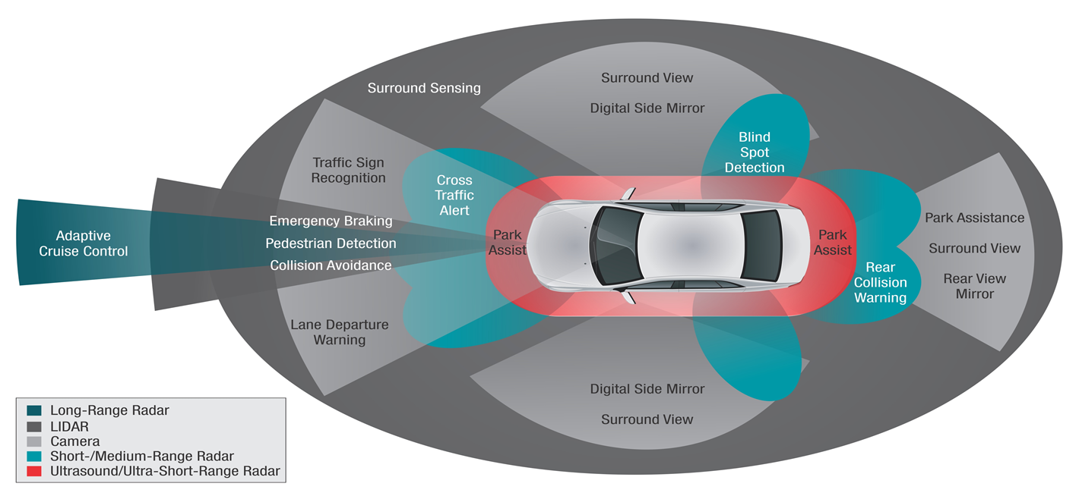

ADAS Calibrations Workflow
The Value of a Standardized Industry Process
Presented by: Emerging Technologies Committee
Chuck Olsen
Darrell Amberson
Gene Lopez

Slide 2
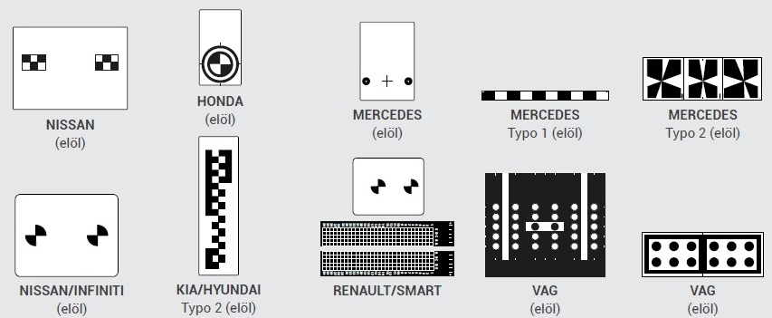
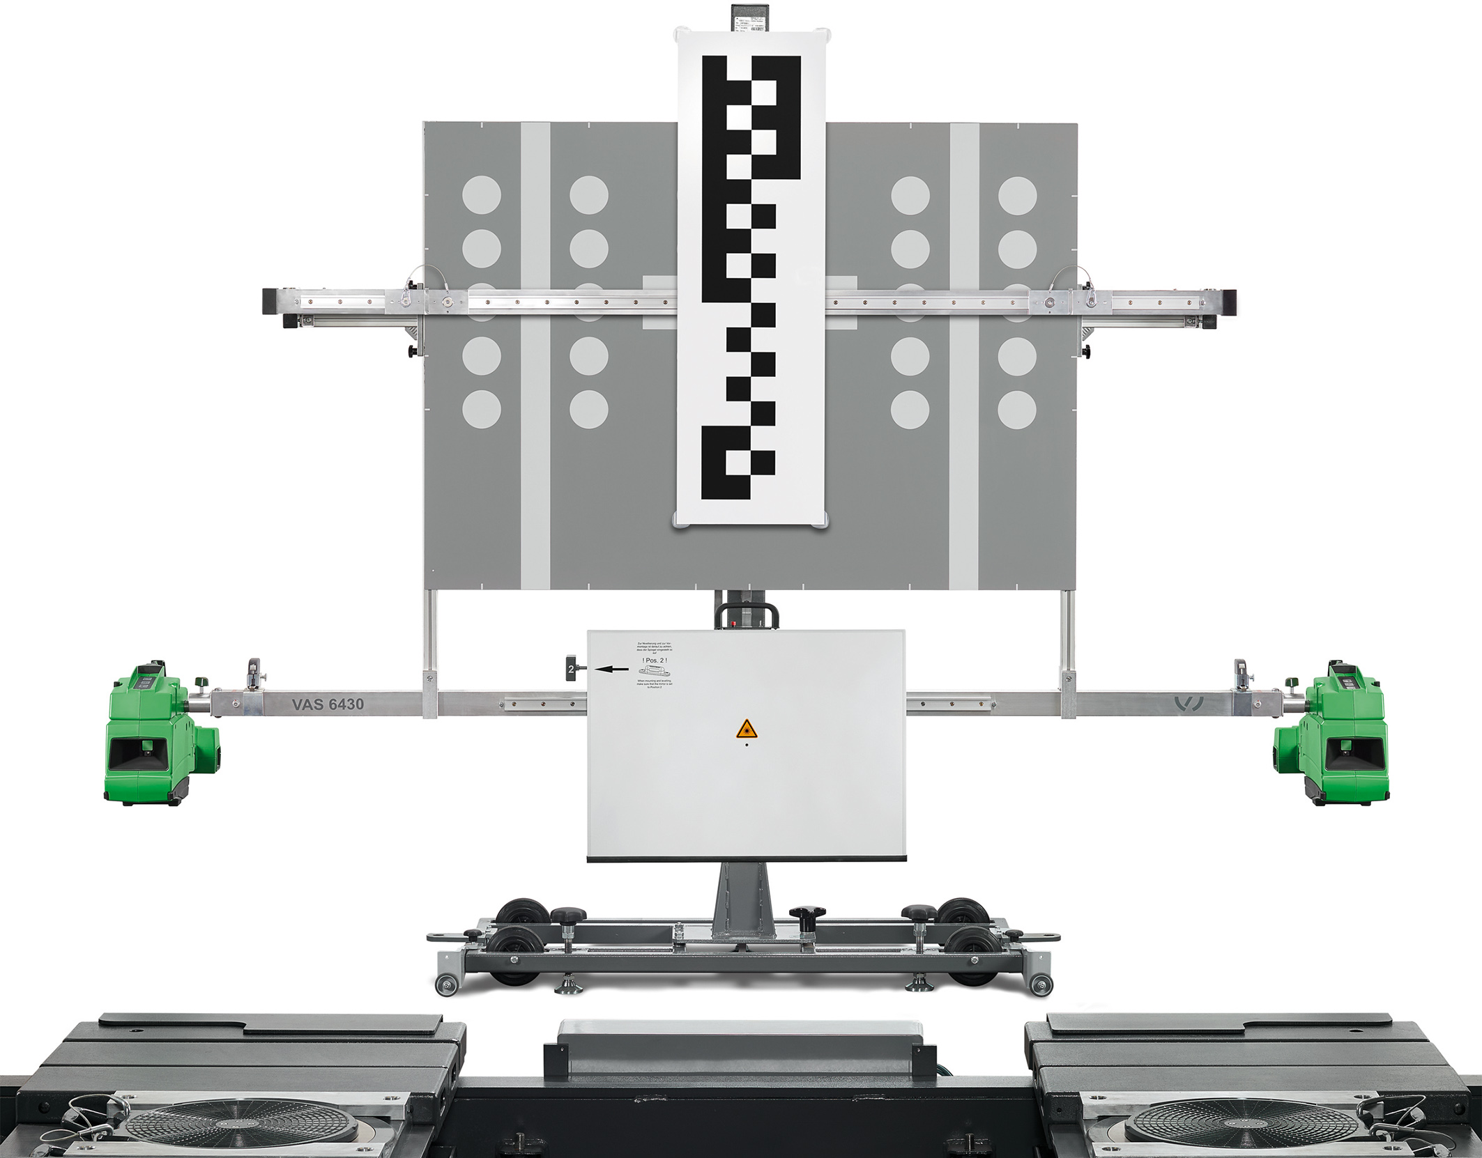
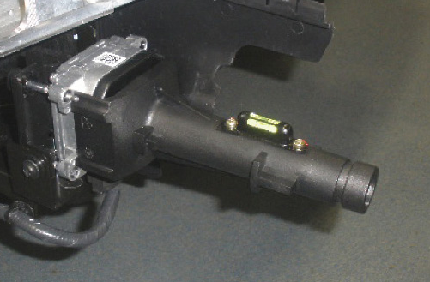
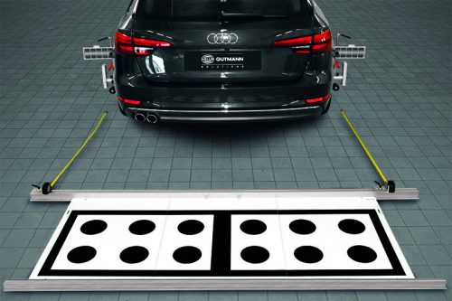
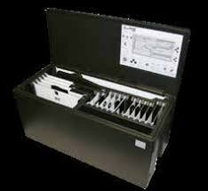
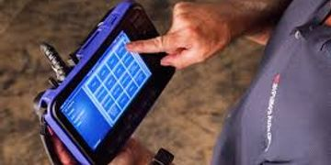

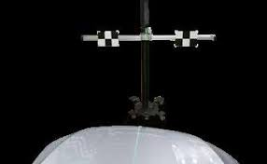

Slide 3
ADAS Calibrations Workflow
The CALIBRATION workflow was developed by the CIECA Calibration Committee to provide an overview of the process that is supported by the messages developed and updated in the Business Message Suite (BMS) and Codes.
Problem: The repair community currently has no standard process to approach and document vehicle calibrations to ensure safe repairs. Meanwhile, ADAS-equipped vehicles requiring calibrations have doubled in the last 5 years and will become standard on most vehicles by model year 2022.
Solution: Create a workflow to identify steps and documentation methods for vehicle calibrations to assist the industry in performing complete, safe, and quality repairs to vehicles with complex ADAS systems.

Slide 4
Benefits Identified by the CIECA Calibration Committee
Enable a more accurate, consistent, efficient and transparent process for calibration
Improve the level of documentation standards regarding calibration processes
Identify third-party resources for calibration services that employ OEM procedures
Enable processes and procedures that assure vehicle safety by setting the vehicle to the OEM’s prescribed calibration settings
Enable calibration data to flow through multiple providers and document the process
The calibration data includes the final confirmation that the calibration was done accurately and to the OEM specifications
Increased repair facility’s confidence and accountability through verification of proper answerable data
Reduce the risk and potential liability of various entities—including repair facilities, insurers, and vehicle manufacturers—with respect to calibration procedures and confirmation

Slide 5
Industry Segments
The service being implemented with this guide includes the sending and/or receiving of Calibration information. Industry segments impacted by this Implementation Guide include:
Repair Facilities: Any company whose business concern is to repair and calibrate damaged vehicles. Repair facilities include, but are not limited to: dealerships, mechanical providers, collision centers, calibration centers; to perform calibration according to procedures (sublet)
OEM Vehicle Manufacturers: These are the originators of all necessary proprietary technical information, establishing calibration procedures and documentation. Certification, warranty and other programs may include required communication
Information Technology Providers: Any entity that develops and/or maintains software applications or services related to the repair and calibration of ADAS and other vehicle calibration features
Tier One Providers: These are companies with whom the OEM manufacturers contract to provide the calibration procedures. It is recognized the OEM Vehicle Manufacturer’s procedures have priority on calibration procedures over the Tier One Providers.
Calibration Companies: Those who offer calibration services for repair facilities, including on-site and off-site companies (this includes the sublet calibration providers)
Insurance Companies: Property and Casualty insurers in one or multiple lines of business who act on behalf of their policy holder and impacted parties for the settlement of the loss for the vehicle repair including necessary electronic and physical calibration features
Third Party Administrators (TPA): The companies whose main business is to administer the repair process life cycle for insurance carriers and repair facilities and others, including appraisers
Other Entities: Other parties that are not directly providing loss settlement, vehicle repair or calibration tasks

Slide 6
Audience Response Question:
Agree/Disagree/Abstain question: A standard “best practices” process to address all ADAS related calibration procedures will benefit my operation.
Agree
Disagree
Abstain
Leave this area for the response results

Slide 7
Workflow
Start Here: For ease of understanding, follow Repair Facility column
Information & Documentation: column provides information as to what information is recommended and what to document
Calibration Documentation to Parties: Information, options, and tips of what has a high likely hood to be shared or obtained via other parties
Definitions: are found in CIC Glossary of terms section for Automotive Scan, Diagnostics, Calibrations and programming
www.ciclink.com/automotive-scan-diagnostics-calibration-and-programming/

Slide 8
Workflow Step 1
STEP 1 - Document DTCs (Document Scan Results) - Virtual Printout (*.pdf, *.jpg, etc.) of all the DTCs and all the modules tested and must include the valid VIN number associated with the scanned vehicle
  Notify owner of known ADAS Systems and update them on these features being returned to OEM specifications
    Refer owner to the owner’s manual the factors that can impact their ADAS Systems operation (e.g., weather, tires, etc.)
  Note: Calibration or re-learn may or may not be reported via DTCs (vehicle specific)
  Research means to identify what is related and not related to the damage/repair, and to define corrective remedies
  Research includes OEM service information (If OEM Procedures are Available)
    Date, Time, Personnel, Source for Download Documented
  Evaluate if vehicle has been altered, see STEP 9
  Notify all parties involved (e.g., owner and insurance carrier) of all related and non-related ADAS research findings and then document

Slide 9
Workflow Steps 2-3
STEP 2 –
  Document Vehicle ADAS Option’s Content and Features using a Check List and/or
    Visual verification
    OEM Build Data Sheet (if Available)
    Document Repair Procedures (If OEM Procedures are Available)
    This includes identifying pre-existing and non-related damage
  This is critical information that is not easily captured.
STEP 3 –
  Document Parts and Repair Operation to include ADAS Systems
  Identify the tasks that need to be completed and determine who is going to complete the work
  Identify if and what Calibrations are Needed, (ADAS & Non-ADAS Calibrations)
  Evaluate the State of Reassembly Needed for Calibrations and Document
  Documenting All Dates and Times Associated in this Process (i.e. for info retrieved, for repair procedures downloaded, etc.) Is Critical
  Identify Required Inspections

Slide 10
Workflow Steps 4-8
STEP 4 –
  Document DTCs and the Assessment
STEP 5 –
  Document Initialization, Programming, and Module Setup Processes using OEM Procedures (e.g., for modules), if needed
STEP 6 –
  Document DTCs (Document Scan Results) - Virtual Printout (*.pdf, *.jpg, etc.) of all the DTCs and all the modules tested
  Research Results
  Document Required Repair Procedures
  Note: Calibration or re-learn may or may not be reported via DTCs (vehicle specific)
STEP 7 –
  Document Scan Results (see above)
STEP 8 –
  Retrieve Calibration Procedures from OEM
  Identify Calibration Prerequisites
  Identify Tools & Qualified Personnel
    Refer to STEP 3 for an inclusive list
  For Sublet, please see bullet at the end of this document

Slide 11
Workflow Steps 9-12
STEP 9 –
  Document Calibration Procedures from OEM and that pre-conditions were met
    Ensure and document all calibration process pre-conditions have been met, e.g., full fuel tank, check tire pressure, alignment
    If the vehicle was altered, e.g. larger/high performance tires or modified ride heights, it may not be possible to perform a proper calibration
    However, some OEMs may have limited procedures for related alterations
      If altered, document and advise the owner/driver that the alteration can cause the inability for some ADAS systems to operate correctly and proper calibrations to be performed successfully
STEP 10 –
  Document Completed Proper Calibration Process:
    Retrieved OEM Calibration Processes, Steps Followed, Photos, Videos & Other Documentation (e.g., screen shots) to Provide Evidence It Was Performed Correctly
    Again, Personnel, Dates and Times Associated with Each Step
  Insurance Companies and OEMs may require pictures supporting calibrations
STEP 11 –
  Repair facility should have an agreement with the personnel performing the test drive and receive adequate documentation to prove it completed correctly
  Document Personnel and Date & Time of Test Drive and Results
STEP 12 –
  Review ADAS Features with Owner, Document and Inform Owner ADAS Systems set to OEM Specifications
Notes:
Gene . Hand back to Chuck

Slide 12
ADAS Calibrations Workflow-Next Steps
Enhance usability of workflow in both electronic and printable formats
Combine supporting documentation with workflow into a single electronic product
This feature will add the function of clicking on a step to view “Matching Workflow Documentation”
Present updated product features as finished product during CIC-SEMA session in November 2020
Create an animated video to describe workflow process and promote a standard ADAS calibration workflow with documentation
Keep workflow consistent with CIECA-developed Business Message Suite (BMS) and Codes.

